Slide 1
GLM-18 & GLM-19
Performance Assessment
Monte Bateman
The University of Alabama in Huntsville

Slide 2
Virtual Network
Wanted the “best possible” source to compare GLM against
Used several ground-based networks – GLD360, ENGLN, CLDN,
NLDN (stroke & flash)
Clustered similar to GLM clustering algorithm
Within 330ms and 16.5km

Slide 3
Coincidence Checking:
GLM against Virtual
Coincidence:
within 50km and ±1s or ±10 min
Detection Efficiency
DE =
Coincident flashes / all virtual flashes
False Alarm Rate
FAR =
Non-coincident flashes / All GLM flashes
These are relative to virtual network
(the best comparison source we have)

Slide 4
Data Analysis Period
GLM-18 & GLM-19 vs. Virtual Ground Network:
Aug 2024-Jul 2025 (GLM-18)
Jan-Jul 2025 (GLM-19)
±1s (flash to flash)
±10 min (flash to storm)
Technique detailed in Bateman et al. (2020)
Plotted: 24h DE & FAR

Slide 5
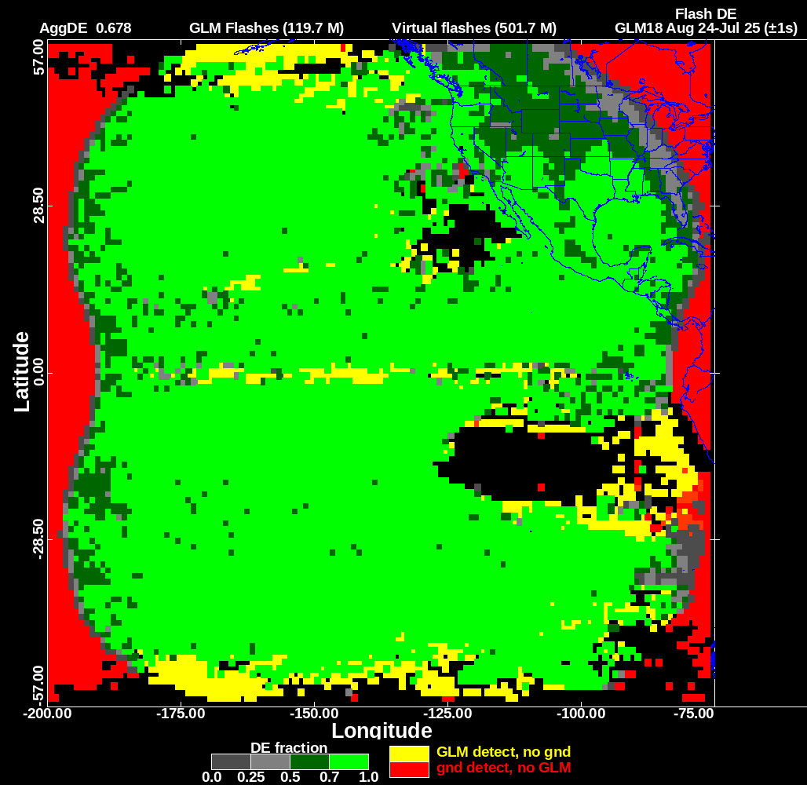
GLM18 DE
±1s
8/24-7/25
0.678

Slide 6
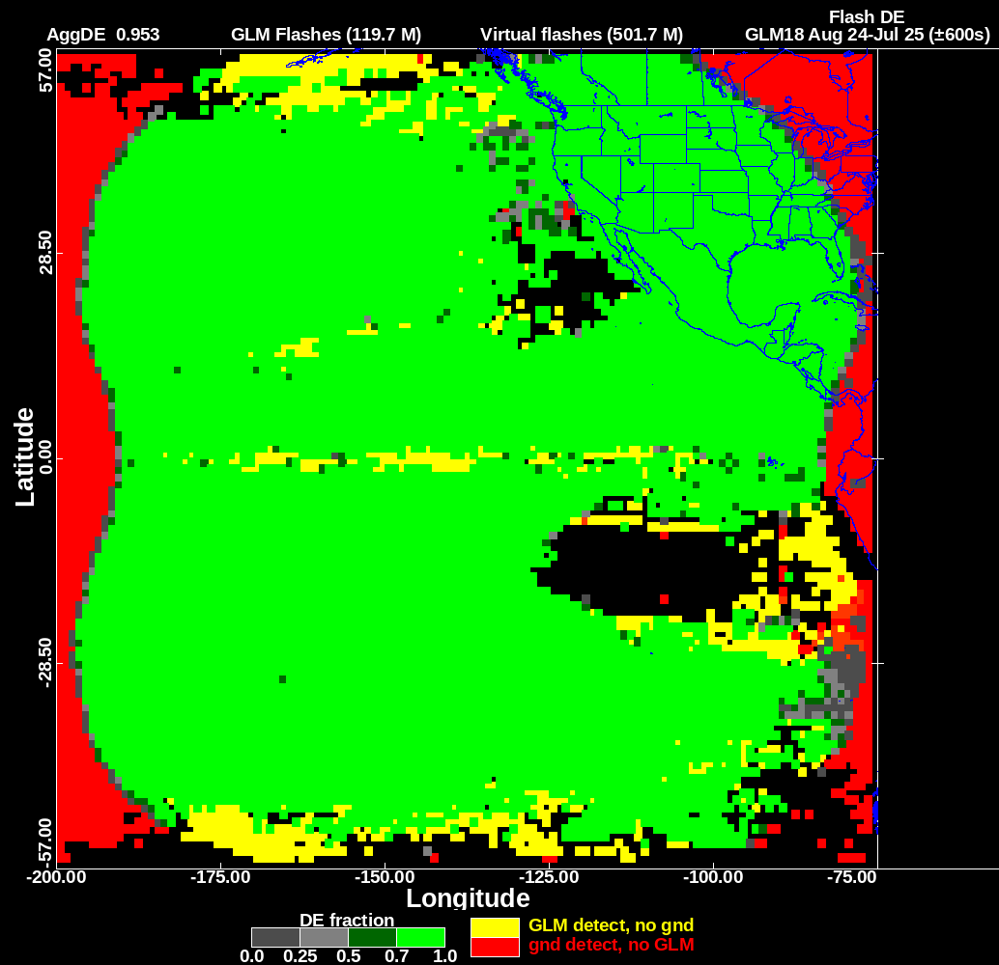
GLM18 DE
±10 min
8/24-7/25
0.953

Slide 7
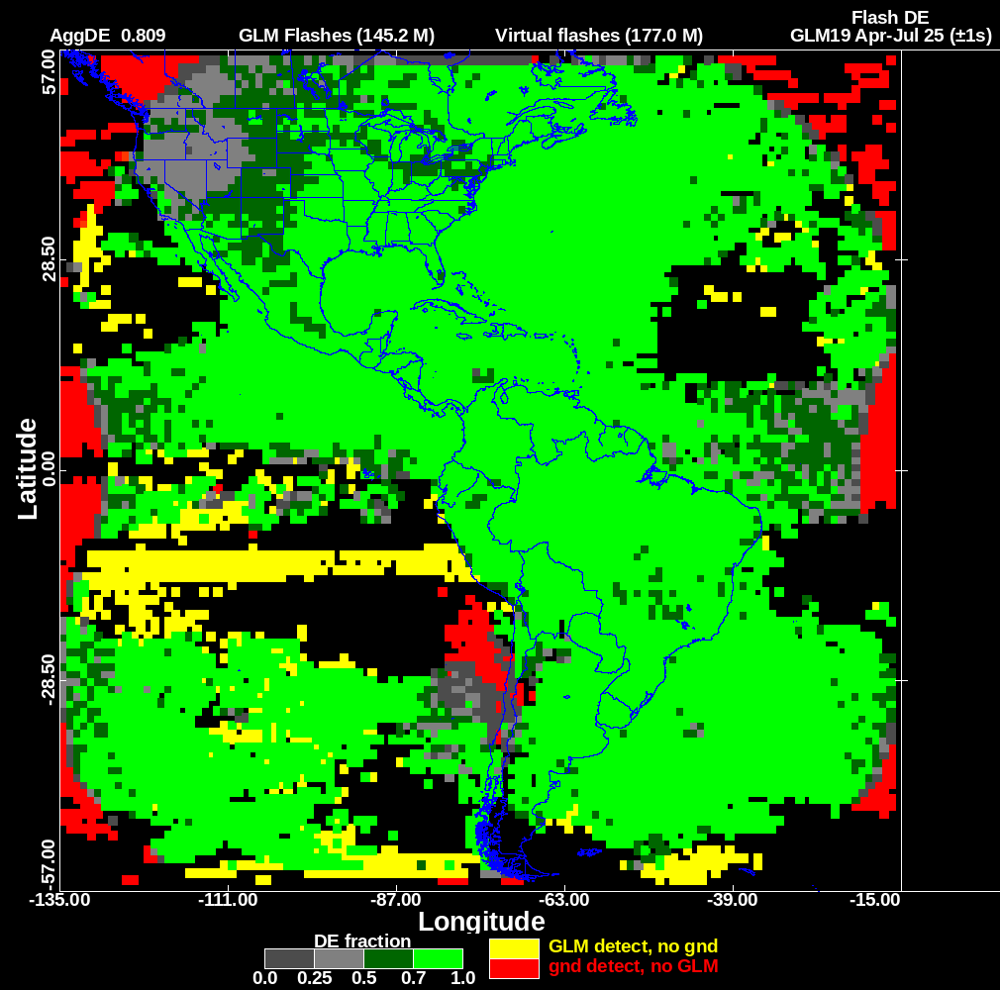
GLM19 DE
±1s
Apr-Jul 25
0.809

Slide 8
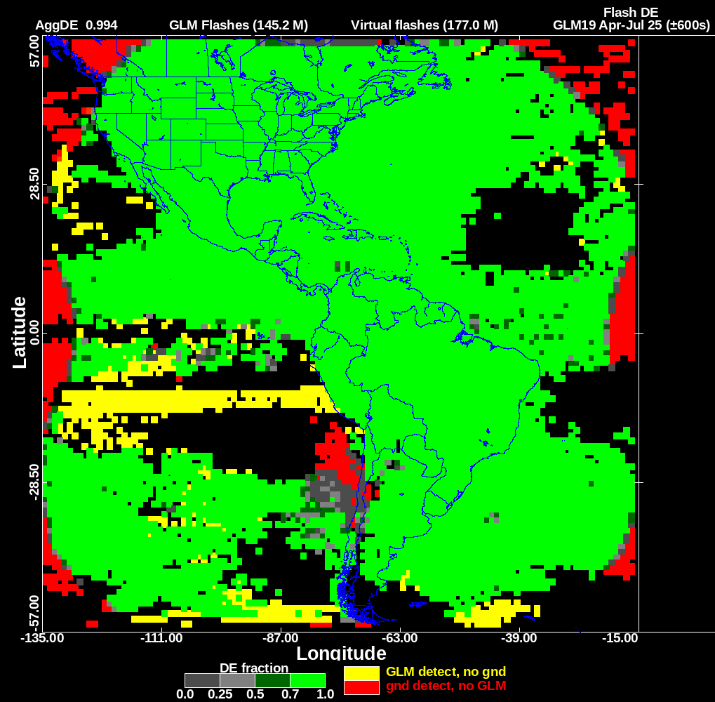
GLM19 DE
±10 min
Apr-Jul 25
0.994

Slide 9
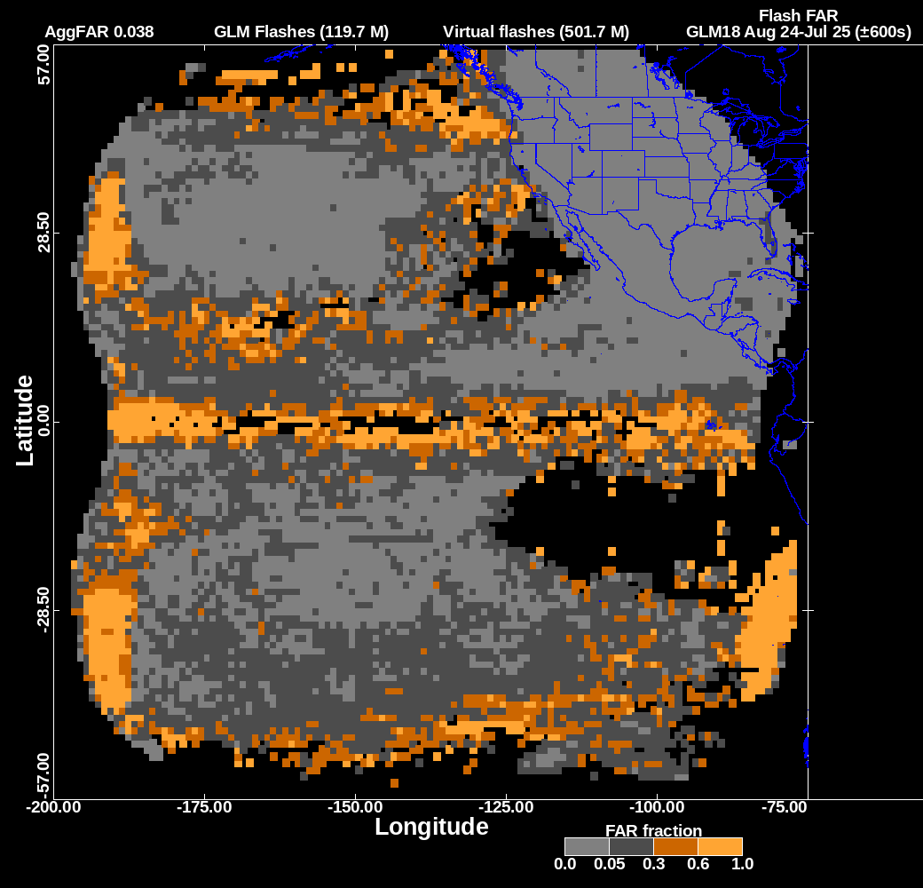
GLM18 FAR
±10 min
8/24-7/25
0.038

Slide 10
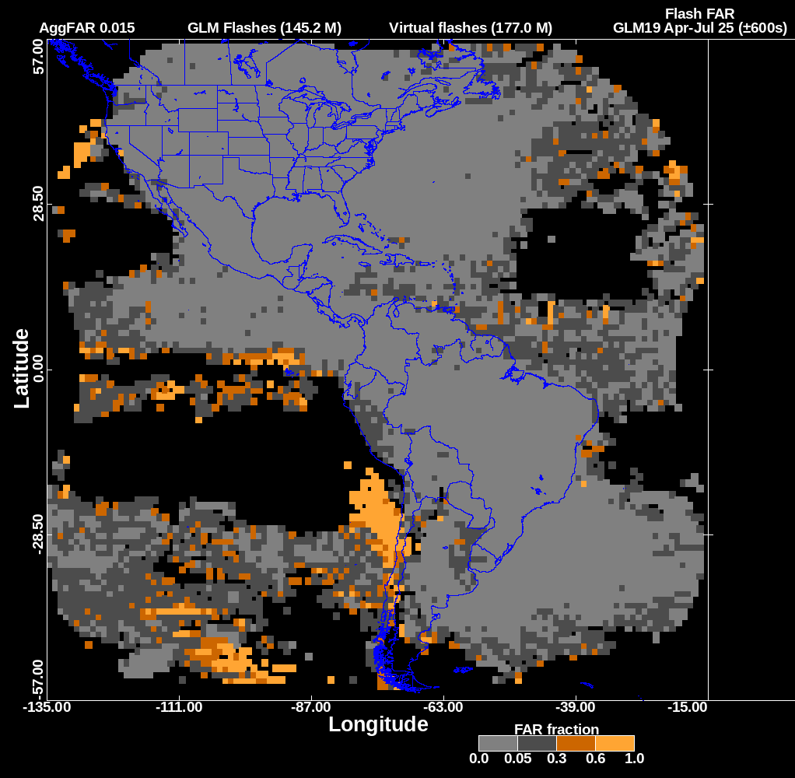
GLM19 FAR
±10 min
Apr-Jul 25
0.015

Slide 11
Concluding Remarks
DE & FAR for GLM-18 & GLM-19 are performing close to spec
GLM-18 suffers from having most of its FOV over the Pacific Ocean, where the ground truth data are sparse
GLM-18: DE 0.678, FAR 0.038
GLM-19: DE 0.809, FAR: 0.015

