Slide 1
LMLEO
LMLEO Lightning Detection
Detecting Lightning from Low Earth Orbit
GLM Science Meeting
02 September 2025
Jonathan Dalrymple
© 2025 Lockheed Martin Corporation. All Rights Reserved.

Slide 2
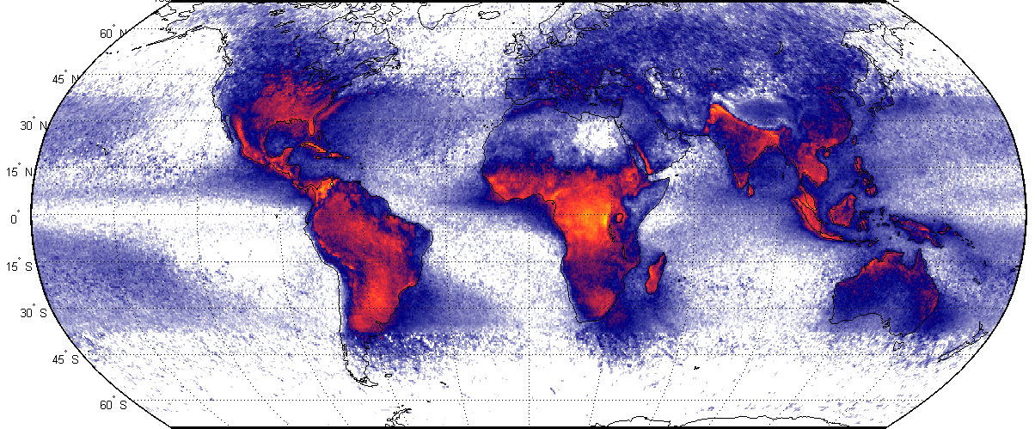
What is LMLEO?
LMLEO is a new lightning mapper designed for Low Earth Orbit
Global Coverage
High Sensitivity
High Spatial Resolution
Global Flash Rate Distribution
Compare to LIS: ~7 µJ/m²/sr day ~3.3 µJ/m²/sr night
16+ LMLEO pixels cover 1 GLM pixel
1000+ km FOV for
almost 2 minutes of persistent observation
Asia remains poorly covered by GEO ring
LMLEO measures an essential climate variable globally across seasonal and diurnal cycles, extending the climate data record
LMLEO can observe smaller and dimmer optical sources than any lightning mapper ever flown (3x dimmer than LIS)
LMLEO’s fisheye optics provide a ground sample distance of 2.2 km at nadir (FOV average 2.6 km, 4x smaller pixel than LIS)

Slide 3
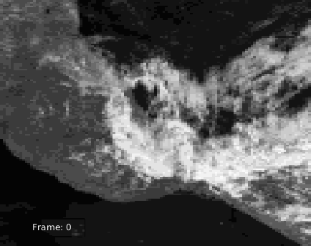
LMLEO Image Simulation
GOES ABI Imagery
LMLEO Image Simulation Model
Boresight Displacement Model
Background scene generation
Simulated video
Scene Flow Model
LMLEO radiometric model
Scene Flow
Example LMLEO Image Sequence
We have a state-of-the-art image simulation framework to model a LEO lightning mapper

Slide 4








GeoXO LMX Lightning Detection Algorithm in GEO
Background Estimation
Dynamic Thresholding
Downlink
Focal Plane Array Readout
Possible Lightning Events
Noise Estimation
The GeoXO LMX Real-Time Event Processor uses background and noise characteristics to determine possible lightning events

Slide 5

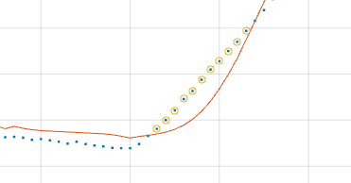

Scene Flow – “I've got a feeling we're not in GEO anymore!”
Pixel Footprint Encounters Strong Local Contrast
RTEP Limitations at a Contrast Boundary
Contrast Boundary
Phew!
Scene Flow
leads to…
Pixel Footprint
Oh no!
Strong Local Contrast
Real-time processors can’t see into the future, so we can’t tell if inflection points are due to pulses (lightning) or induced by scene flow.
Local contrast boundaries are a problem for any real-time event processor!

Slide 6
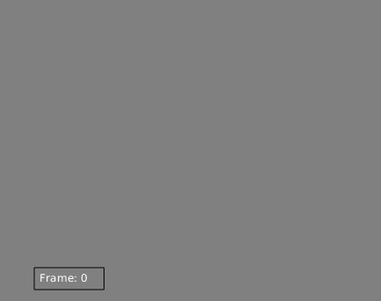
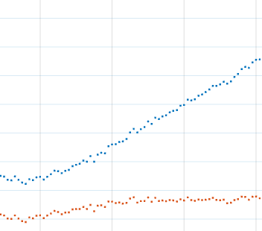
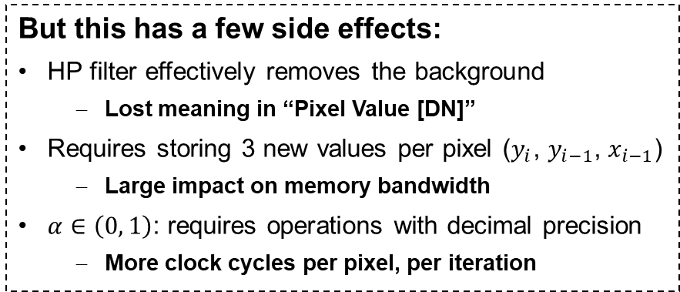
Algorithm Adaptations for LEO
But this has a few side effects:
HP filter effectively removes the background
Lost meaning in “Pixel Value [DN]”
Requires storing 3 new values per pixel ($y_{i}$, $y_{i−1}$, $x_{i−1}$)
Large impact on memory bandwidth
$α∈\left(0, 1\right)$: requires operations with decimal precision
More clock cycles per pixel, per iteration
Add a recursive high-pass filter architecture?
$$y_{i}=α{×y}_{i−1} + α×(x_{i} −x_{i−1})$$
Filtered Value
Portion of Previous Filtered Value
Portion of Change in Input Values
Example Image Sequence with High-Pass Filter
Recursive High-Pass Filter On Simulated LMLEO Data
High frequency details are not lost!
Not all hope is lost!
Recursive HP filter tells us that there is value in modeling the medium-term change in the input values to suppress contrast boundaries’ effects on the RTEP algorithm
Slowly-changing slope is removed
Pixel Value [DN]
Original
High-Pass Filter
Time

Slide 7
Algorithm Adaptations for LEO
By estimating slope, we can reduce the effect scene flow has on the background state
BG Slope Estimation
Background Estimation
Dynamic Thresholding
Downlink
Focal Plane Array Readout
Possible Lightning Events
Noise Estimation
Estimation of the background slope reduces the effects of scene flow on the RTEP algorithm!

Slide 8
LMLEO Path Forward
Maturation of the instrument design in parallel with LMX
Funded partially by Lockheed Martin IRAD
Orbit selection
575 km altitude, 45.4° inclined orbit is affordably accessed by SpaceX Bandwagon ride share
Investigate teaming possibilities and mission scope
Instrument only or full mission?
Deliver hardware or deliver data?
How best to fund the effort?
We are eager to build a team and support behind LMLEO!

Slide 9
Thank You
© 2025 Lockheed Martin Corporation. All Rights Reserved.

