Slide 1
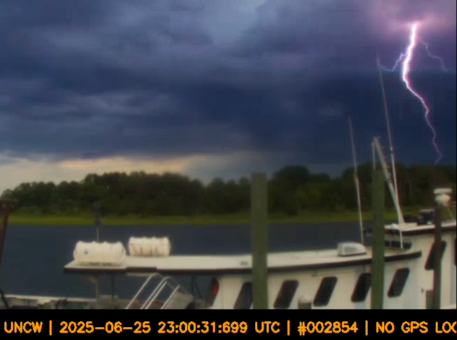
Boltcam: A GPS-Integrated Raspberry Pi Live Streaming and Data Management System for Lightning Observations
2025 GLM Science Meeting
Guangyang Fang, Damian Figueroa
University of Maryland/ESSIC/CISESS
September 2, 2025

Slide 2
Outline
Introduction to Raspberry Pi Camera Network (RPCN) and Boltcam application
Boltcam dashboard and data management
Automatic lightning footage selection
Automated troubleshooting
Lightning footage captured in 2025
Future work

Slide 3
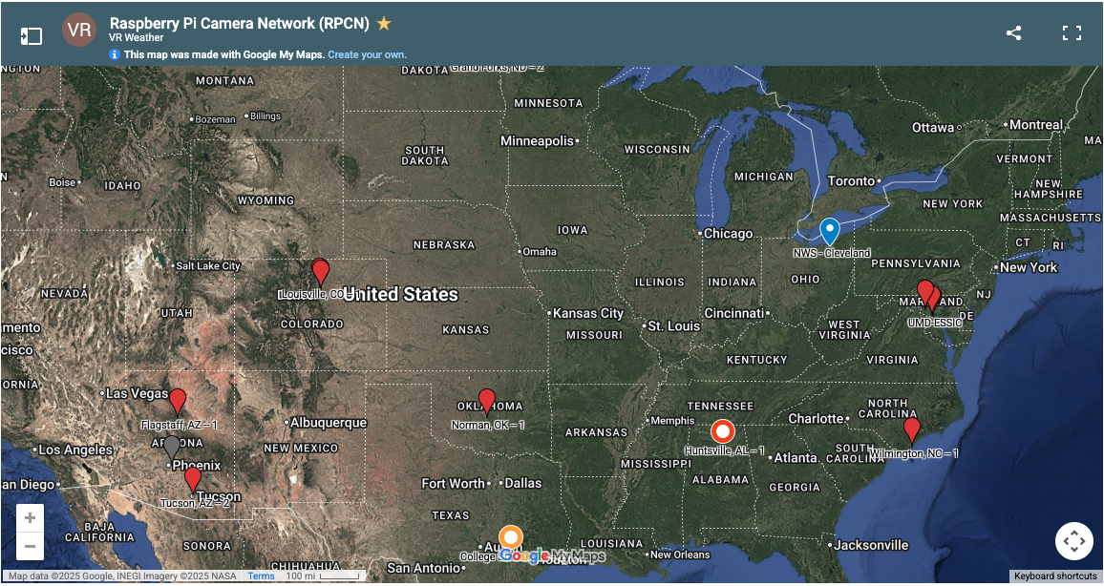
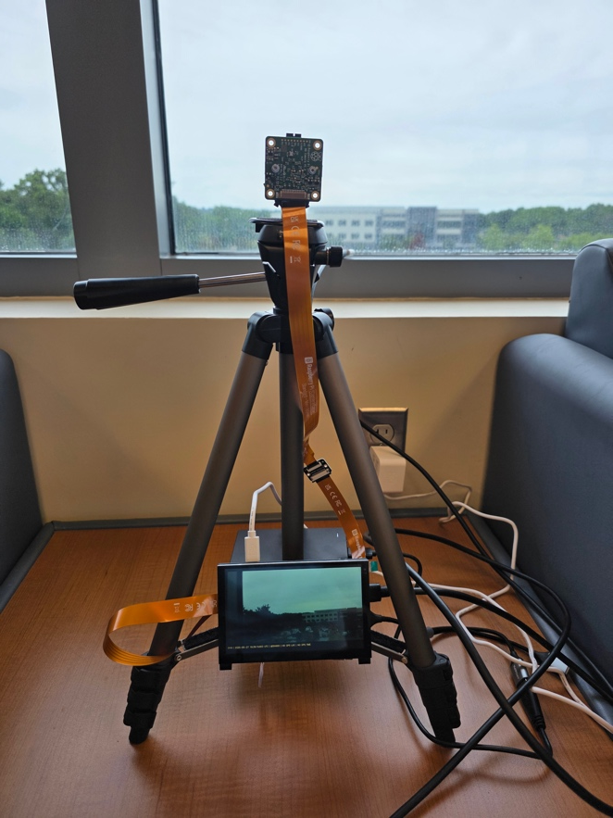
Introduction to Raspberry Pi Camera Network (RPCN)
Raspberry Pi camera network: low-cost, flexible, and scalable network for optical observation of lightning.
Updated stations: UMD-ESSIC_South, UMD-ESSIC_West, DC, Germantown (Earth Networks), Wilmington(UNCW), UMD-AOSC, NWS-Cleveland.

Slide 4
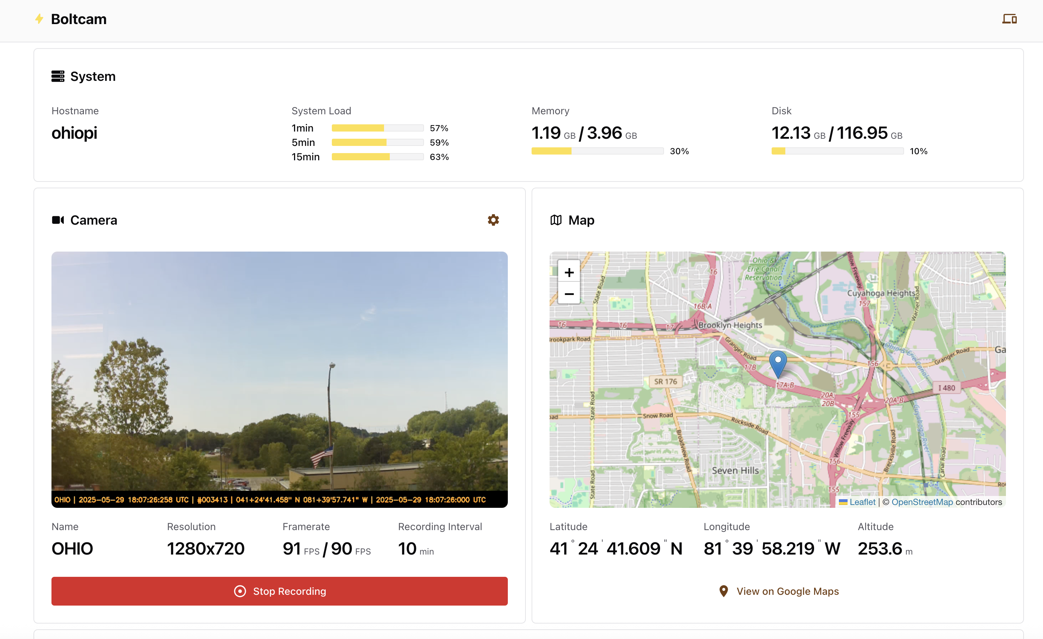
Introduction to Boltcam
Boltcam: Built on Raspberry Pi hardware, Boltcam integrates automated high-speed video recording, on-device data management, and remote access capability to provide a robust platform for optical lightning observations.
Deployed at the same RPCN stations for integration.

Slide 5
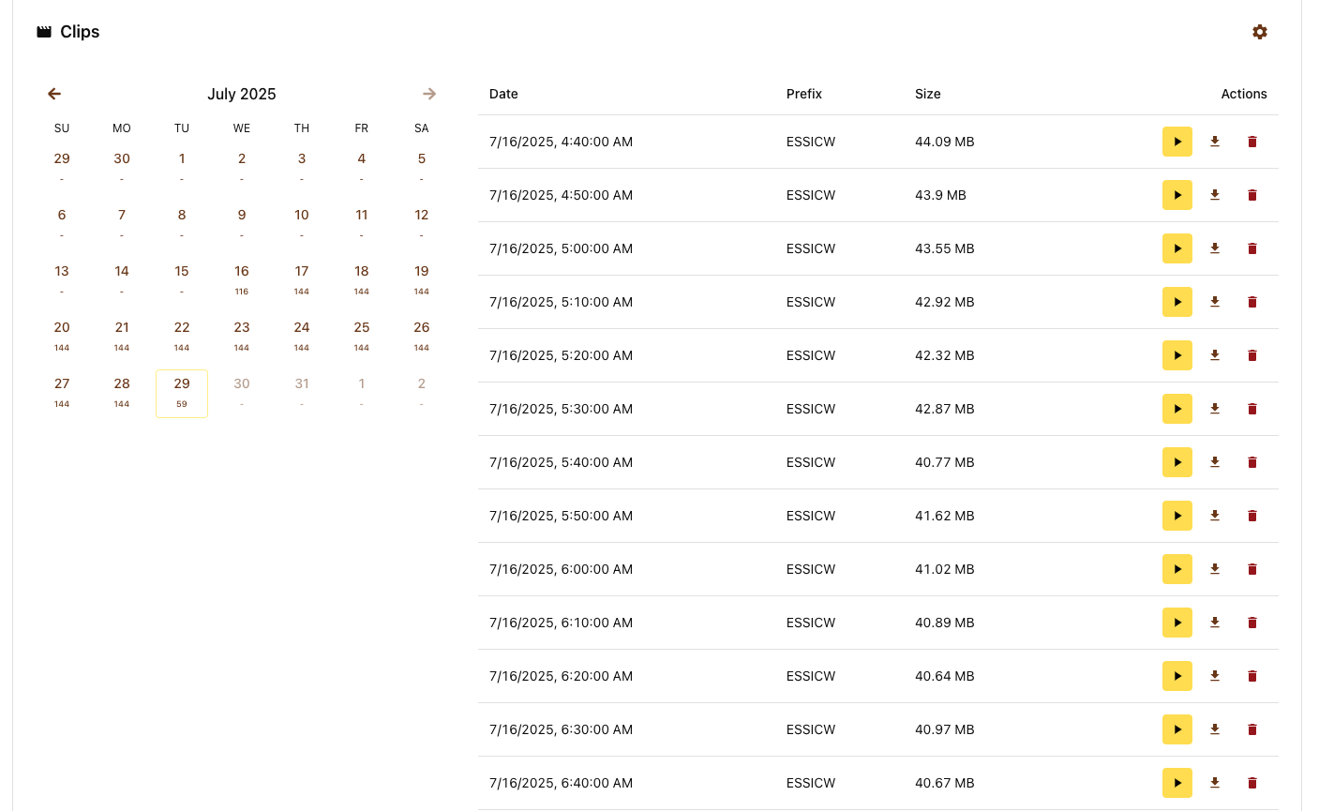
Data Management of Boltcam
Data recorded locally on Raspberry Pi.
Periodic manual archiving to central storage.
Goal: automate upload to server for long-term storage and sharing.

Slide 6
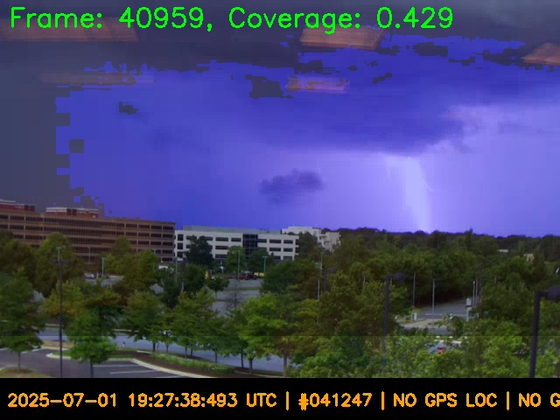
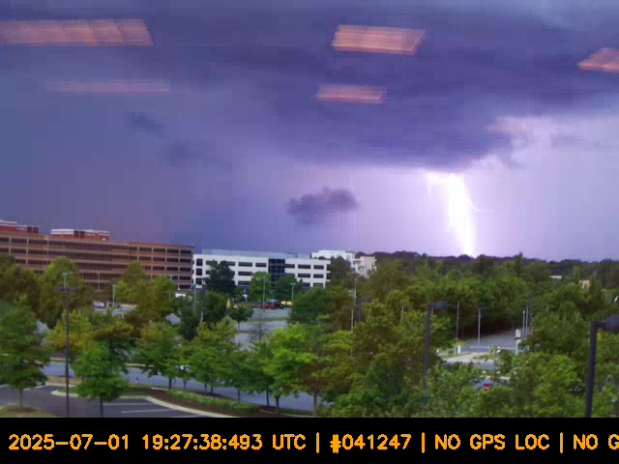
Automatic Selection of Lightning Footage
Script looks for sudden changes in brightness from frame to frame. Because the camera views are mostly static, this works well for detecting most of the bolts. It enables quick isolation of lightning events from continuous video.

Slide 7
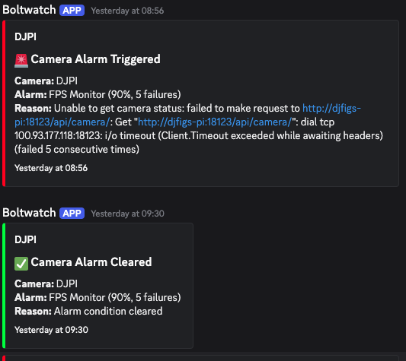
Botlcam Auto Troubleshooting
Raspberry Pi is set to reboot at mid-night every day to troubleshoot most of unexpected and common issues.
Built-in scripts send alerts when errors occur.
System can auto-correct certain failures to maintain uptime.

Slide 8
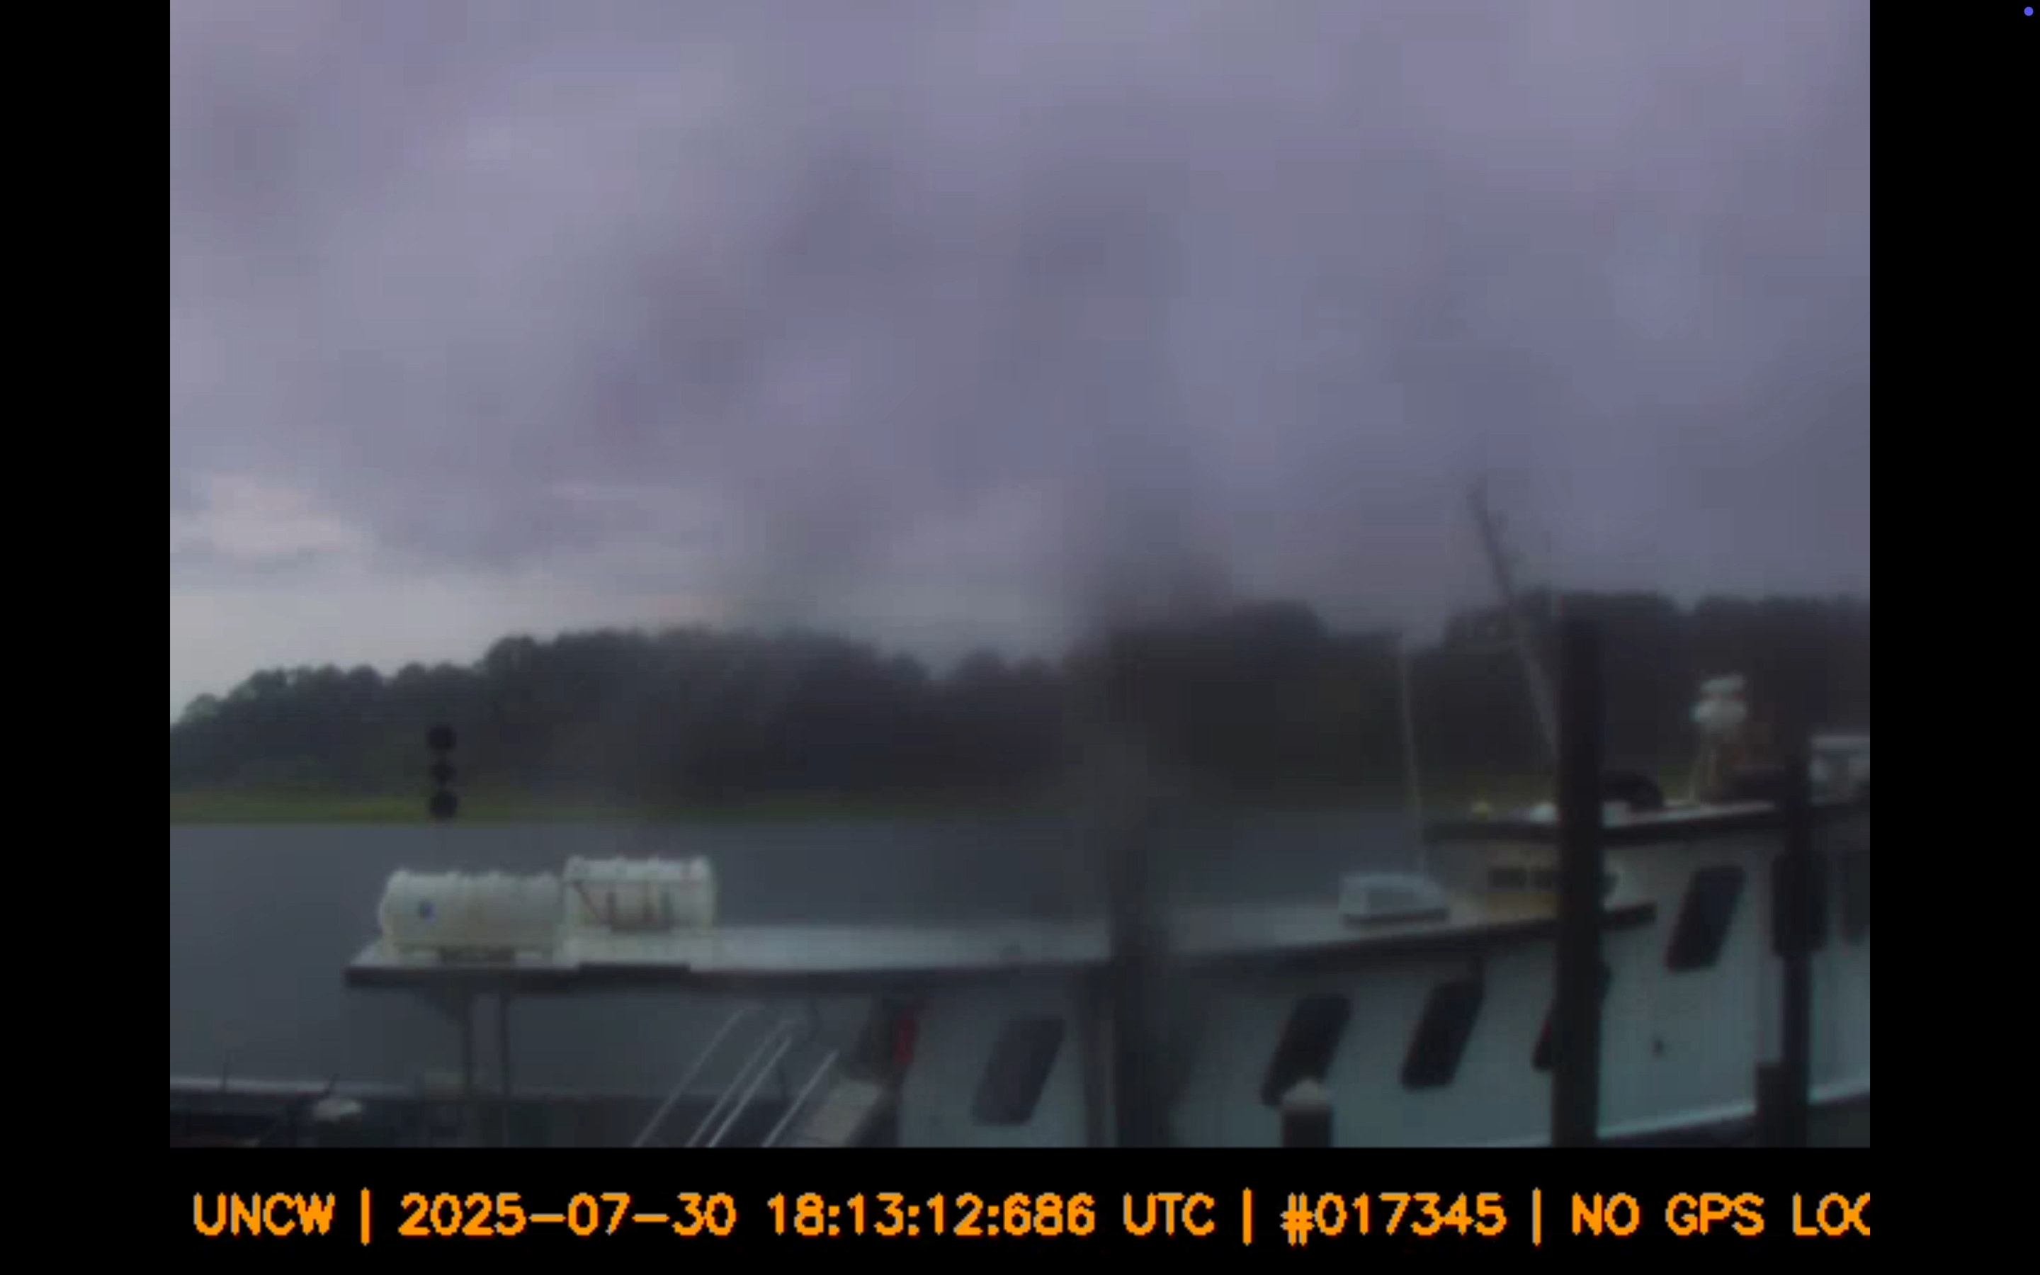
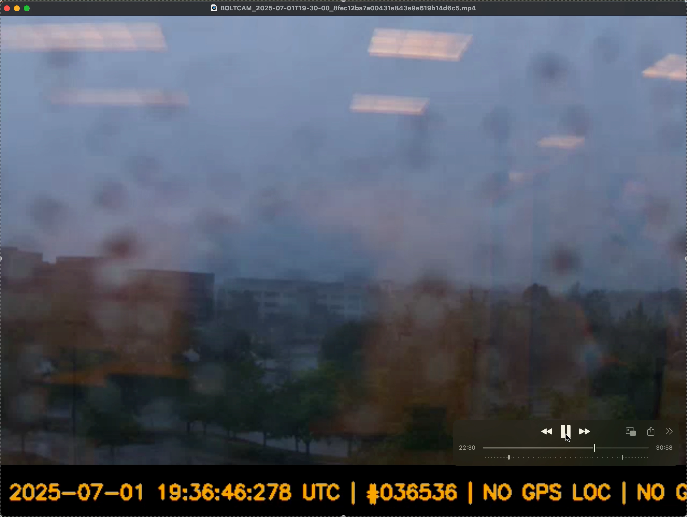
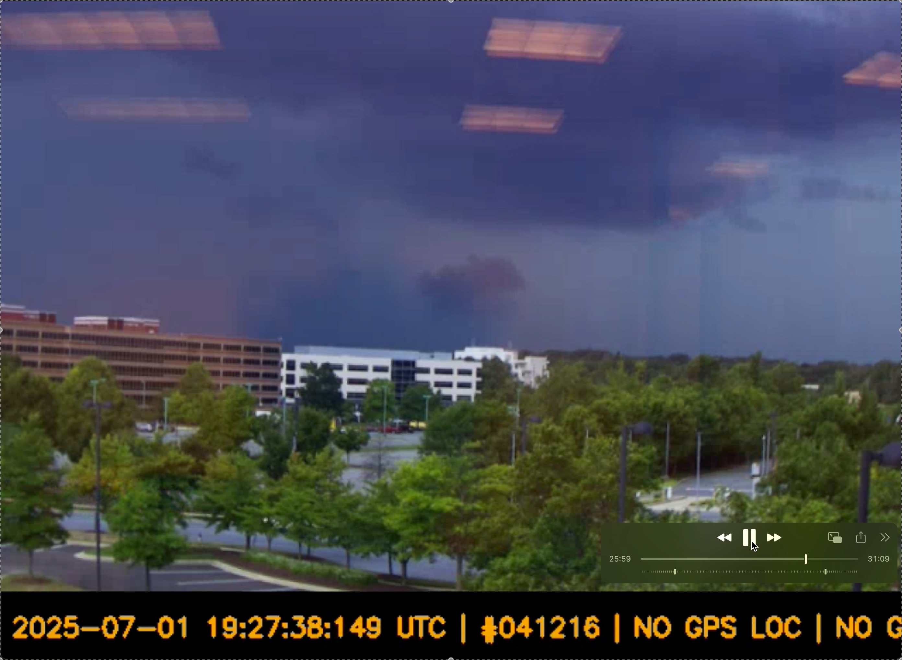
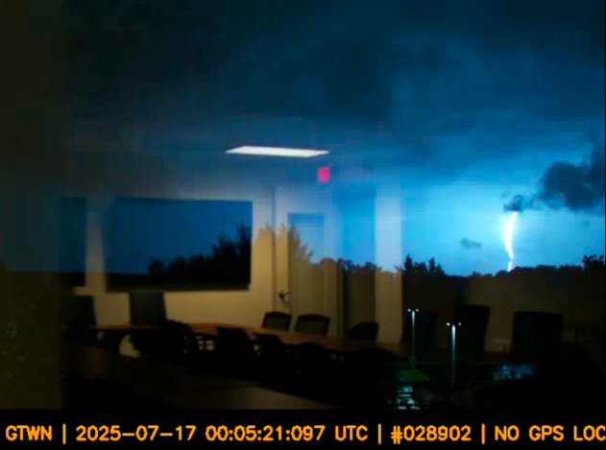
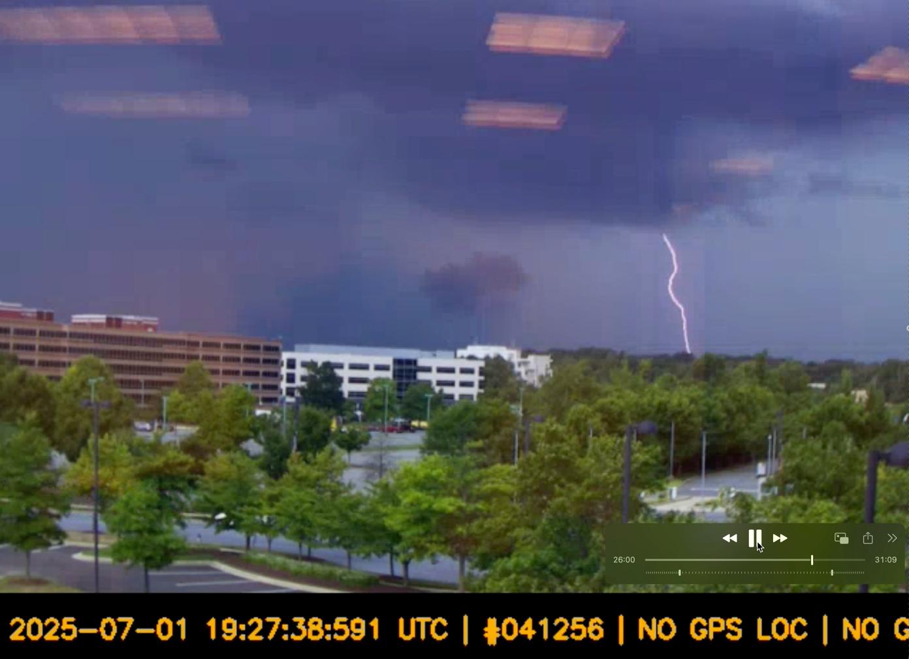
Lightning footage captured by Boltcam in 2025
Example footage in the processing pipeline.
More videos are being processed.

Slide 9
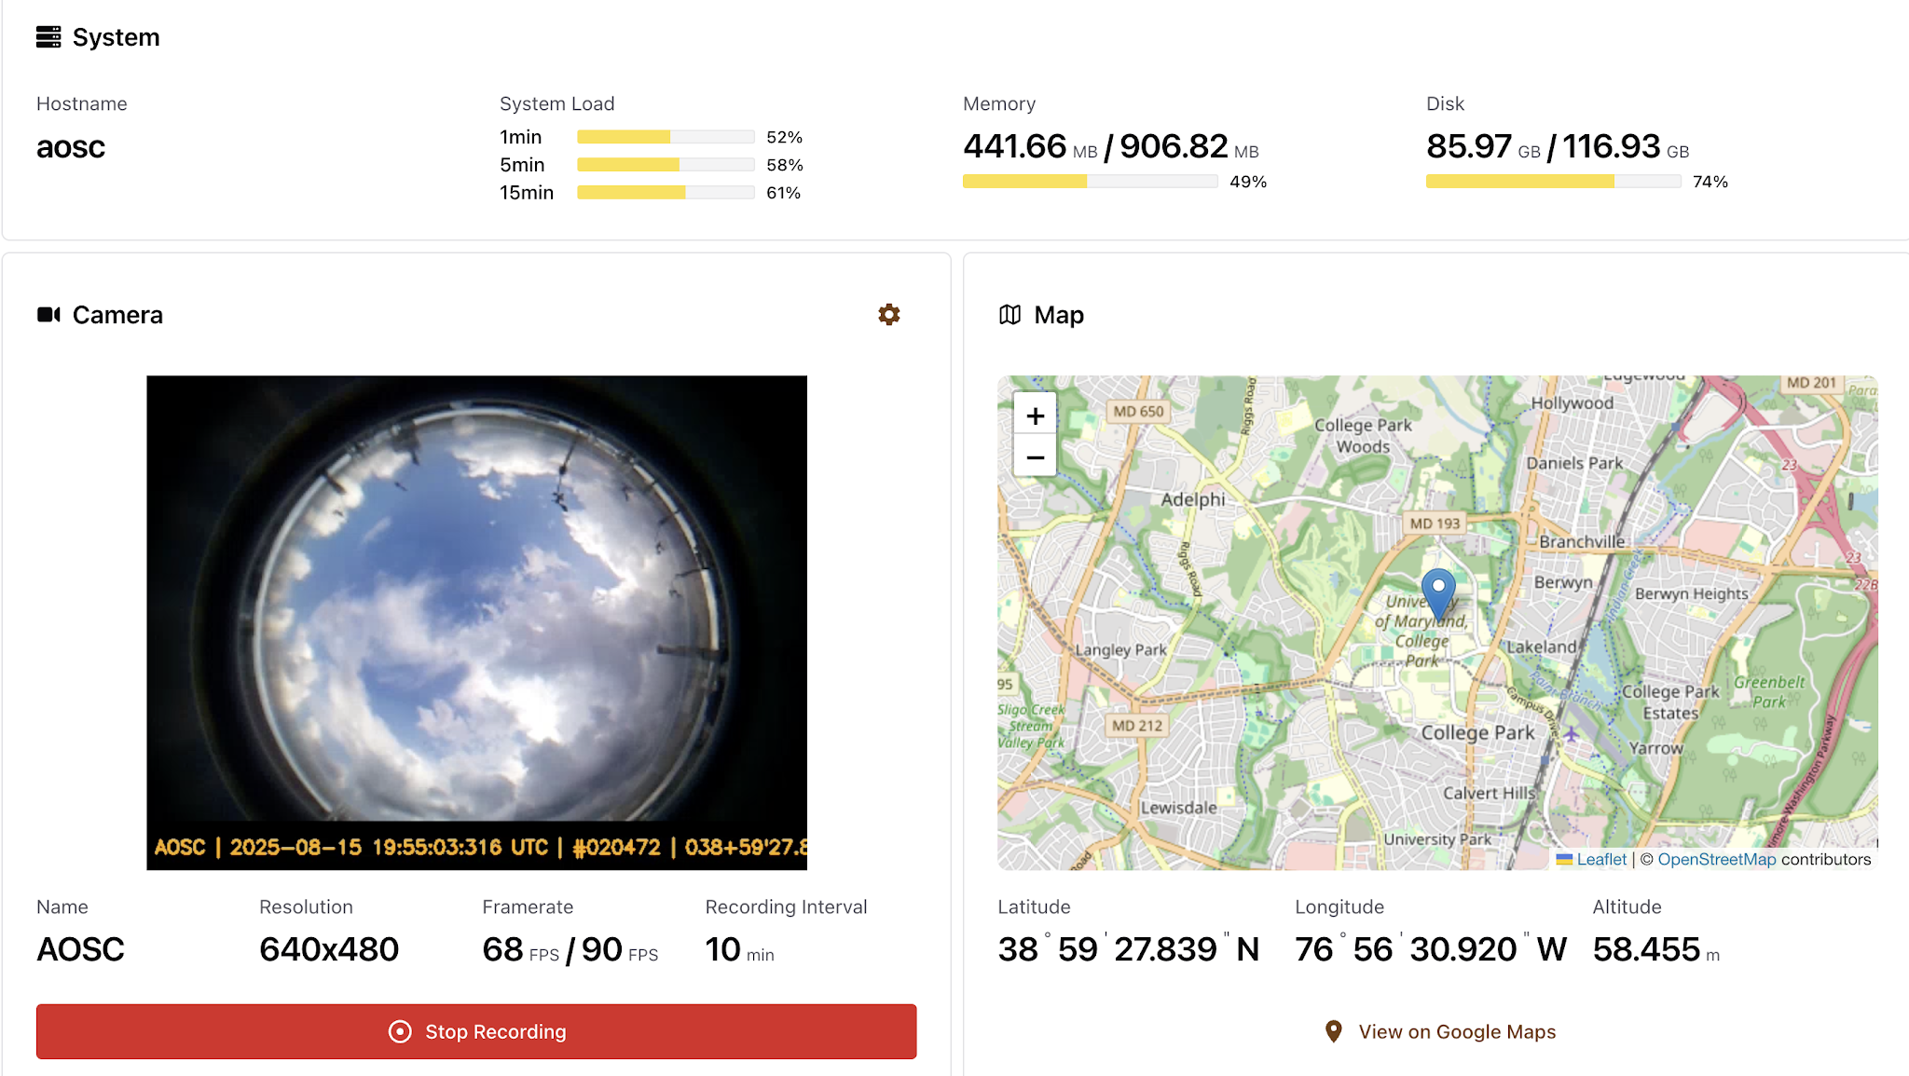
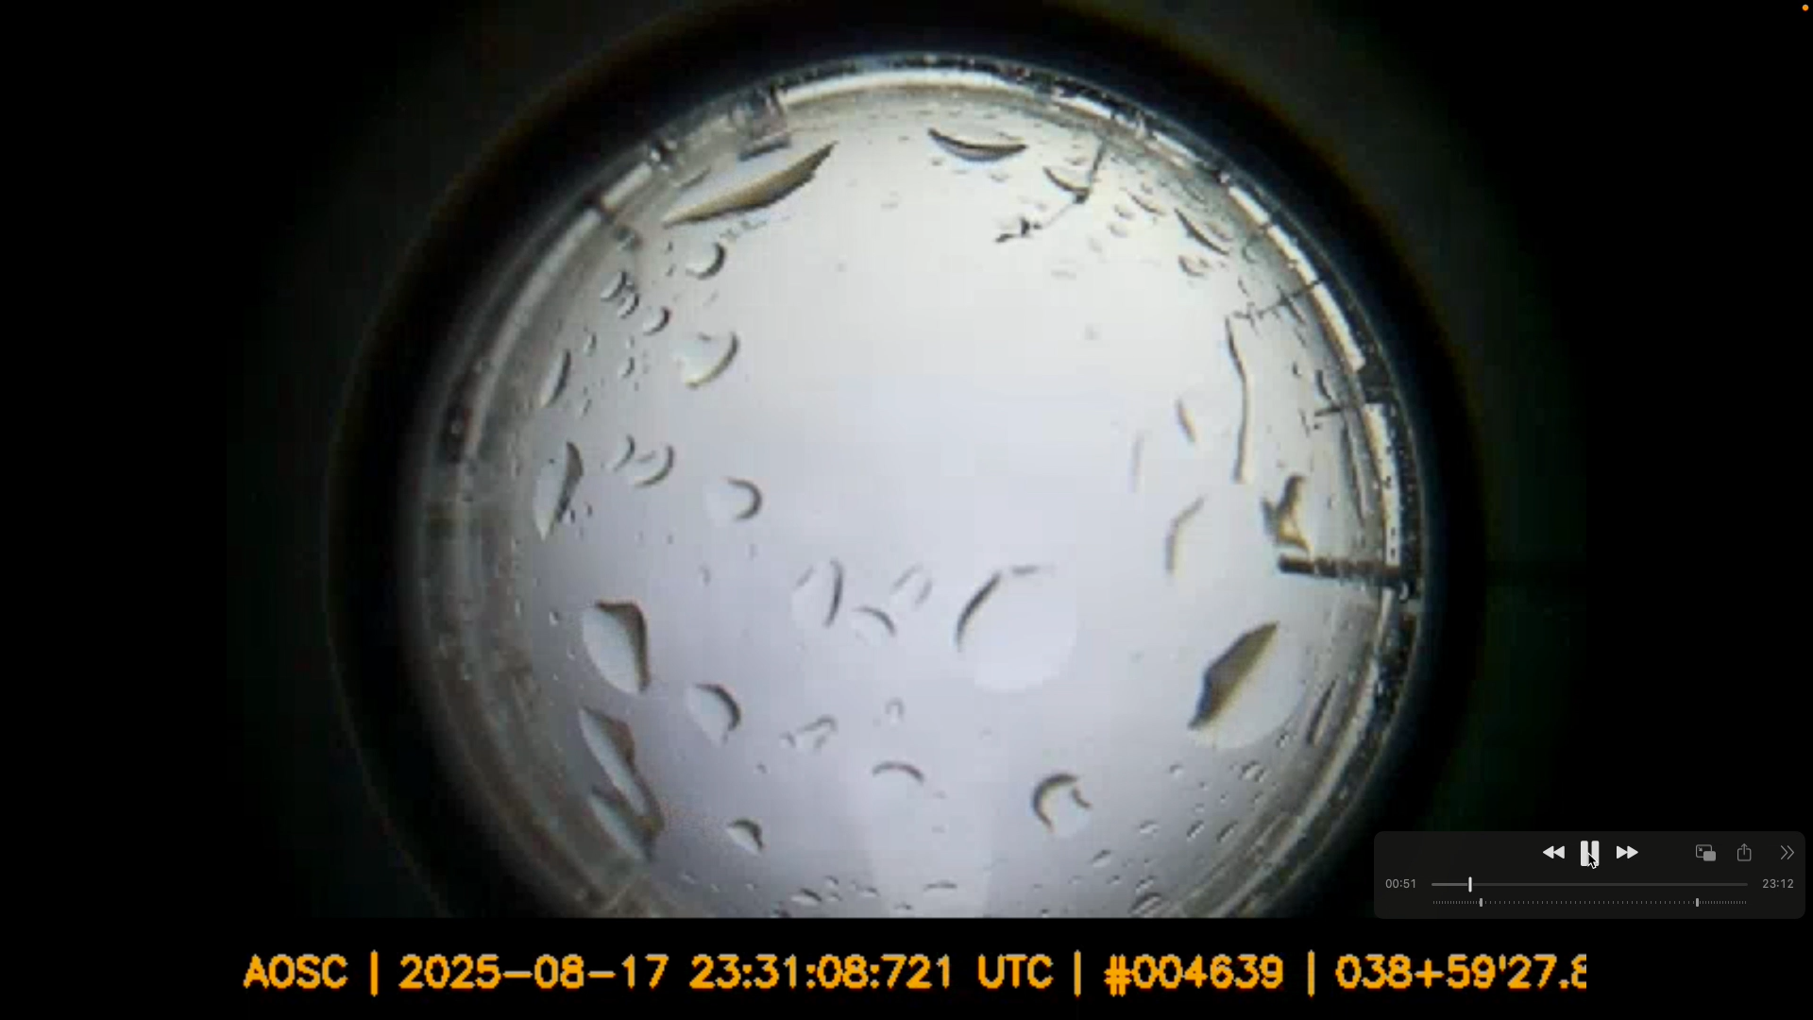
Fisheye camera on UMD-AOSC
First fisheye camera was set up to watch the full sky at the rooftop of UMD-AOSC Atlantic building.

Slide 10
Future Work
Expand RPCN with additional stations.
Improve stability and reliability of Boltcam.
Complete automation of lightning footage selection.
Enable automatic upload to central server.
Upgrade fisheye camera system.
Perform intercomparisons of NLND, ENTLN, LMA, and GLM with the footage.

