Slide 1
Ground-based radiometry for source-constrained optical modeling
GLM Science Meeting
2 Sep 2025, Online
Eric Bruning, Kelcy Brunner, Stephanie Weiss, Sam Gardner (TTU)
Thom Edwards, Belle Storm, Lydia Wermer (Sandia)
This work supported by the GOES-R and GEO-XO programs under a NOAA Cooperative Institute Task 3 project through CIWRO. Thanks to ENTLN and NLDN for providing data as part of GLM cal/val.

Slide 2
Talk outline
GLM Science Meeting
Overview of field site, instruments, sample count
Thanks to ENI and NLDN via cal/val agreement for data, and GLM cal/val and GEOXO funding
Four case examples
Even in four flashes, lots of combinations of mutual detection, providing a good test.
Delta E for each stroke
Will get stroke energy, cloud optical depth, etc. from Sandia
Synthesis plans
Can we covary observed source energy with observed GLM using a simple
Consistent signal that 337 precedes 777
Next steps/concluding remarks
Cloud modeling of cases and optical transport of well-characterized
Reminder brag about dataset size
Happy to share LMA and slow antenna for ground network comparisons

Slide 3
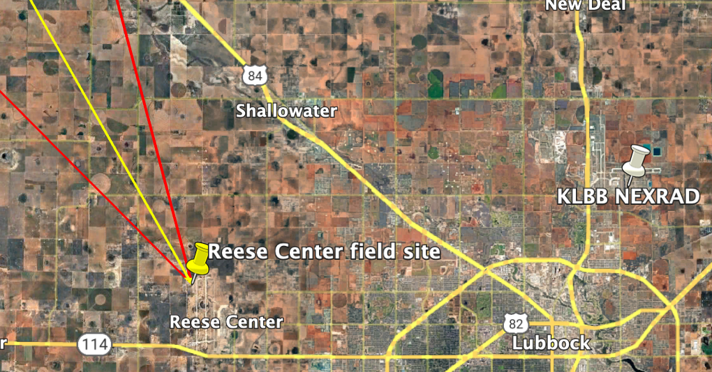
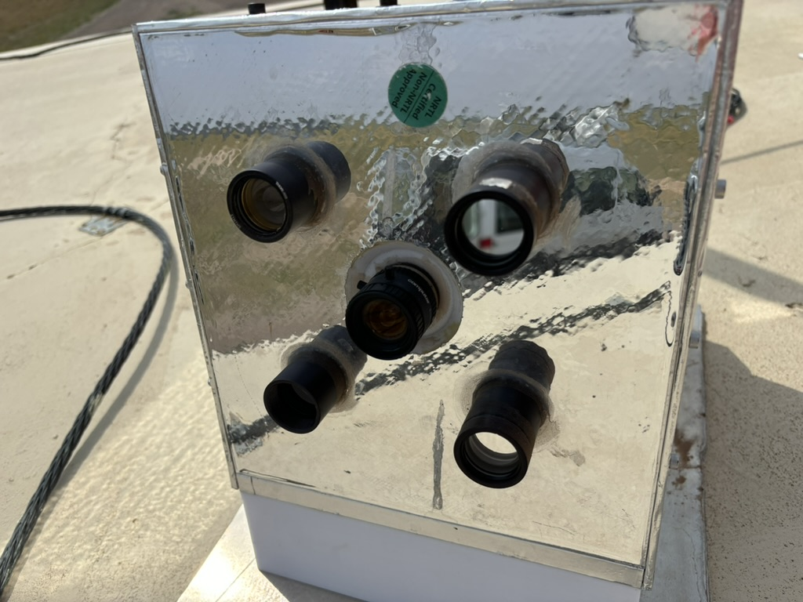
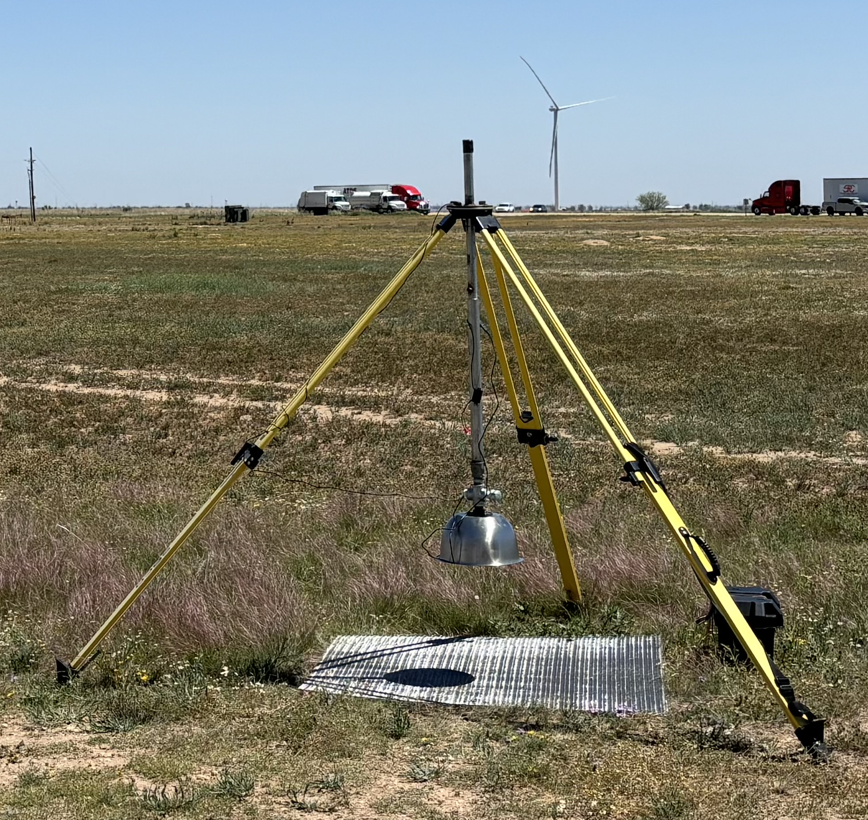
2025 dataset
Radiometer
field of view FOV
Instruments
Continuous regional measurements:
West Texas LMA, GLM-E/W, GLM-East; ENI and NLDN; KLBB WSR-88D.
At TTU Reese Center Field site:
Sandia Radiometer at 337, 777, 150 and 320-1110 nm
Calibrated to watts at radiometer aperture
200 ksps, with triggered context camera
View is to NNE
TTU electric field change “slow” antenna, 100 ms time constant, 10 ksps
Calibration in process

Slide 4
2025 dataset
Radiometer trigger counts
Date | Count | Herein
4/26/2025 | 74
4/30/2025 | 3
5/6/2025 | 2
5/25/2025 | 1
5/27/2025 | 1
6/2/2025 | 1
6/3/2025 | 2 | 2 –CG
6/5/2025 | 1
6/24/2025 | 1 | 1 +CG
6/30/2025 | 1
7/8/2025 | 5 | 1 –CG
7/21/2025 | 89
7/22/2025 | 1
7/23/2025 | 210
392 total radiometer triggers
Slow antenna on each day, usually 1-3 at Reese site.
Distributed 8-station network across Lubbock for a tornadic supercell and multicell storms on two days, but storms to east of radiometer FOV.
Numerous supercell and multicell cases, some disorganized lines of storms
Next slides: some examples close to field site with clear context camera images of CGs

Slide 5
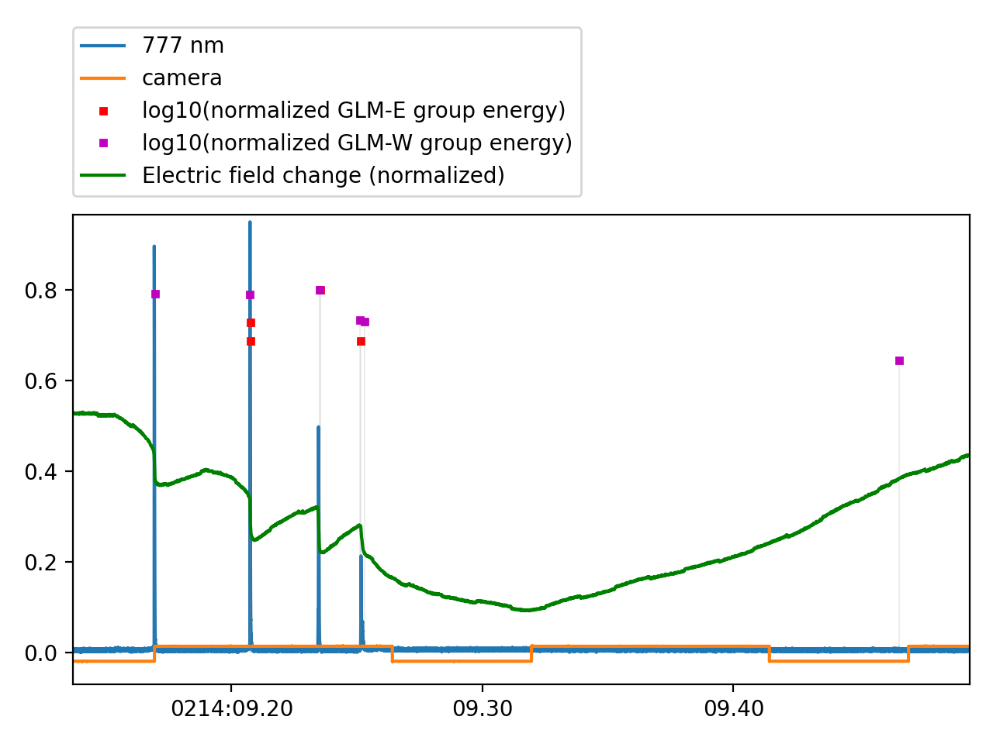
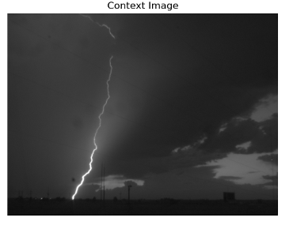
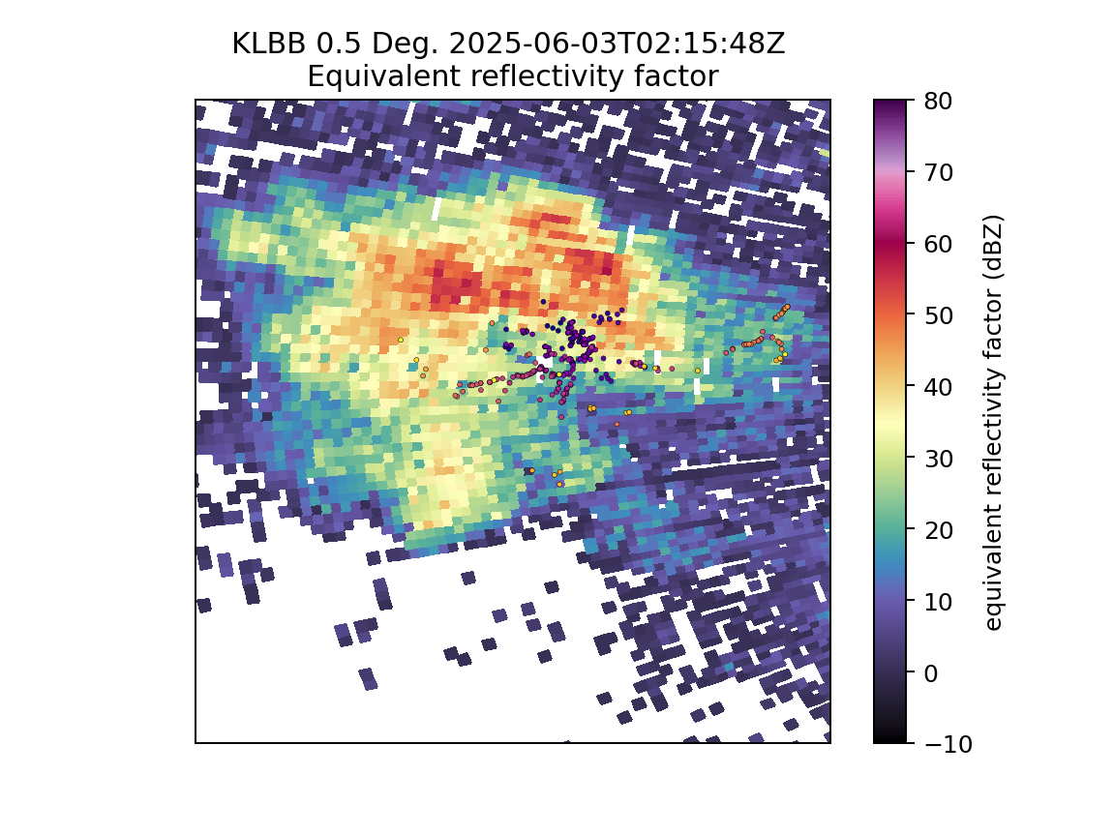
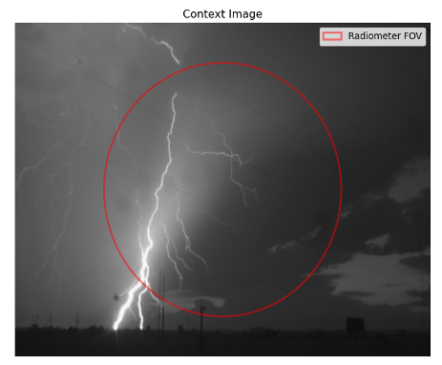
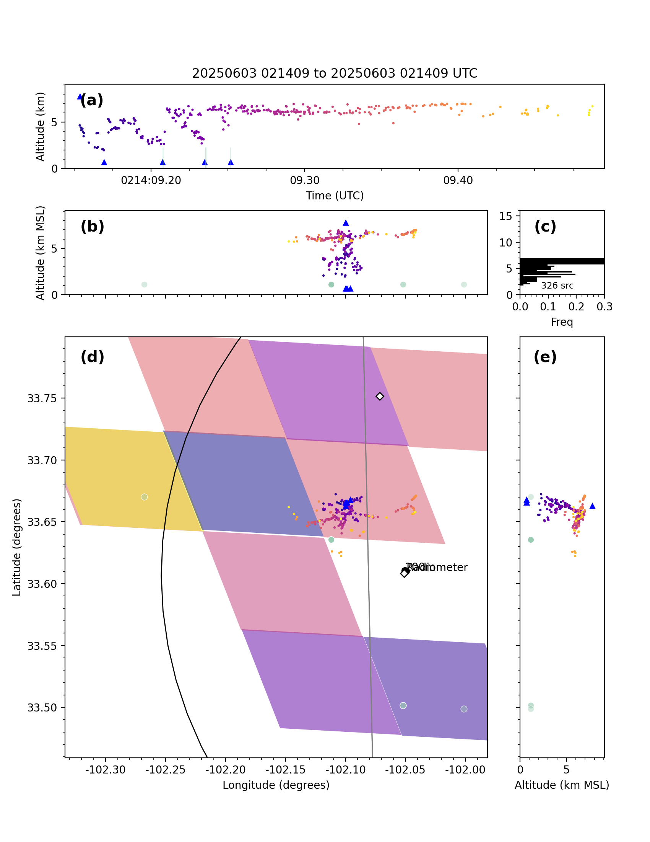
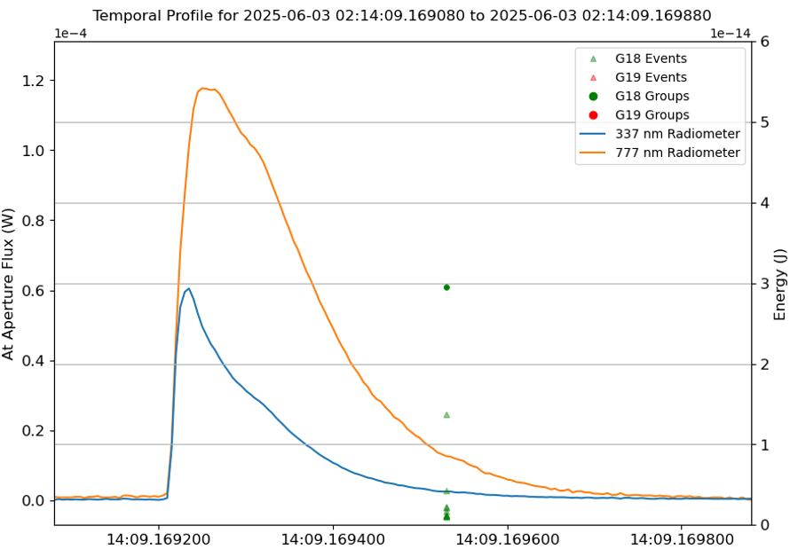
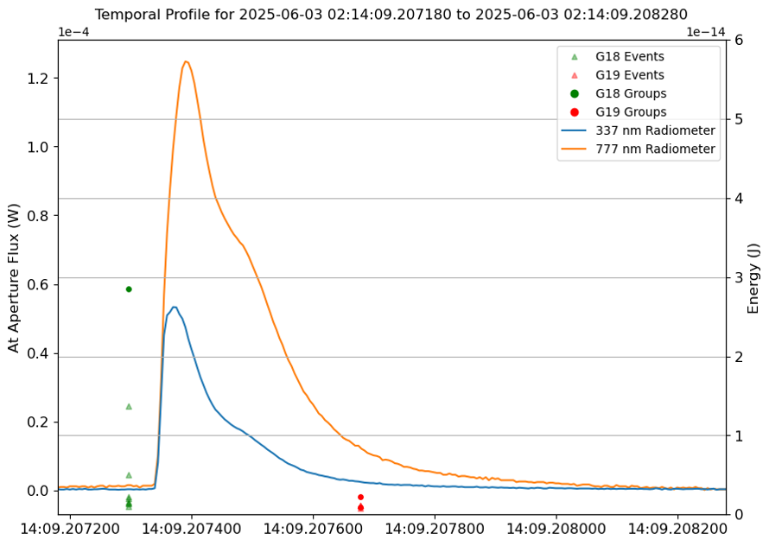
3 June 2025, 02:14:09 UTC: four –CGs
No radiometer amplitude during
continued illumination in second camera frame.
radiometer
no
no
GLM-W
yes
yes
GLM-E
A
BCD
Obs
site
ΔE
A
B
C
D
First camera frame (0.1 s, A-D)
1st cam frame
2nd cam frame
BCD
C
A
-23, -19, -23, -11 kA
–CGs at A, B, C, D at two ground strike points. C, D are subsequent strokes of B.
All detected by radiometer and GLM-W.
A, C: Not detected by GLM-E.
B, D: Detected by GLM-E.
Perhaps dart leader activity on positive channels at 6-7 km altitude explains GLM-E difference.
Largest electric field change at times of CGs, with slow electrostatic change continuing after last stroke during IC processes.
A
B
C
D
A
777 nm
B
777 nm
0.2 ms
0.2 ms
GLM-E: no
GLM-E: yes
337 nm
337 nm
A
BCD
Obs
Site
Colored pixels: GLM-E total optical energy
Green dots / lines: GLM groups
Other dots: West Texas LMA channels

Slide 6
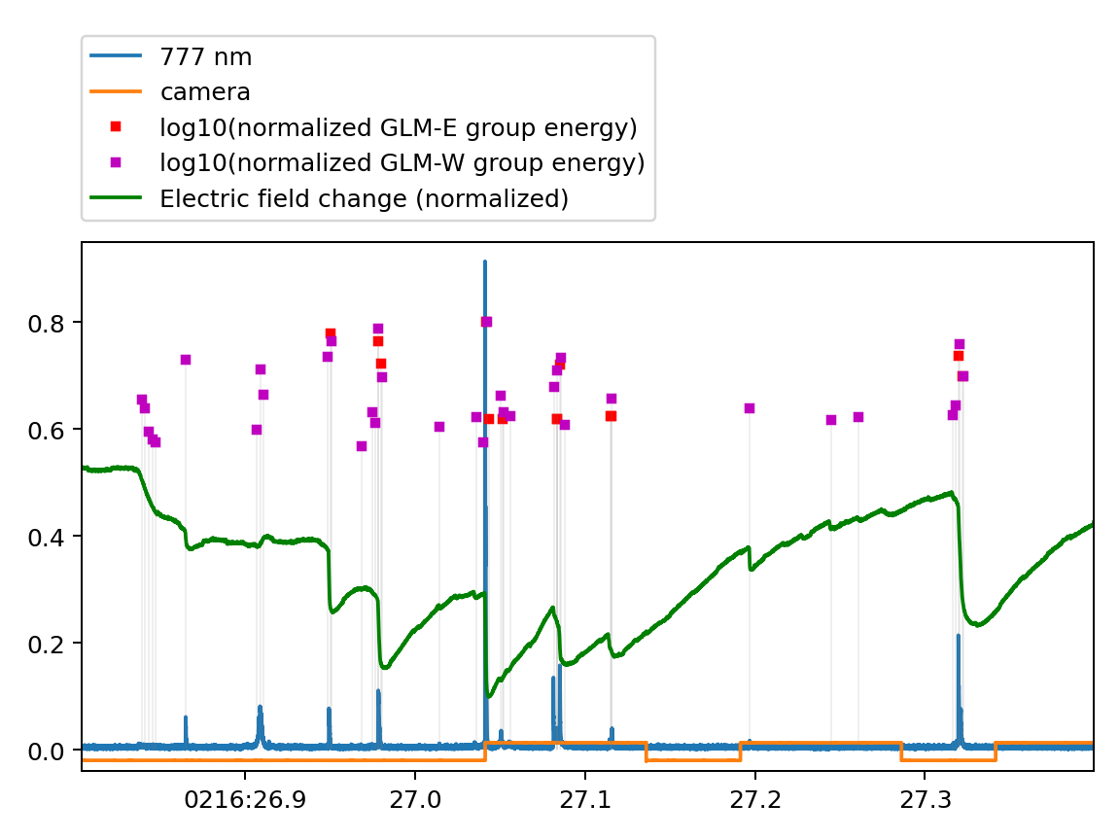
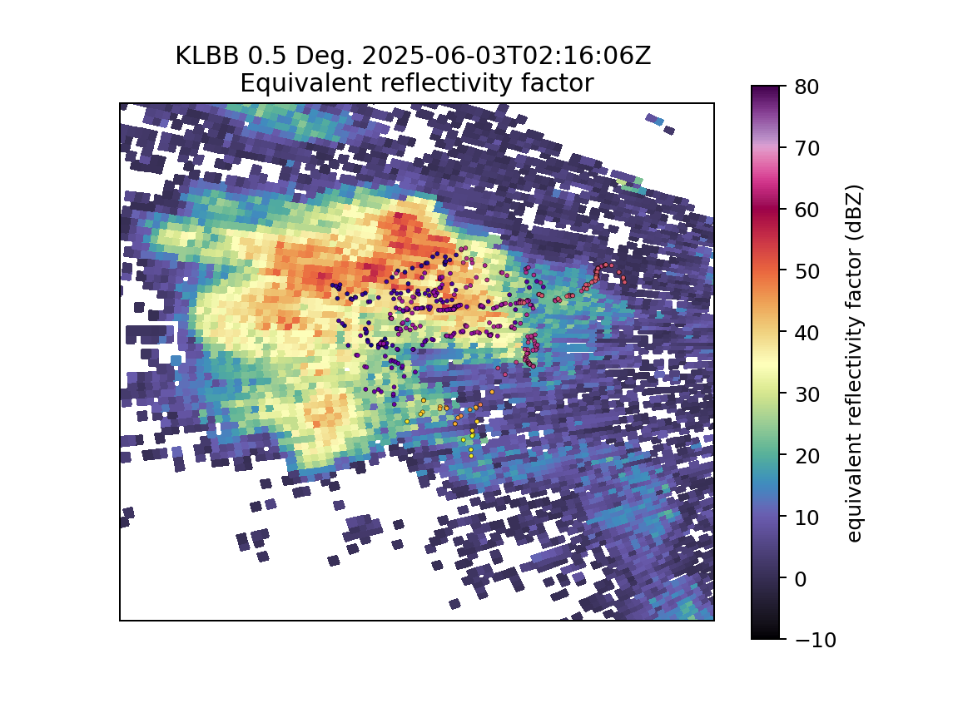
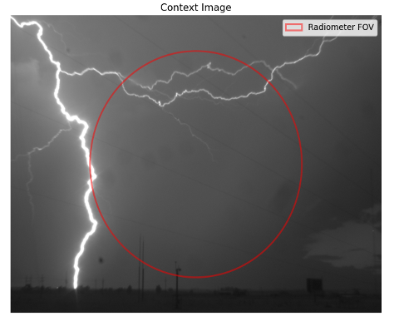
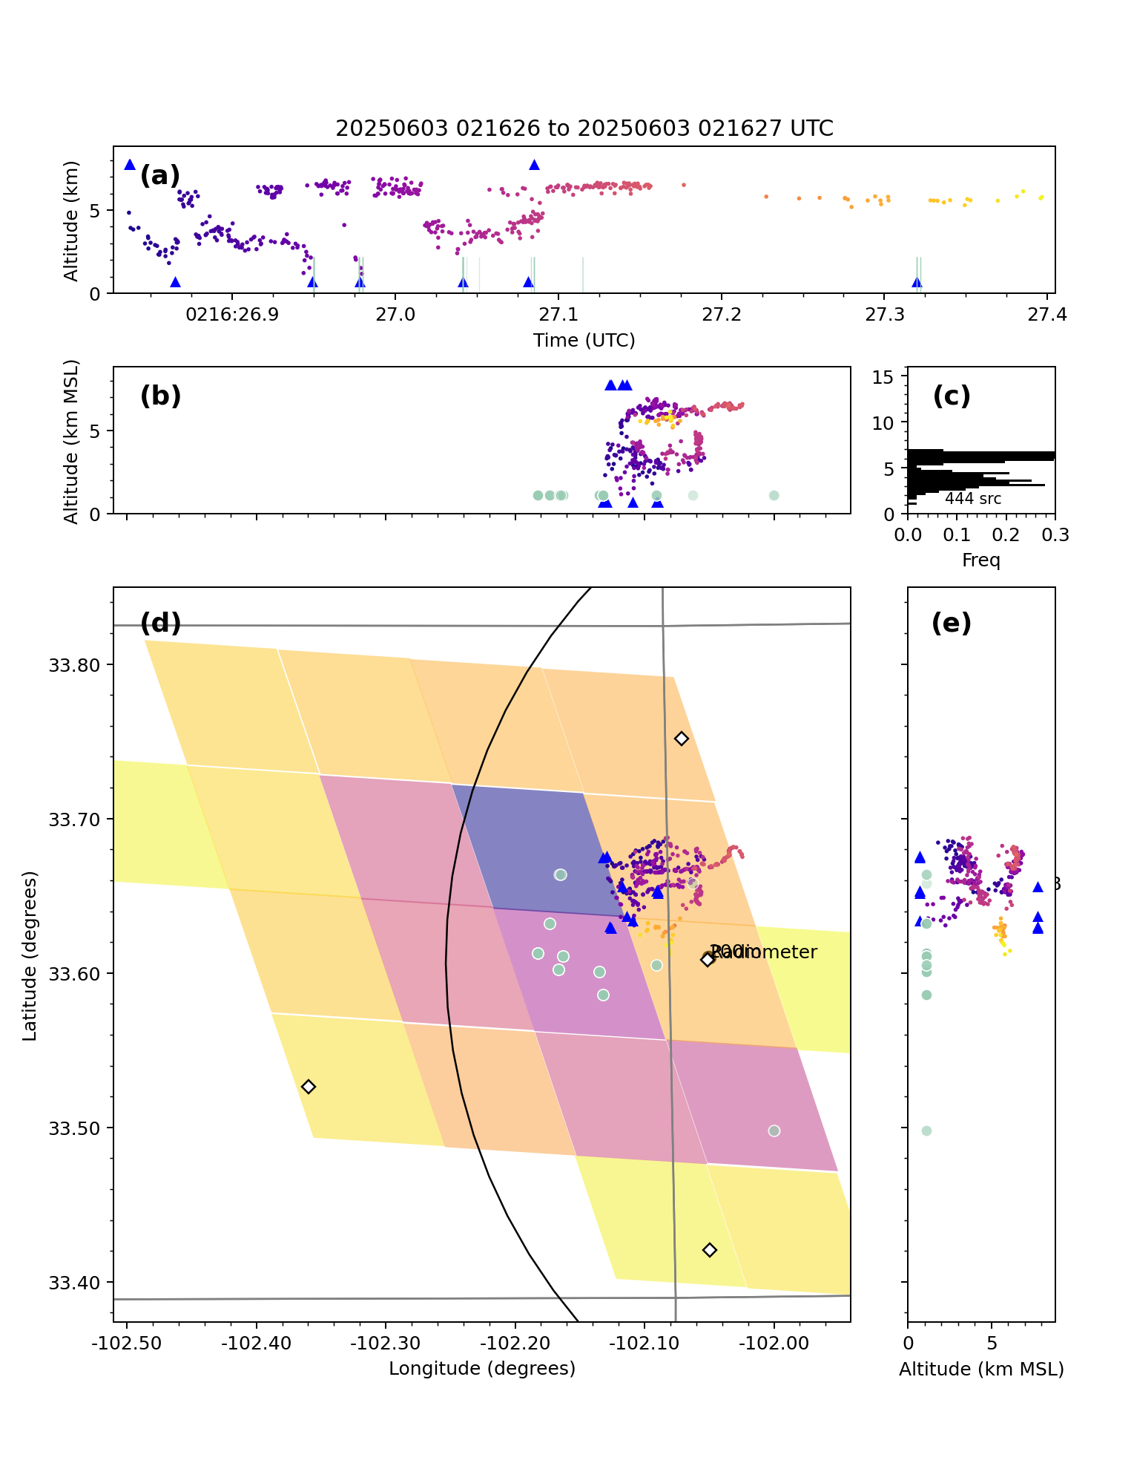
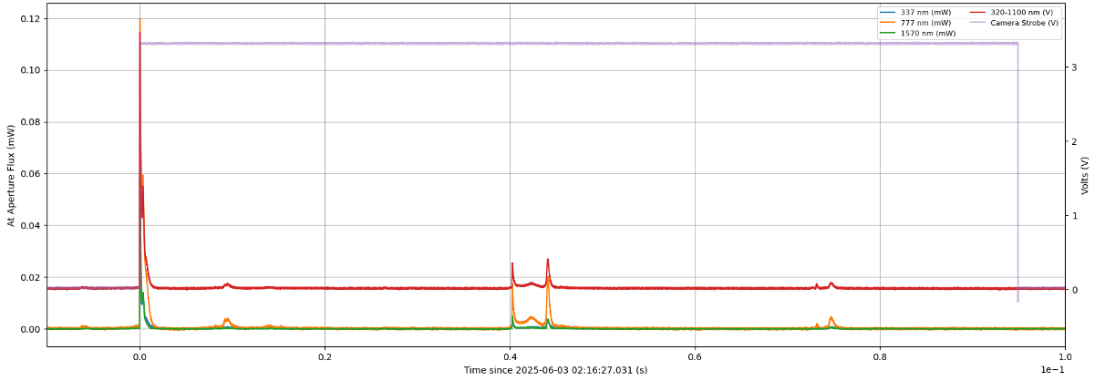
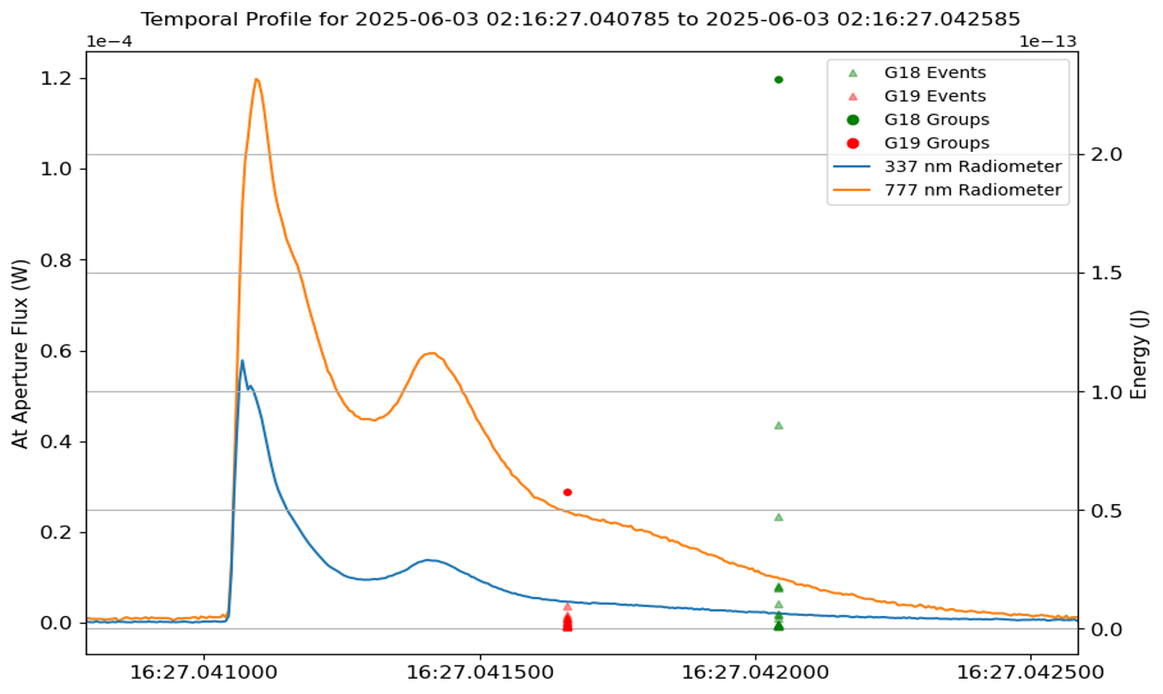
3 June 2025, 02:16:26 UTC: six –CGs
-10, -17, -17, -19, -7, -10 kA
–CGs at A, C, D, E, F, H, at three ground strike points.
Every radiometer pulse and CG detected by GLM-W.
A, B: Not detected by GLM-E.
Camera did not trigger on A, D, which were dimmer: more obscured by precip.
E, F are first and subsequent strokes. G may be misclassified, since ΔE is sharp. F and G have multi-pulse optical structure over several ms. H is in between second and third camera frames.
Many additional electric field change episodes corresponding to GLM-W , likely all from dart processes on positive leaders.
Much brighter
GLM-W
GLM-E
AD
no
no
yes
yes
yes
yes
yes
yes
EFH
C
Obs
site
E
F
G
ΔE
H
A
B
C
D
radiometer
~dim
dim
E,F,G
B
G
20 ms
A
C
D
E
F
H
E
-19 kA CG
F
-7 kA CG
G
-6 kA IC
E
AD
777 nm
1 ms
C
EFH
Obs
Site
337 nm
Colored pixels: GLM-E total optical energy
Green dots / lines: GLM groups
Other dots: West Texas LMA channels

Slide 7
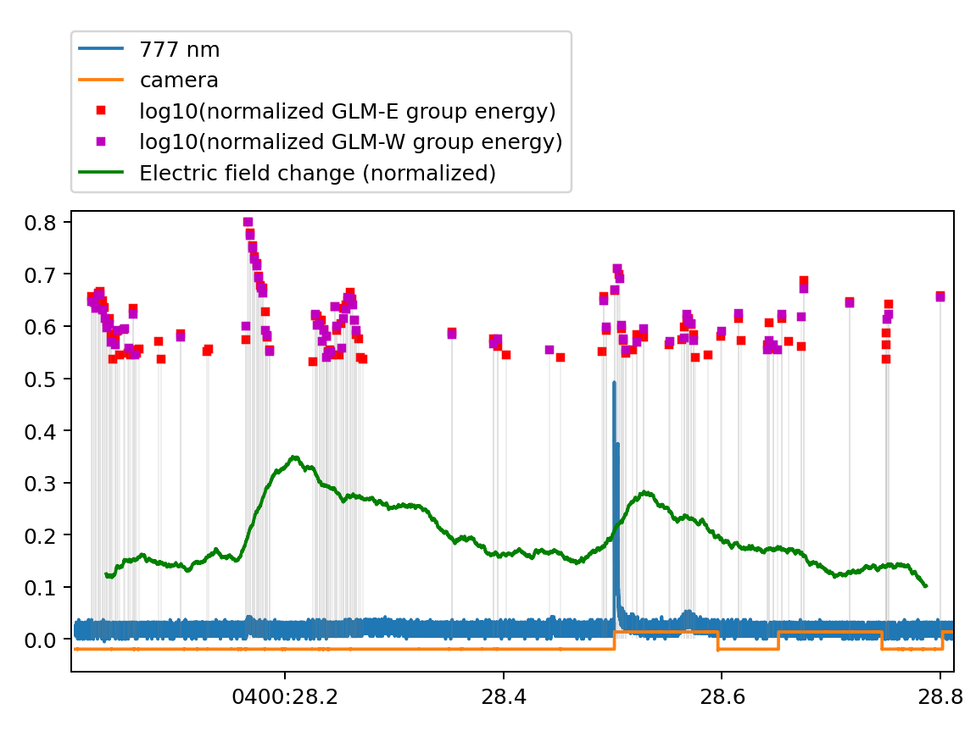
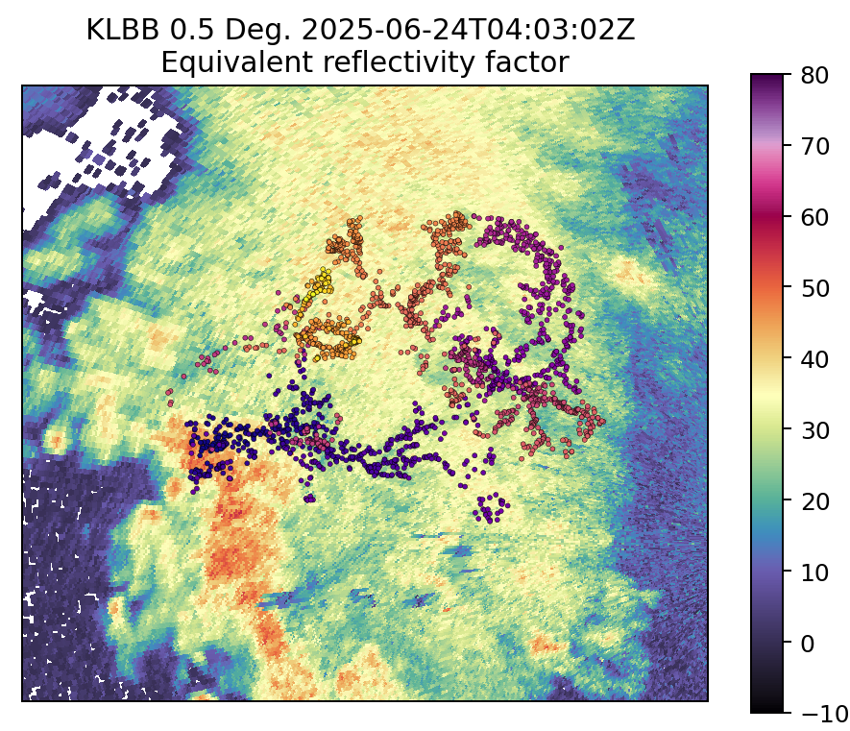
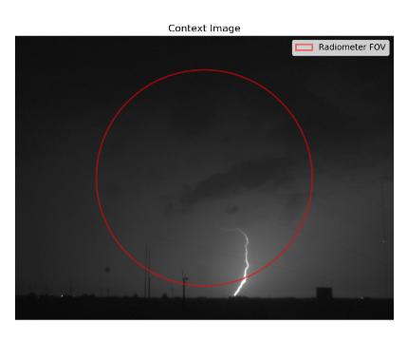
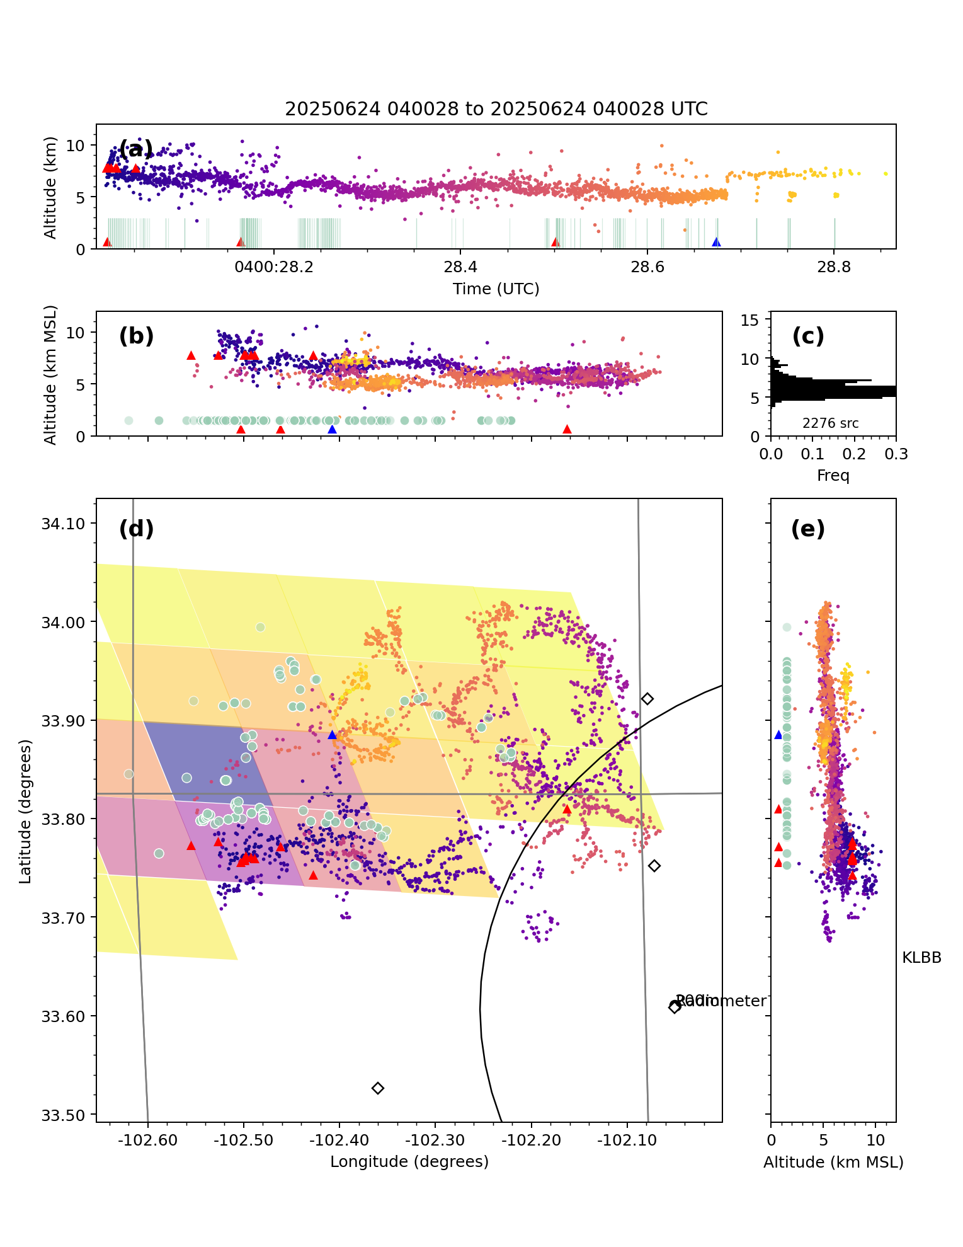
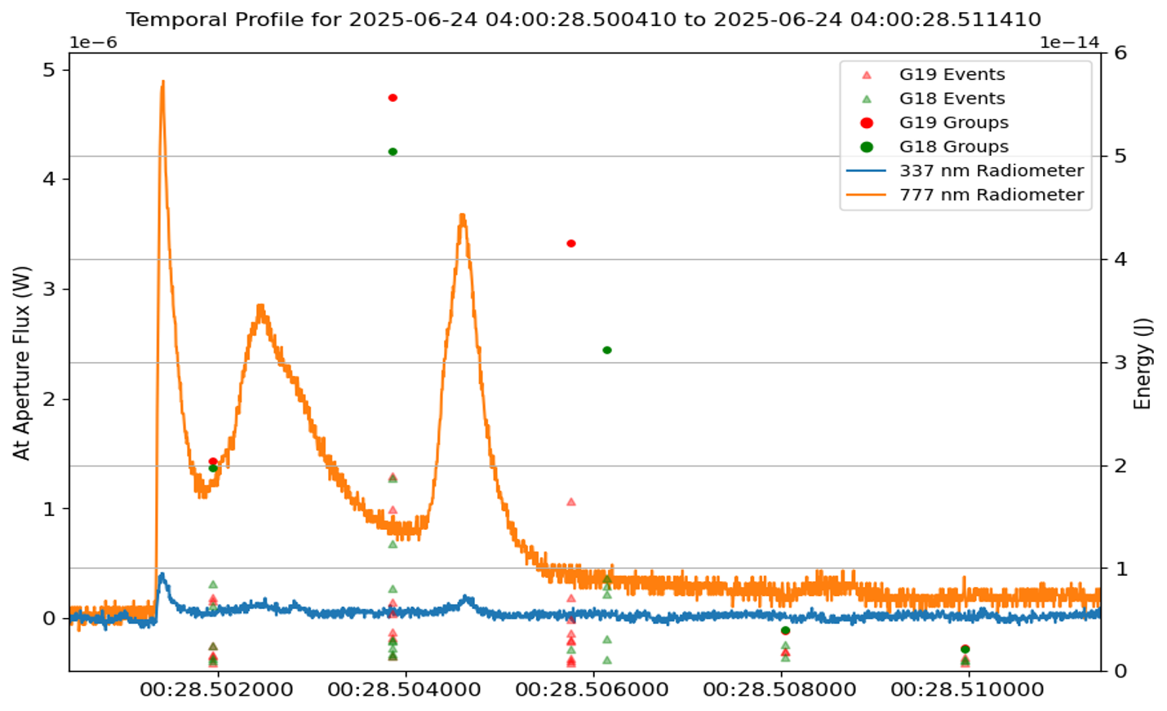
24 June 2025, 04:00:28 UTC: +CG
mod
bright
mod
Three 25 kA +CGs at A, B, C from an extensive charge region in stratiform cloud.
LMA channels span about 50 km
Cloud/rain optical depth modifies the intensity of optical pulses observed at 777 nm by GLM and a radiometer at ground.
A: Moderately bright from GLM, but too far from radiometer observing site at TTU.
B: Very bright from GLM, just barely observable at radiometer through rain at 45 km range; might be cloud illumination due to FOV.
C: Moderately bright from GLM, very bright at radiometer at 15 km range; camera confirmation of ground strike.
(Left): three peaks at 777 during CG; peaks at 337 with first and last peak.
Largest electric field change at times of CGs.
GLM-W
A
B
C
GLM-E
+25 kA stroke to ground
smoothed due to site noise
C
ΔE
A
B
none
dim
bright
rad.
Obs
site
C
A
B
C
2 ms
777 nm
C
A
B
Colored pixels: GLM-E total optical energy
Green dots / lines: GLM groups
Other dots: West Texas LMA channels
Obs
Site
337 nm

Slide 8
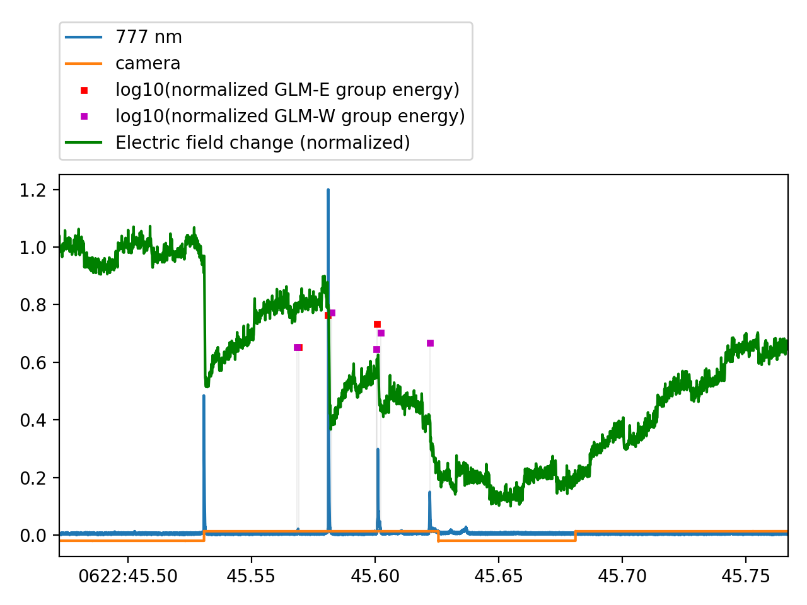
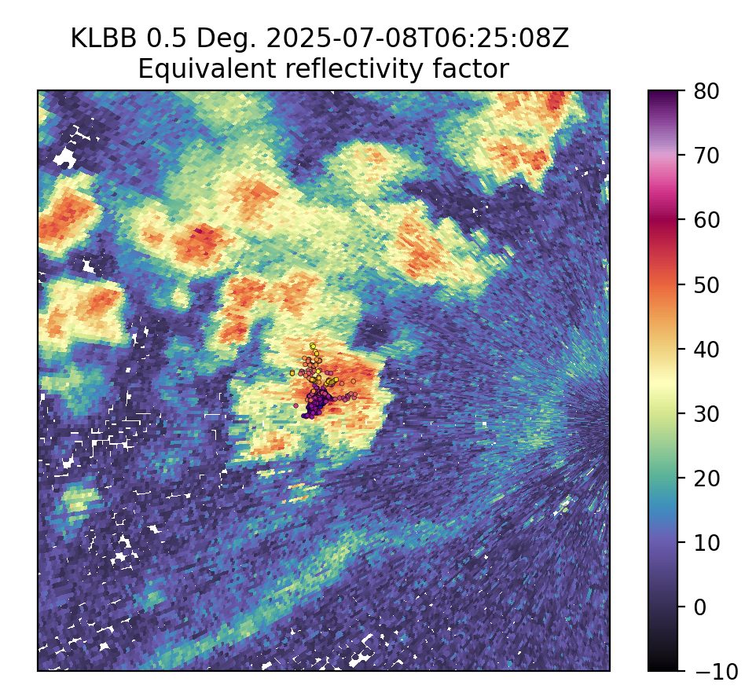
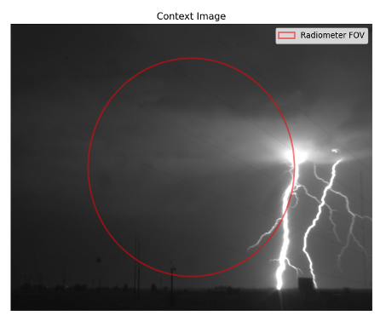
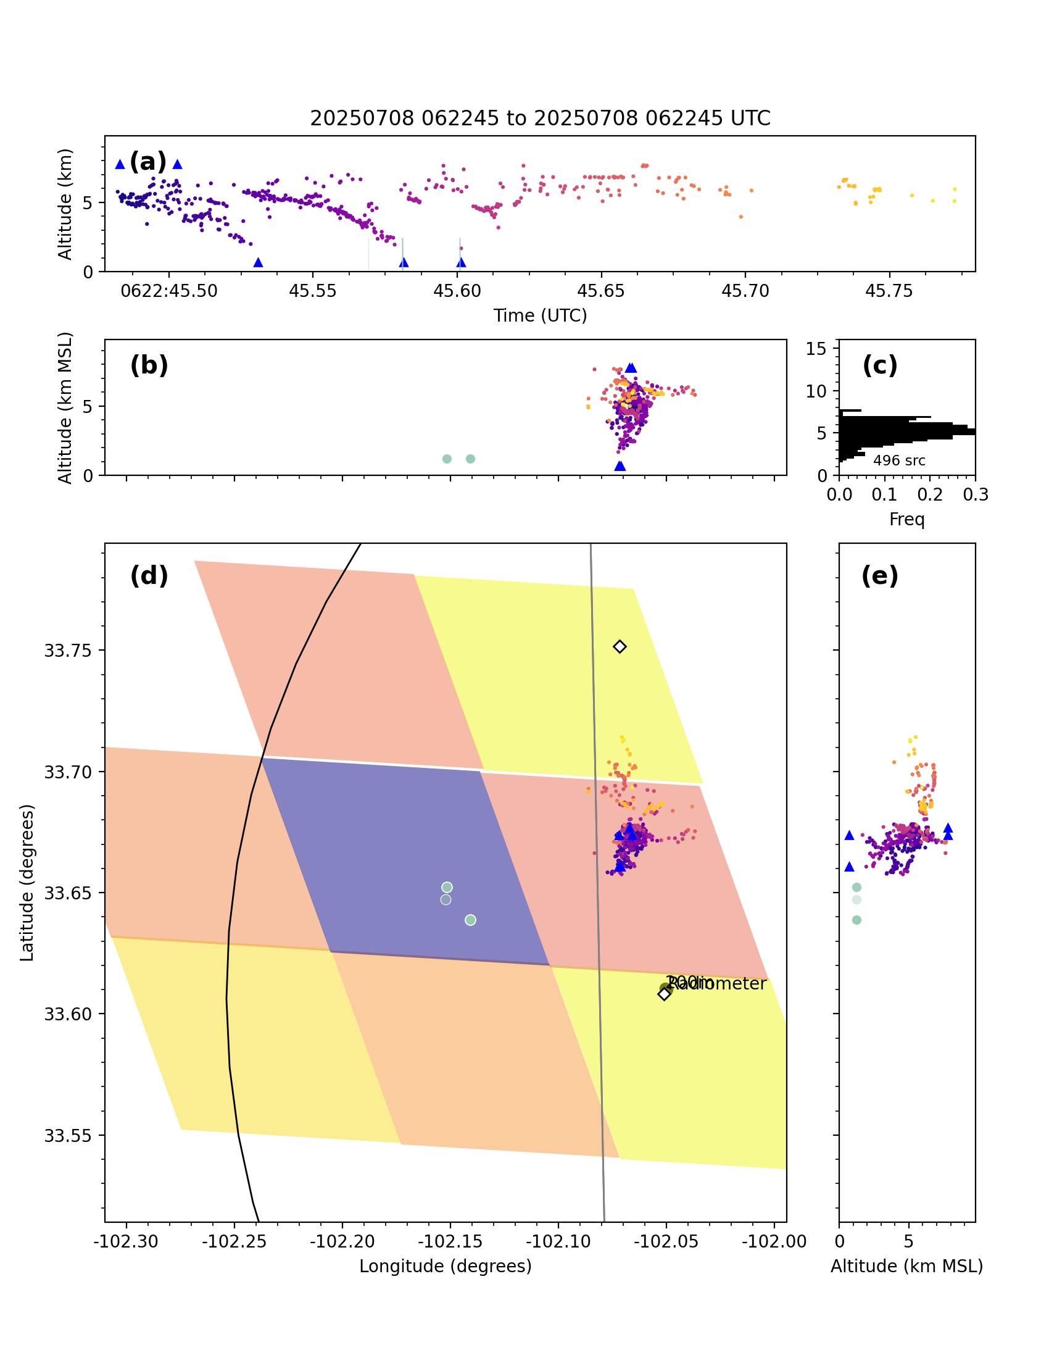
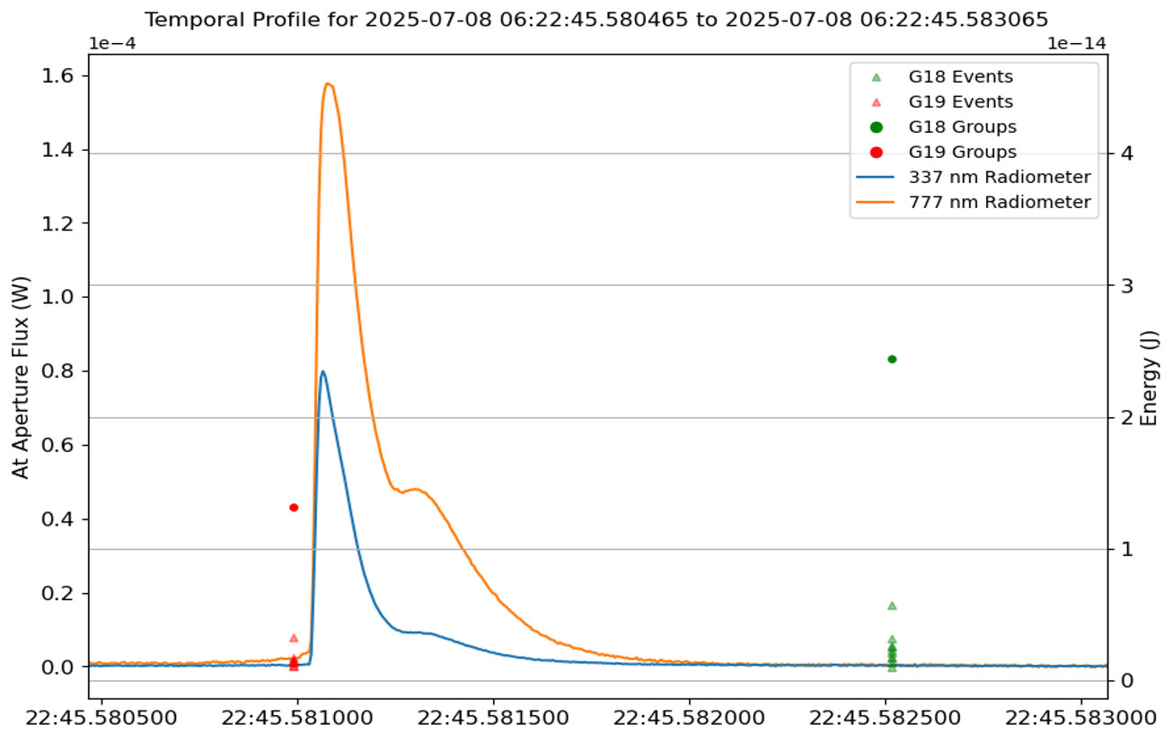
8 July 2025, 06:22:45 UTC: –CGs
A
B
C
D…
-15, -17, -9 kA CG strokes at A, B, C
Cloud/rain optical depth modifies the intensity of optical pulses observed at 777 nm by GLM and a radiometer at ground at about 10 km range.
A: Undetected by GLM-E, W but obvious in radiometer. Optically thicker cloud?
Intracloud event between A, B observed by GLM, radiometer
B, C: Both strokes clearly visible in all instruments. On the southern edge of convective core, so perhaps a better scattering path.
D: Apparent intracloud dart leaders without ground network detection. Only seen from GLM-W. About 20 ms of weak 777 pulses seen at radiometer. Slower field change as charge is rearranged in cloud.
bright
Square wave pattern is instrument artifact
no
mod
no
GLM-E
GLM-W
dim
Bright, mod
dim
ΔE
mod
dim
bright
rad.
Obs
site
B
C
A
C
A
B
B
2 ms
777 nm
A
B
C
Obs
Site
337 nm
Colored pixels: GLM-E total optical energy
Green dots / lines: GLM groups
Other dots: West Texas LMA channels

Slide 9
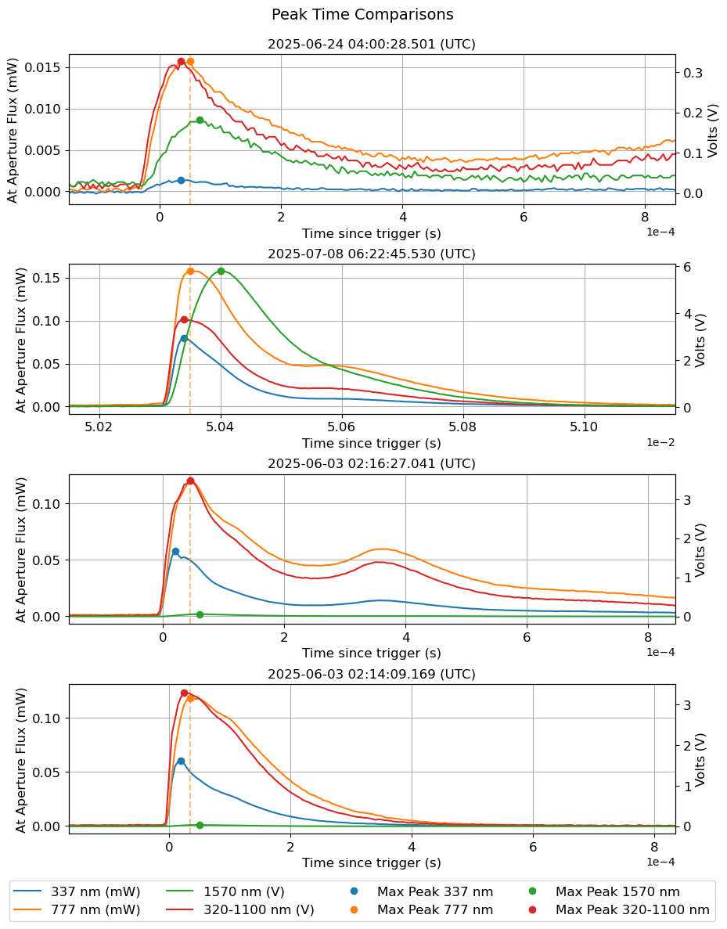
Pulse Analysis
Expected results: 337 nm band peak prior to 777 nm
Actual Observations: 337 nm band peak prior to all other bands*
*The 337 nm band matched the peak time of the wide band in the 7/08/2025 event
Peak Times (relative, µs)
Band | 6/3/2025 02:14:09 | 6/3/2025 02:16:27 | 6/24/2025 04:00:29 | 7/08/2025 06:22:45
337 nm | 20 | 20 | 35 | 40*
777 nm | 35 | 45 | 50 | 50
1570 nm | 50 | 60 | 65 | 100
320-1100 nm | 25 | 45 | 35 | 40*

Slide 10
Future work
Large-sample quantitative testing of optical scattering
Quantitatively test if radiometric measurements plus clouds structure can predict observed energy in space.
During CGs strokes, how much additional light is emitted within the cloud?
Explain why weaker optical pulses aren’t observed by current GLMs
Assess needed sensitivity of future instruments such as GEO-XO LMX.
After calibration, create an open dateset with DOI for slow antenna and LMA data.
Daily cloud variability
Obs of CGs with well-characterized source
Space obs
WRF-ELEC
microphysics
Calibrated
Radiometry
LMA + stroke source location
GLM E
energy at 777
GLM W energy at 777
Source energy at 777 nm
+
vs.
Homogeneous and heterogeneous cloud optical depth
+
Depth of cloud along path from radar
Predict energy emitted to space

Slide 11
Sandia National Laboratories is a multimission laboratory managed and operated by National Technology & Engineering Solutions of Sandia, LLC, a wholly owned subsidiary of Honeywell International Inc., for the U.S. Department of Energy’s National Nuclear Security Administration under contract DE-NA0003525.

