Slide 1
International Space Station Lightning Imaging Sensor (ISS LIS) –Final Orbit and Climatology Products
Timothy Lang¹
ISS LIS Mission Scientist
Coauthors: Daniel Cecil¹, Douglas Mach², Katrina Virts³, Dennis Buechler³, Martino Marisaldi⁴
¹Earth Science Branch, NASA MSFC, Huntsville, AL
²Universities Space Research Association, Huntsville, AL
³University of Alabama in Huntsville, Huntsville, AL
⁴University of Bergen, Bergen, Norway

Slide 2
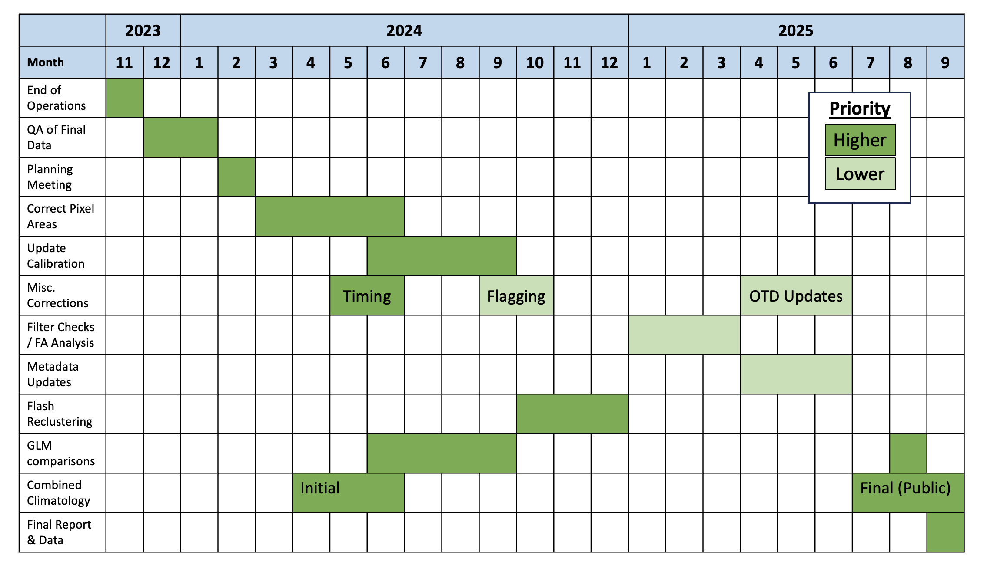
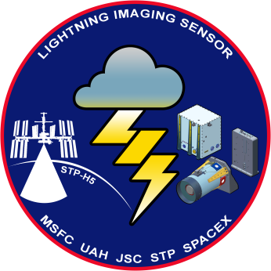
ISS LIS Mission Status
ISS LIS instrument was decommissioned and put into storage on 16 November 2023
Transferred to NG-20 Cygnus spacecraft and deorbited (i.e., burned up) on 12 July 2024
Mission is completing Phase F/Closeout
Final climatology data submitted to GHRC

Slide 3
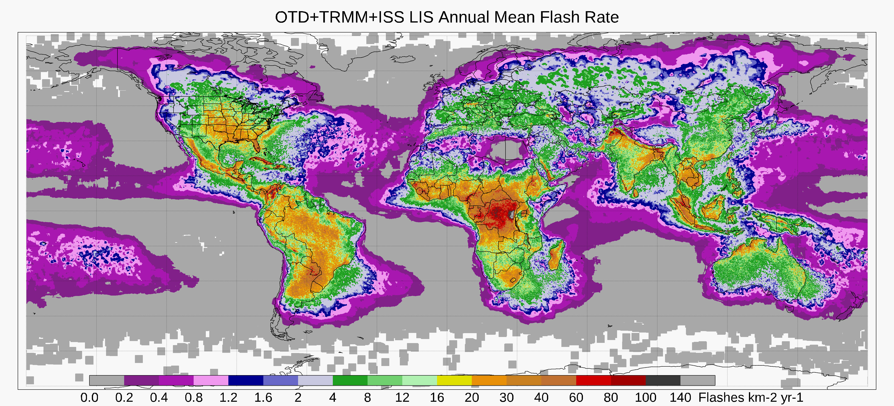
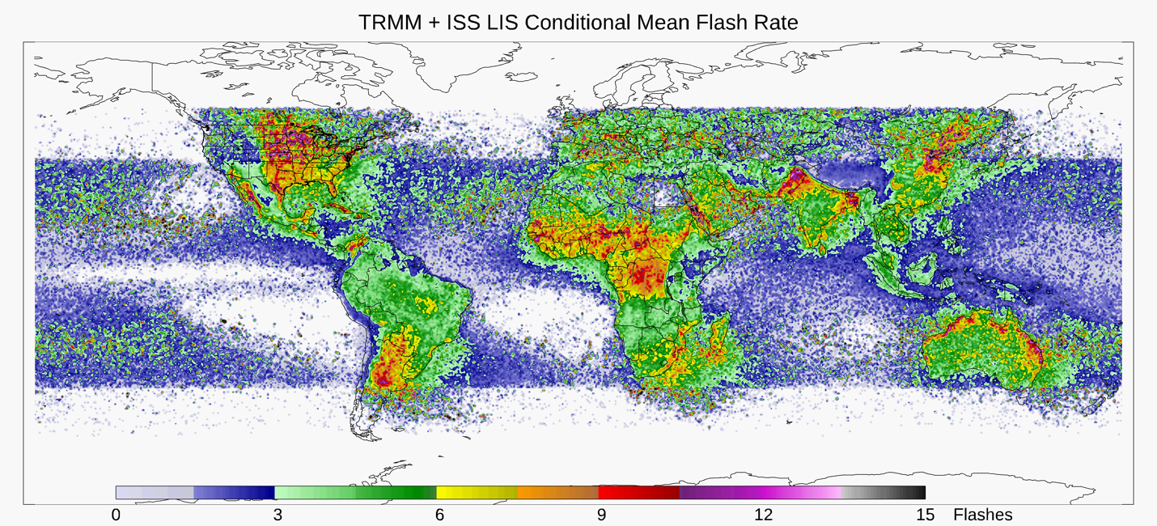
Combined Climatology
Version 1 climatologies have been delivered to GHRC DAAC and are in pre-publication stage http://dx.doi.org/10.5067/LIS/LISCLIMO/DATA101
Native 0.1° resolution, straightforward to coarsen spatial resolution to support increased temporal resolution
Usual Monthly, Seasonal, Annual, Diurnal, etc. climatologies; OTD, TRMM, ISS, Combined
Two supporting articles (Cecil et al. 2025a, b) have been submitted to JAMC and BAMS

Slide 4
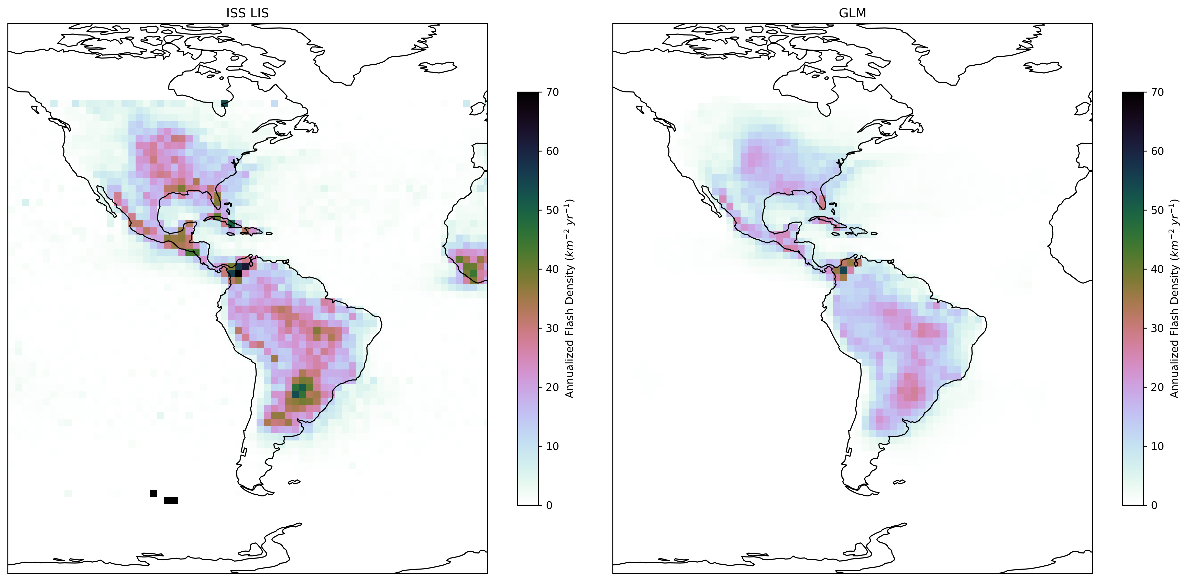
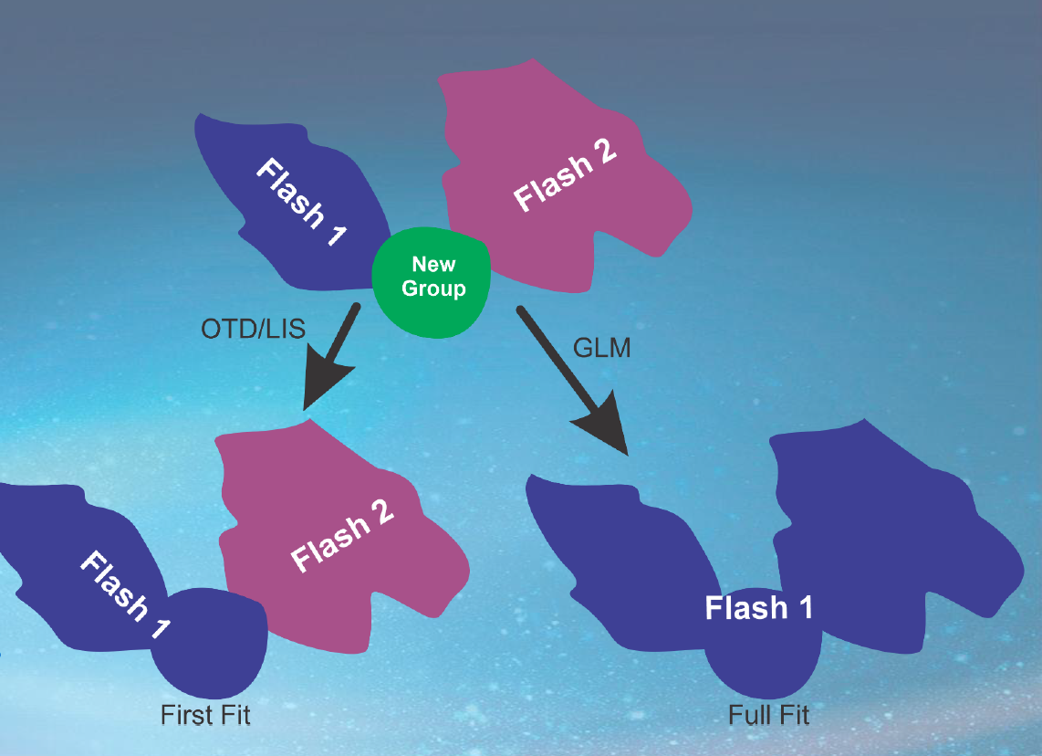
GLM-like Reclustering
2018-2022
ISS LIS flash climatology has ~30% more flashes than GLM, most of which is attributable to ISS detecting more flashes than GLM within common spatiotemporal FOV
Reclustering following GLM approach (full fit vs. first fit) with no restrictions on group numbers can reduce LIS flashes by ~10-20%
Reclustering within LIS operational code led to unforeseen complexities, so reclustering will be done post hoc, and subsequent v2 climatologies will be designated as experimental (Q1 FY26)
ISS LIS
GLM

Slide 5
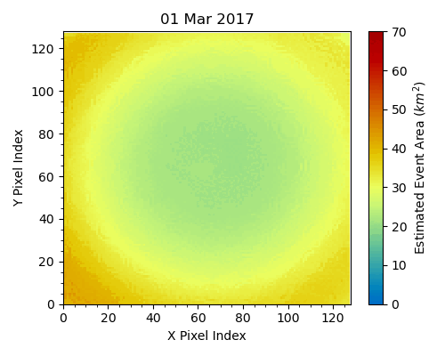
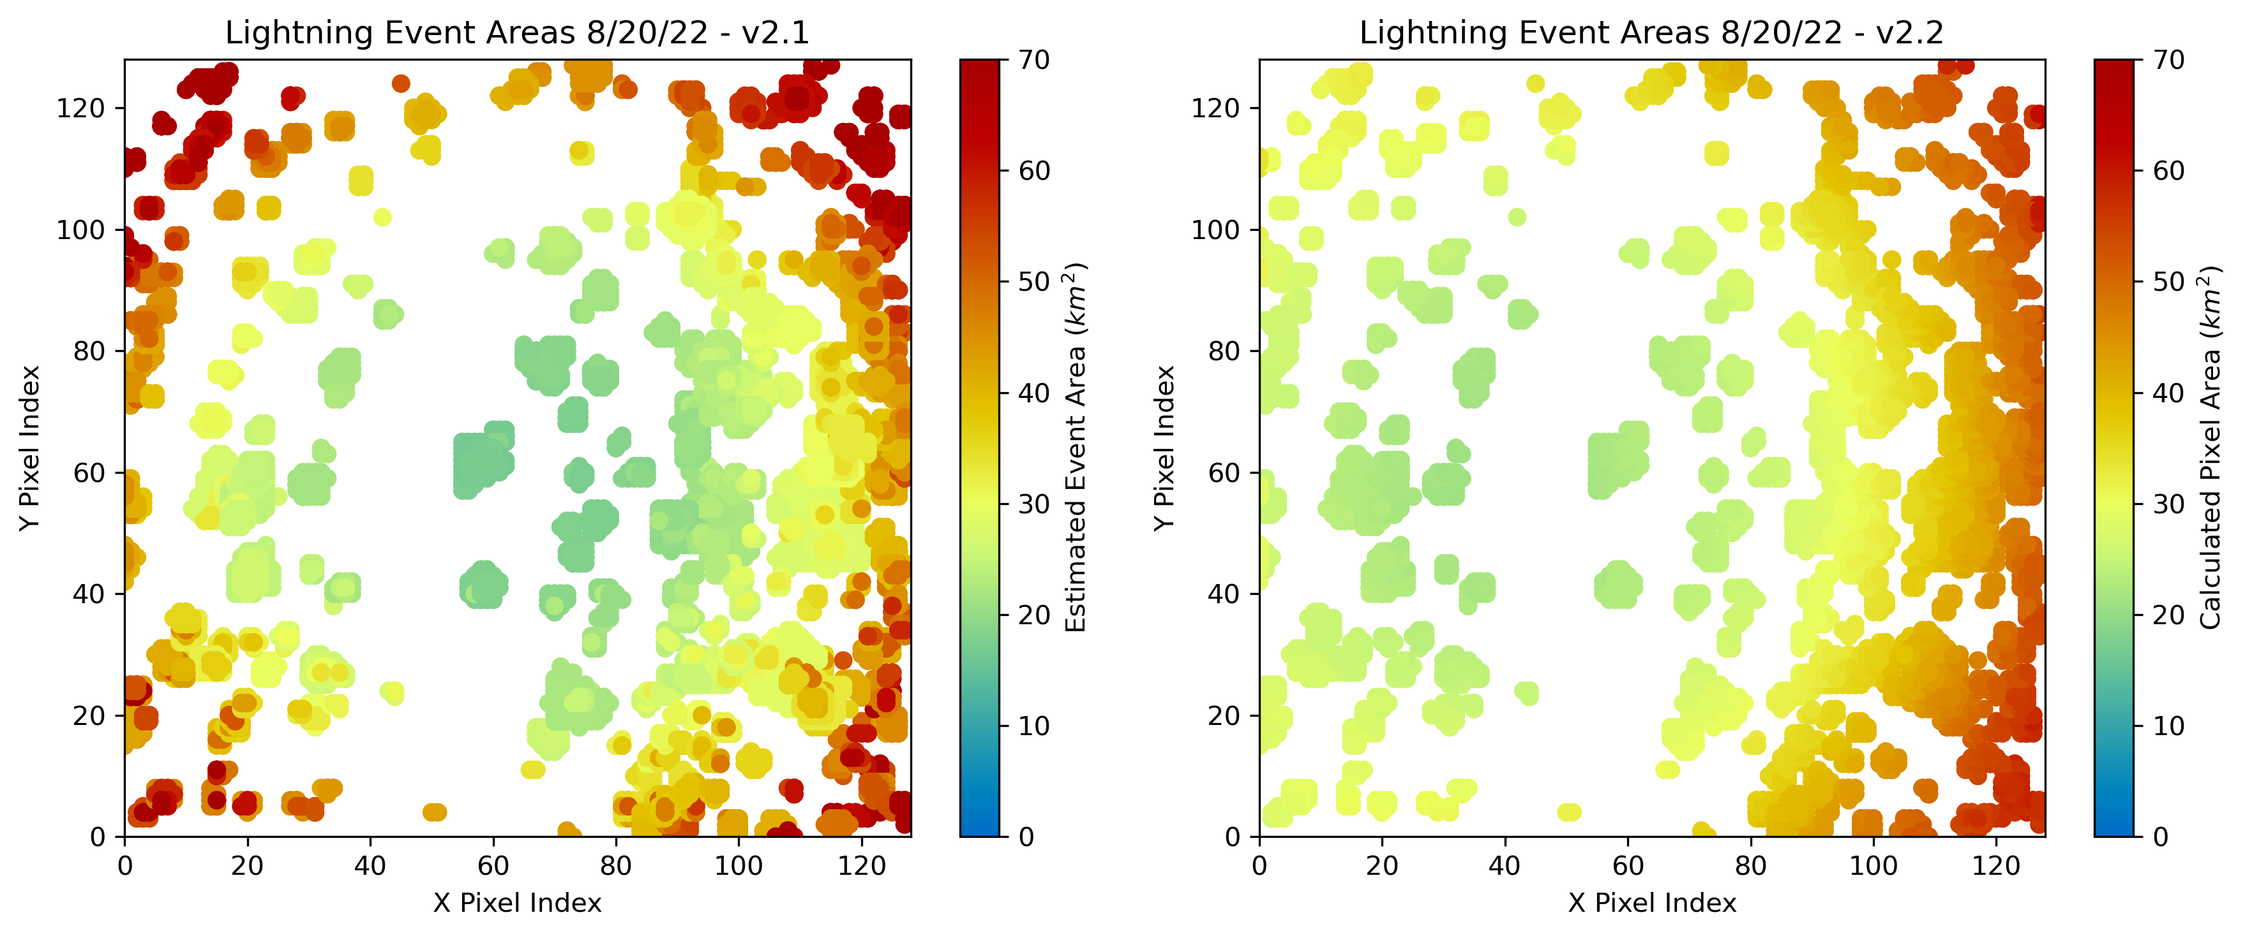
Correction of Pixel Areas
Original LIS algorithm uses trigonometric approximation to estimate pixel (and thus event/group/flash) areas – poor off-boresight performance
Fully geolocated correction implemented as time-varying lookup table for ISS and TRMM; reduces E/G/F size by ~10-20%
Old
New
Processing ISS and TRMM LIS orbit granules now to create v3 ISS and v5 TRMM LIS orbit files, to be complete by ~9/30

Slide 6
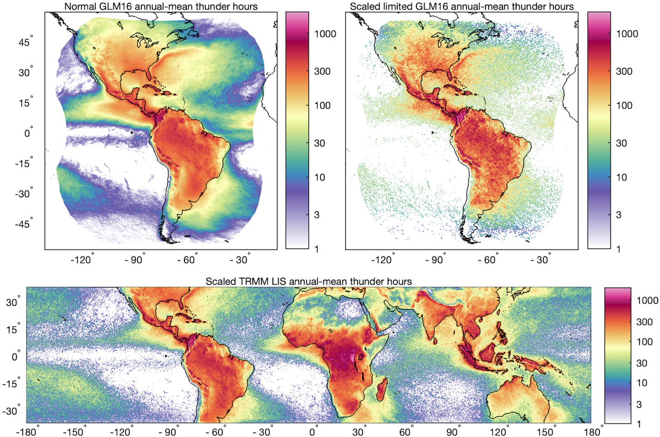
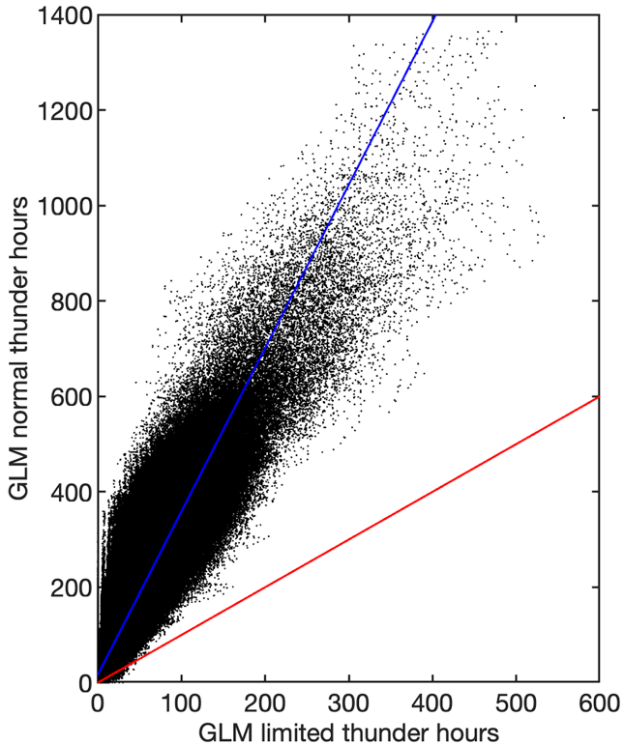
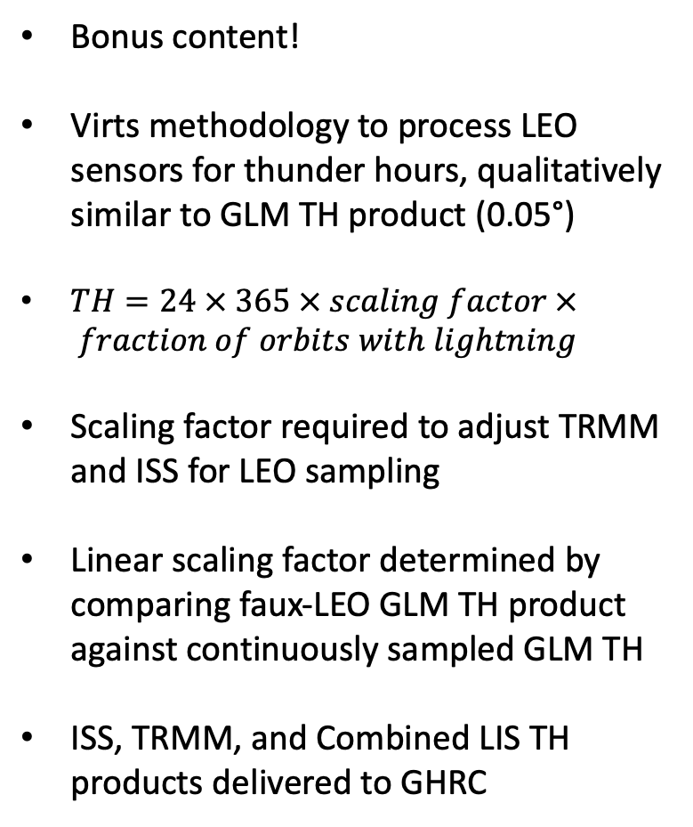
TRMM and ISS LIS Thunder Hours
Bonus content!
Virts methodology to process LEO sensors for thunder hours, qualitatively similar to GLM TH product (0.05°)
$TH=24 × 365 × scaling factor × fraction of orbits with lightning$
Scaling factor required to adjust TRMM and ISS for LEO sampling
Linear scaling factor determined by comparing faux-LEO GLM TH product against continuously sampled GLM TH
ISS, TRMM, and Combined LIS TH products delivered to GHRC

Slide 7
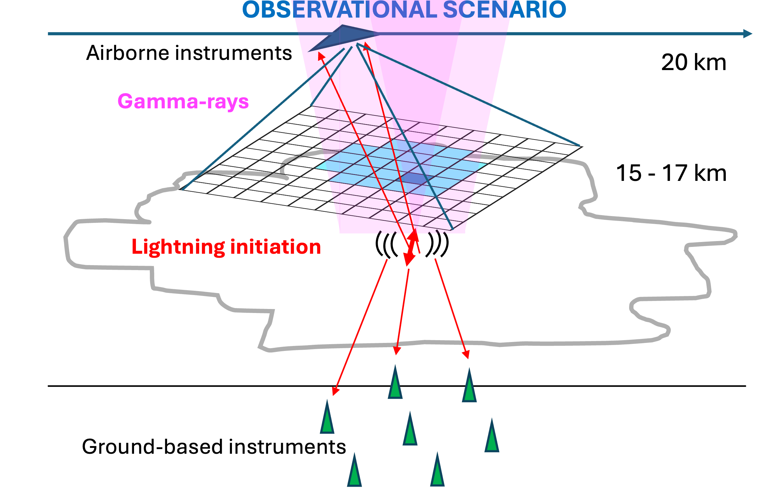
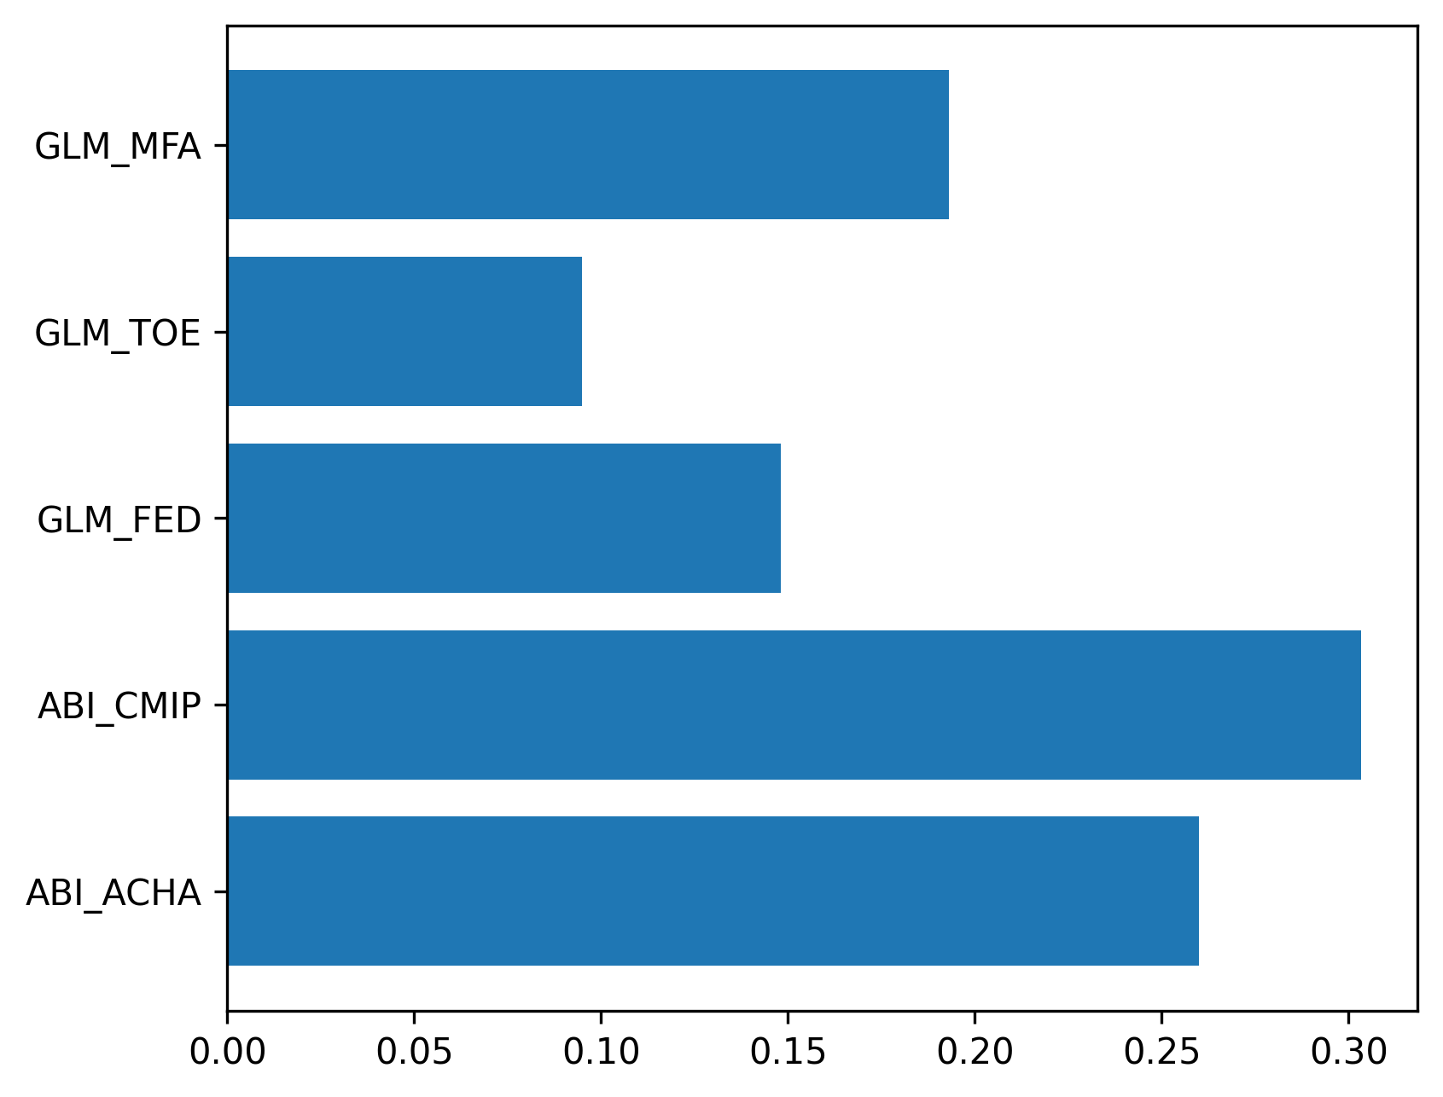
ENLIGHTEN 2028
Funded by ERC and on ER-2’s calendar for July 2028
ConOps modeled on ALOFT (incl. FL deployment)
Core ALOFT lightning payload – FEGS, EFCM, LIP
New instruments
Gamma-ray imaging via pinhole camera and collimated detectors (UIB/NRL)
Airborne VHF interferometer (Duke)
Notable additional possibilities
Sandia lightning spectrometer(s)
Goddard CoSMIR-H (hyperspectral microwave)
Possible mission science enhancement:
Gamma-ray glow prediction product in MTS
Random forest glow predictor using ALOFT dataset
POD – 93%
FAR – 12%

Slide 8
Summary and Future Steps
ISS LIS Phase F is completing essentially on schedule, final v1 climatology datasets already delivered
Updated ISS (v3) and TRMM (v5) LIS orbit granules with corrected footprints but no reclustering due soon at GHRC
Experimental reclustered climatologies (v2) to be delivered in Q1 of FY26; will *not* subsume the v1 products, but instead will be available alongside
TRMM and ISS LIS Thunder Hour products delivered to GHRC
ENLIGHTEN (ALOFT follow-on) will use the ER-2 to study gamma rays again in July 2028; likely to provide another excellent GLM validation dataset
Check out new BAMS article for ALOFT-based LIS & GLM-16/18 validation using FEGS/LIP: https://doi.org/10.1175/BAMS-D-24-0060.1

