Slide 1
Current Research and Future Plans at the Severe Storms Research Center (SSRC)
Michael Peterson, J.D. Burke, Jessica Losego, Levi Boggs Severe Storms Research Center (SSRC) Georgia Tech Research Institute
Margaret Needham University of Georgia

Slide 2
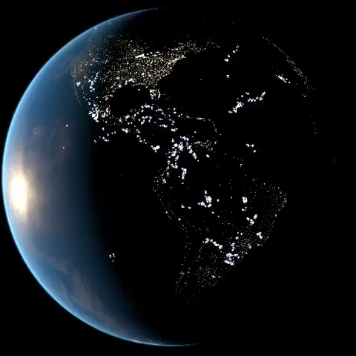
Lightning Detection for Severe Weather Monitoring
Lightning products inform the state of convection
Lightning Jumps (or other signatures) preceding severe weather events
Variations in flash structure between convective and non-convective clouds
Geostationary Lightning Mapper (GLM) lightning detection
Coarse hemispheric 2D lightning maps
Gridded products derived from flash structure diluted by scattering
Lightning Mapping Array (LMA) lightning detection
Fine regional 3D lightning maps
Gridded lightning products
Weather Research and Forecasting (WRF-ELEC) model simulations
Regional simulated gridded products
Expanded validation needed
[1] LA-UR-21-31100

Slide 3
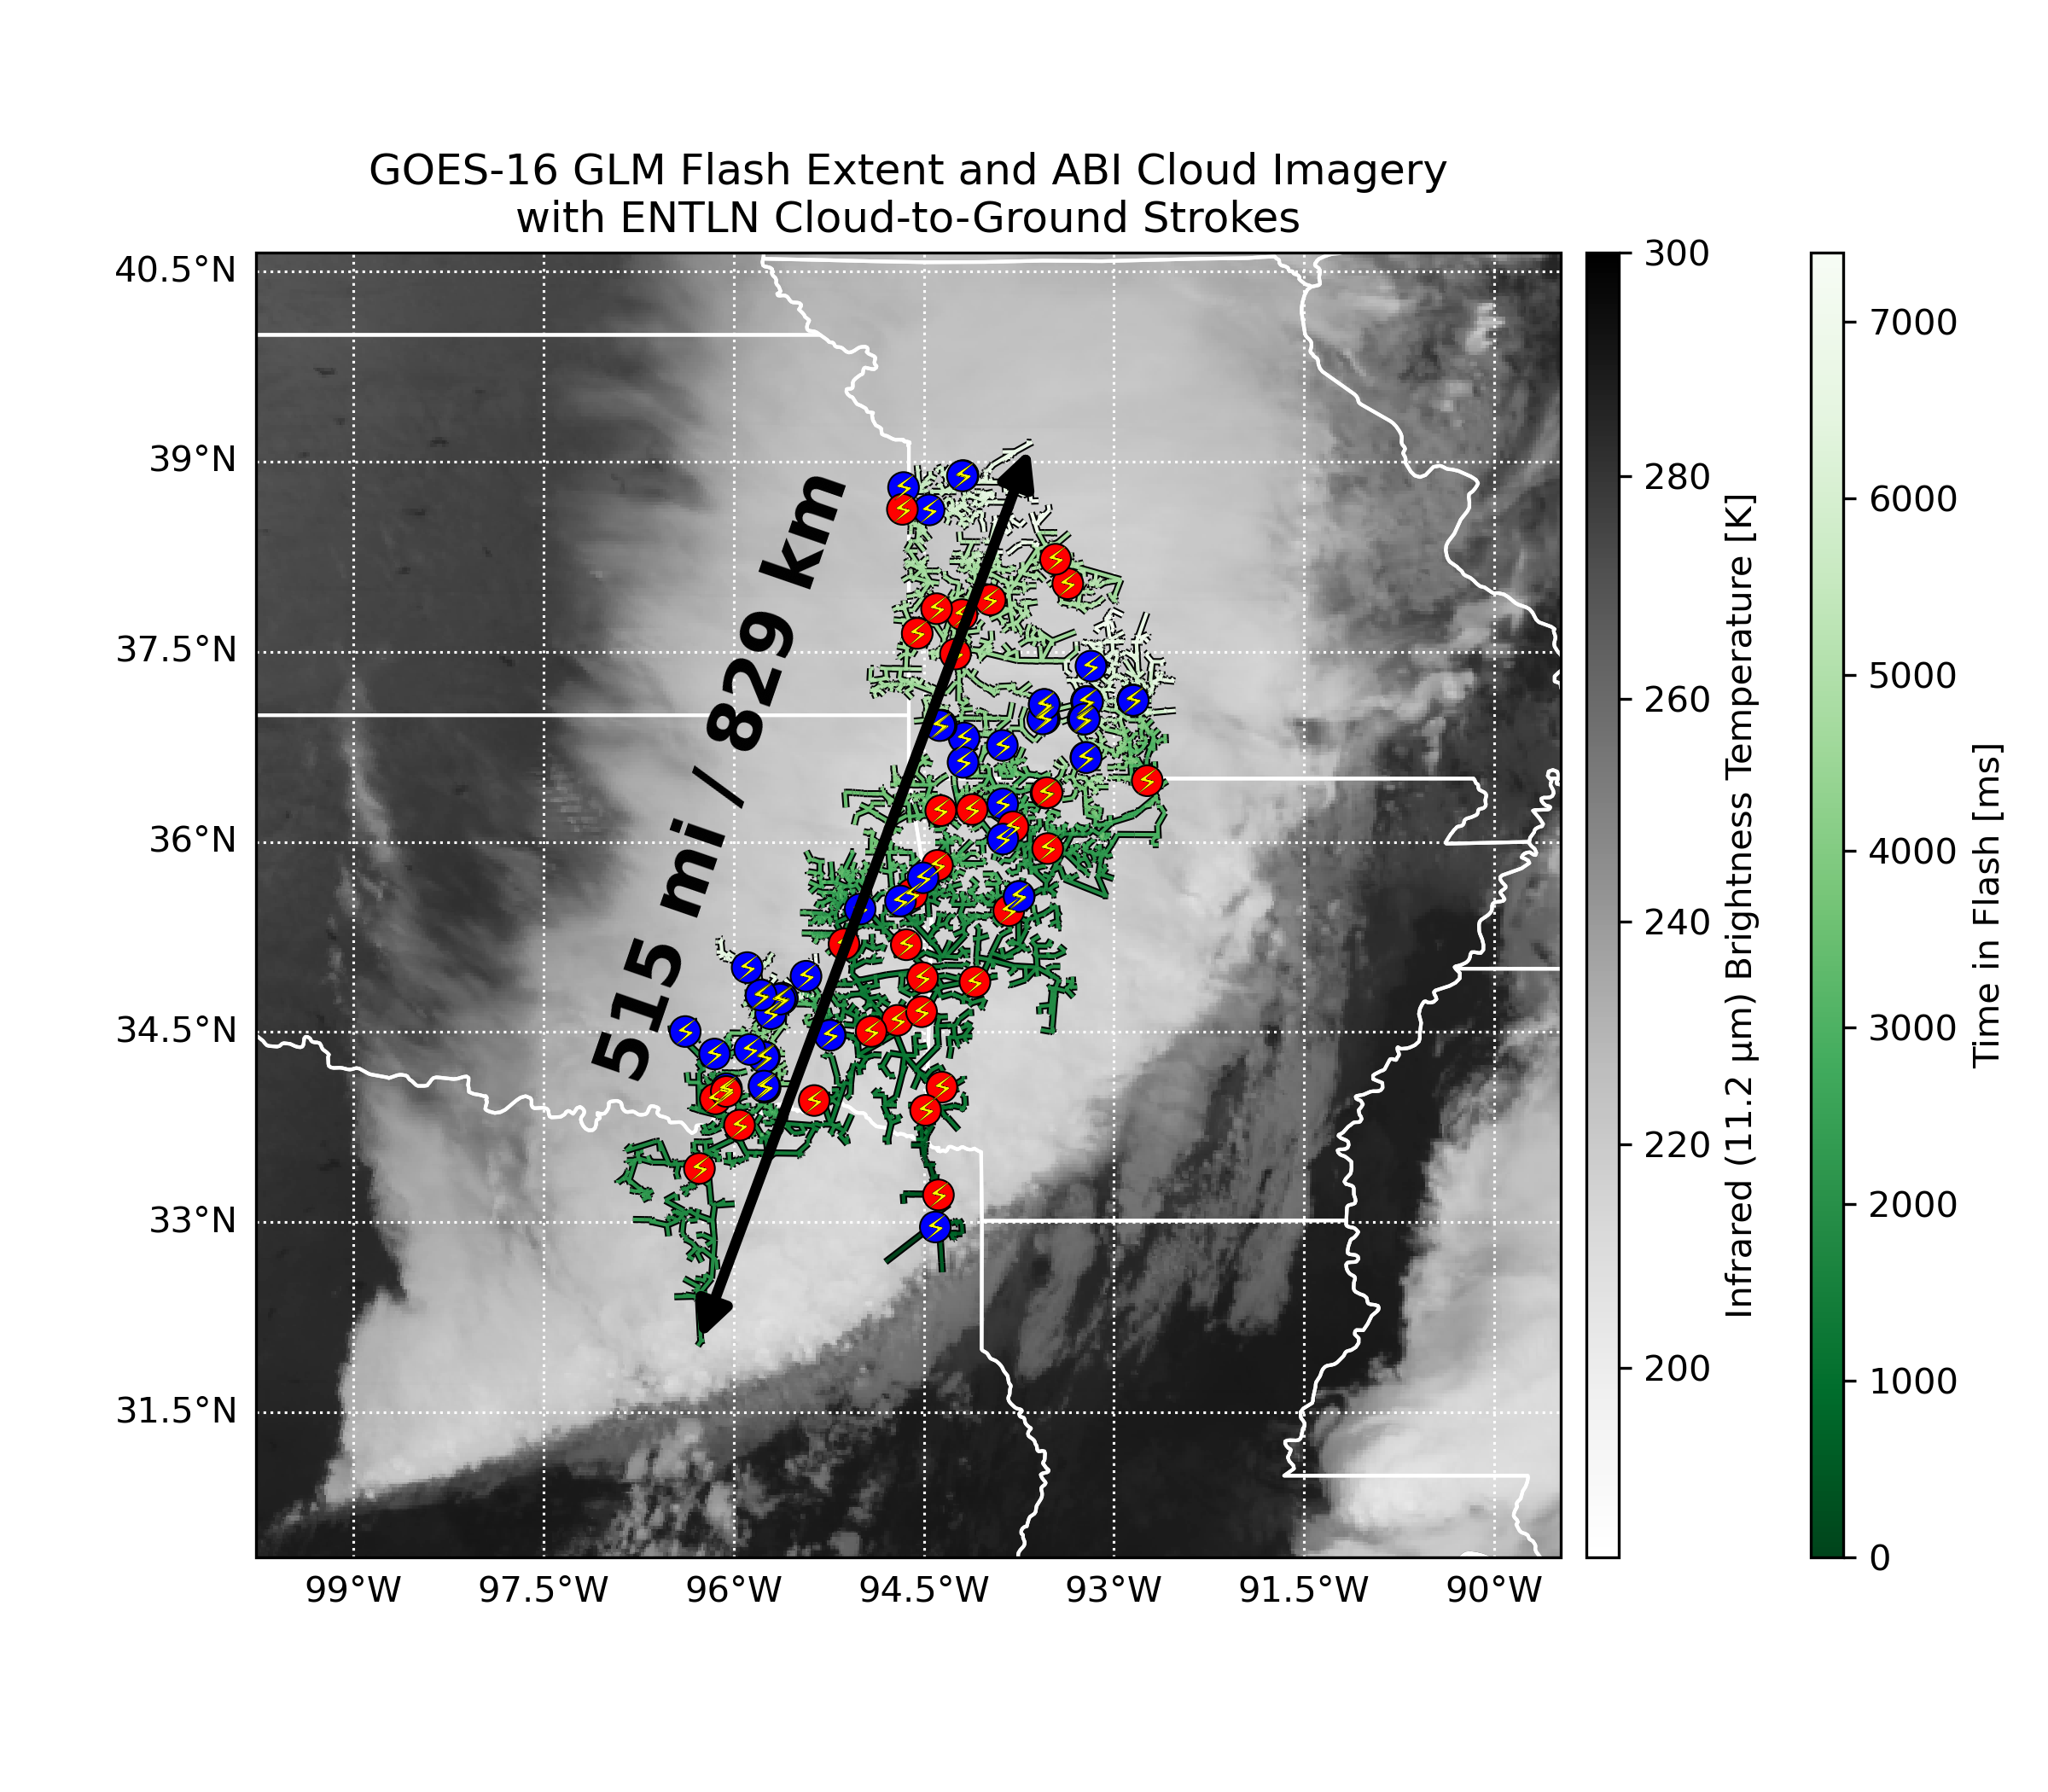
Mapping Flash Structure: A New Record Megaflash
New clustering codes presented at last year’s GLM Science Meeting now applied to full GLM data record
Identified a new record megaflash for flash extent:
October 22, 2017
829 km extent from near Dallas to Kansas City
7.39 s duration
Initiated in convective line, propagated through electrified stratiform region
Produced >100 CG strokes (right)
Included both –CGs (blue) and +CGs (red)
Some CGs had peak currents >100 kA
Far behind the convective line, CGs are “bolts from the grey”

Slide 4
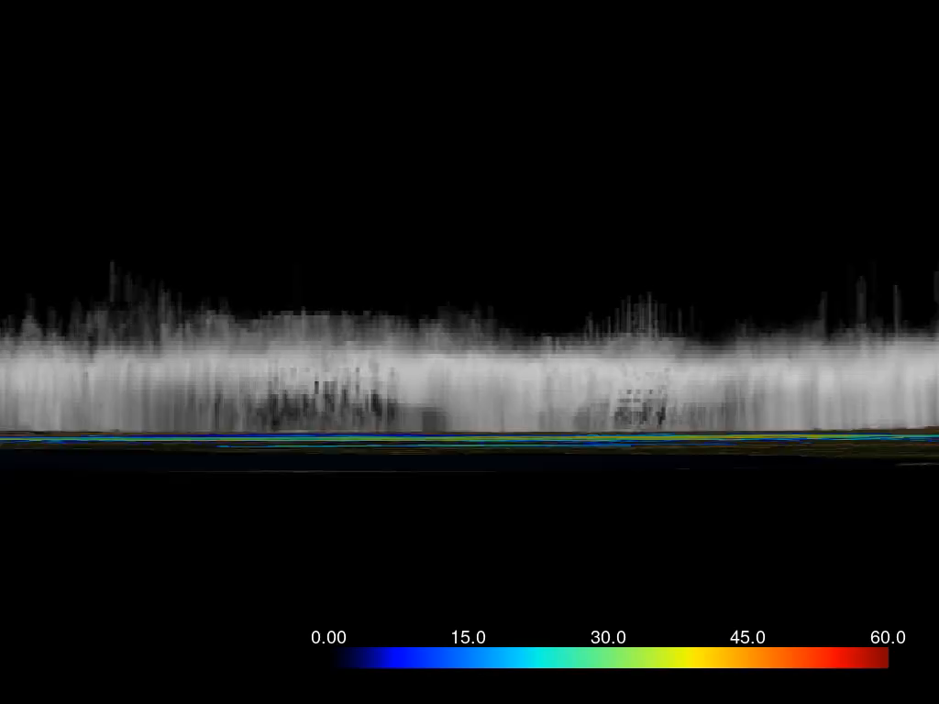
A New Record for Megaflash Extent
NEXRAD Merged Composite Reflectivity

Slide 5
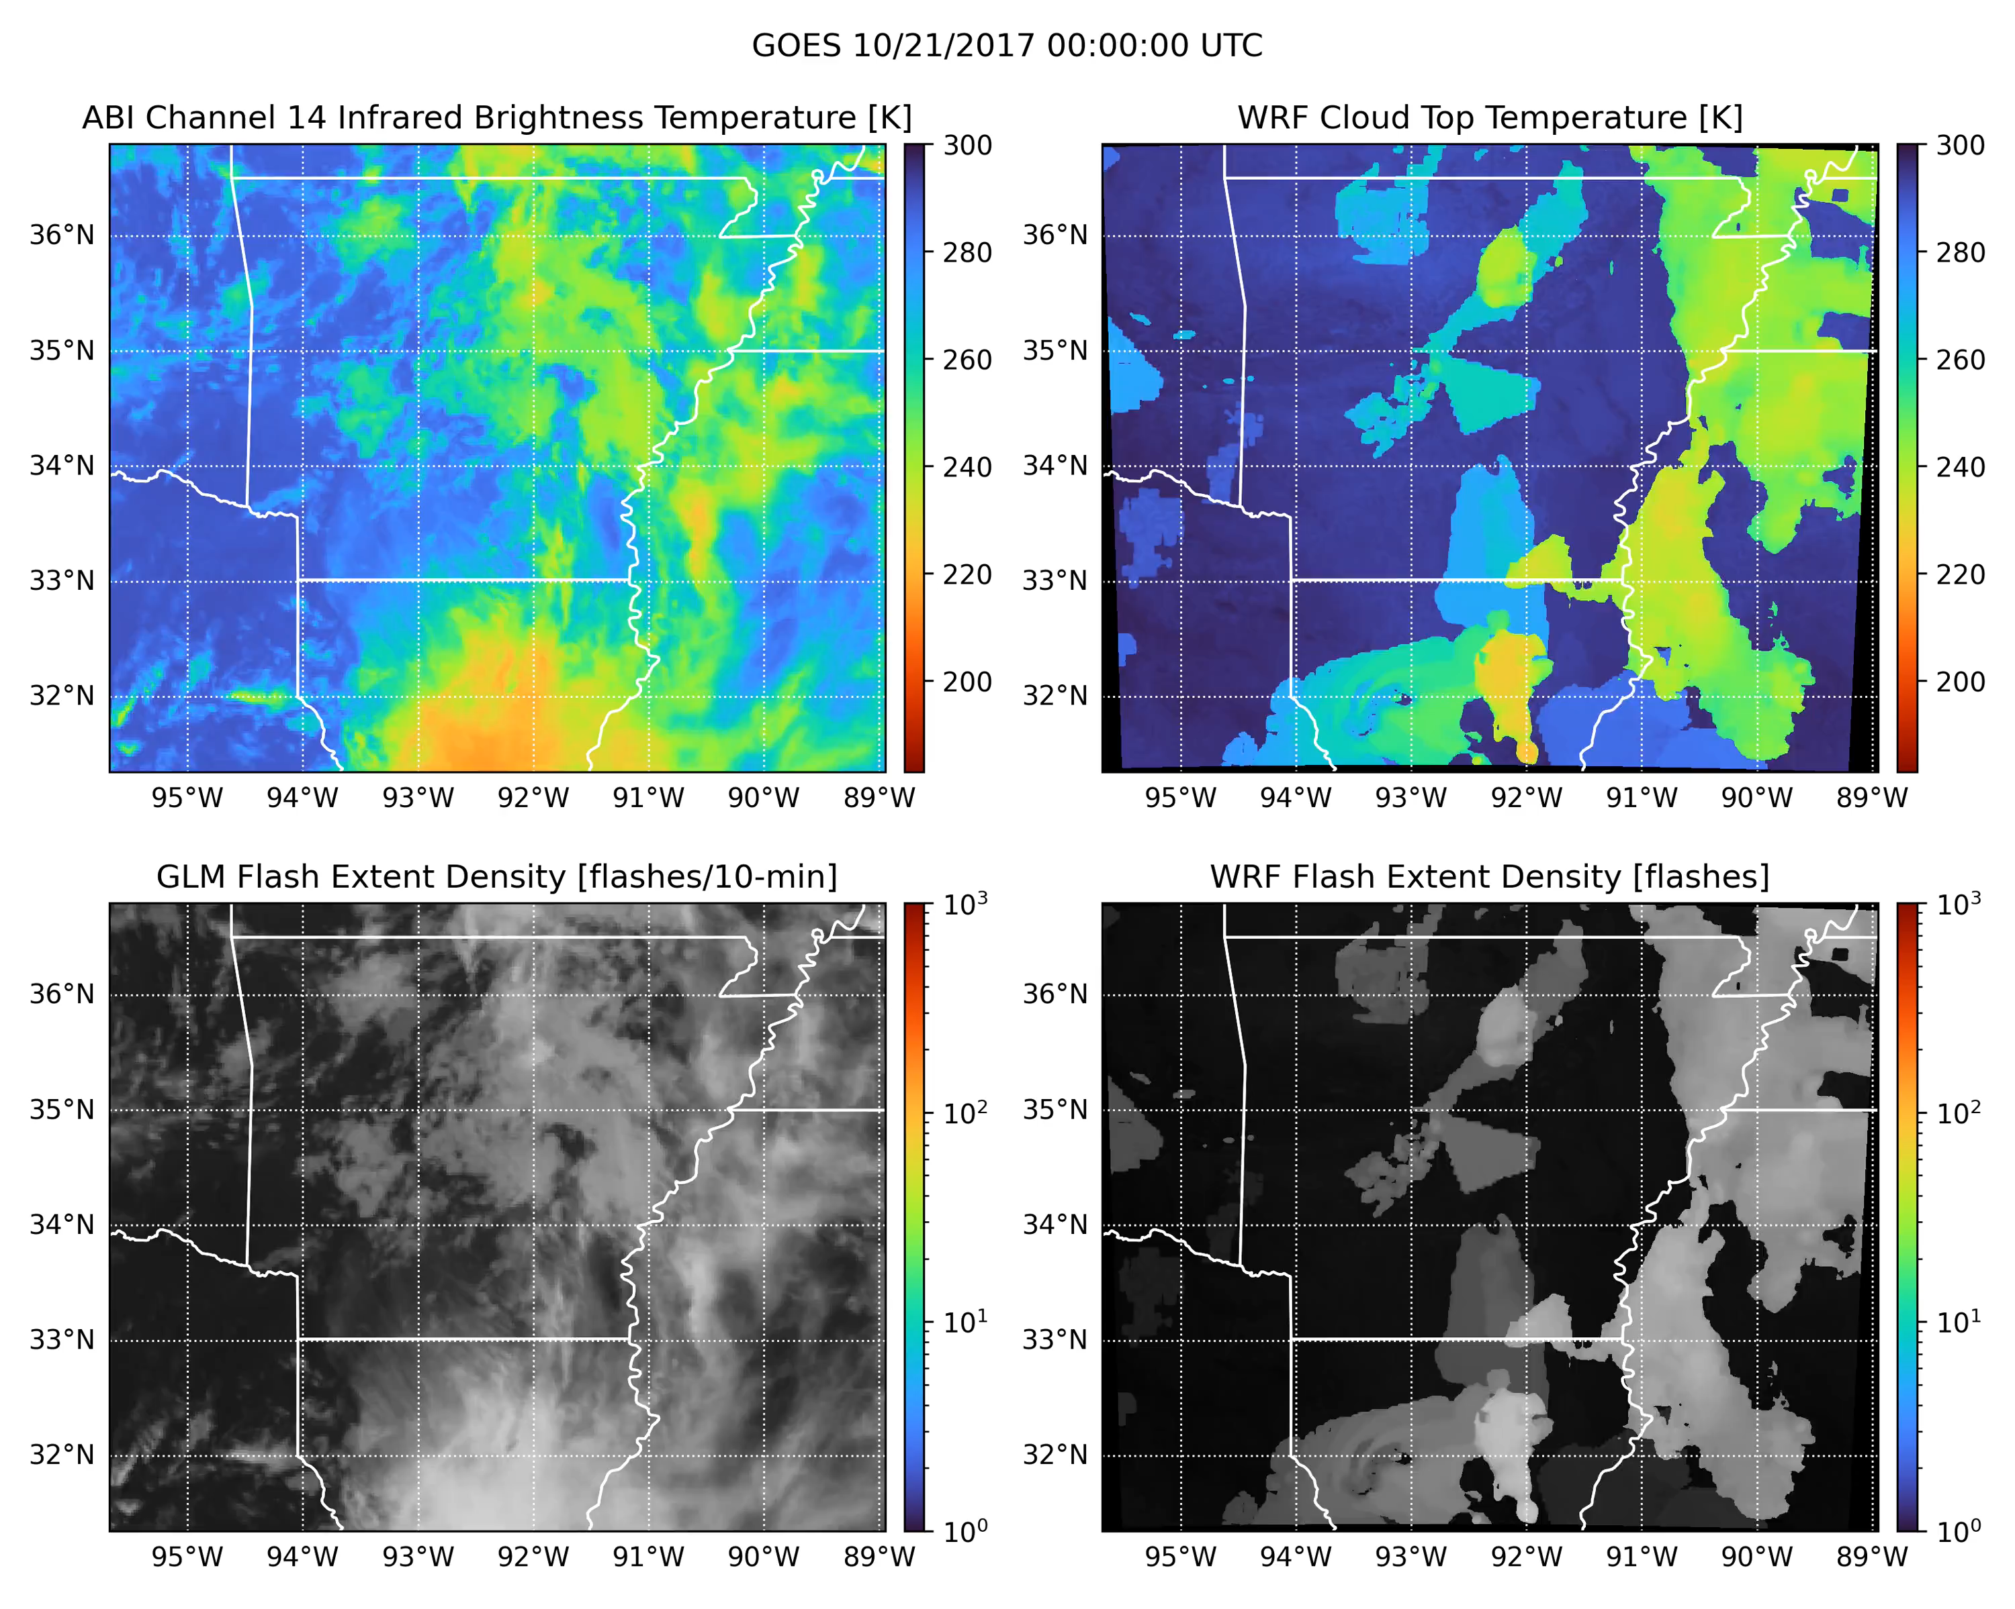
WRF-ELEC Simulations of Megaflash-Producing Storms
We are simulating diverse thunderstorm events in WRF-ELEC to understand its performance across storm modes
Events include land / ocean / summer / winter megaflash-producing storms
October 22, 2017 case highlighted:
Left: GOES-16 ABI infrared brightness temperature and GLM Flash Extent Density (FED)
Right: WRF-ELEC cloud-top temperature and FED
WRF-ELEC captures lightning activity in convective line and stratiform region
Stratiform flashes smaller than observed
WRF-ELEC creates localized stratiform discharges
Majority of stratiform cloud does not experience lightning in WRF-ELEC

Slide 6
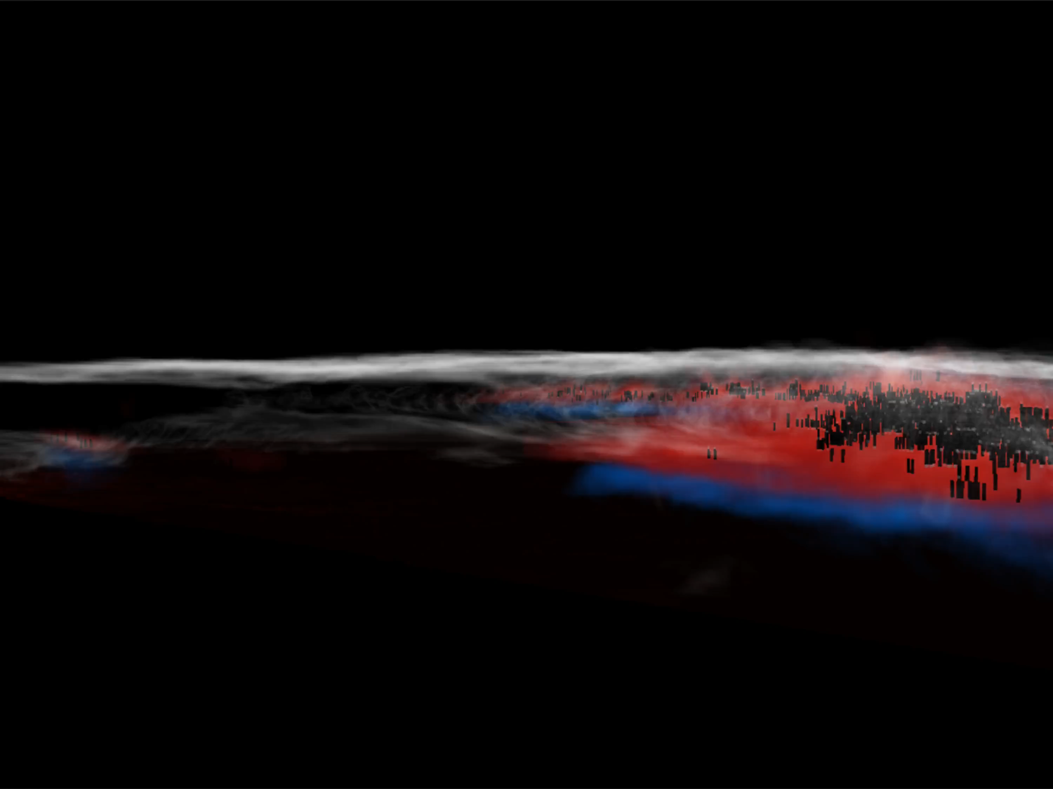
WRF-ELEC Simulation of the October 22, 2017 Event
Red: Positive points, Blue: Negative points, Black: Flash initiations
White: reflectivity-weighted cloud boundaries
Surface contour: Convective Available Potential Energy (CAPE)

Slide 7
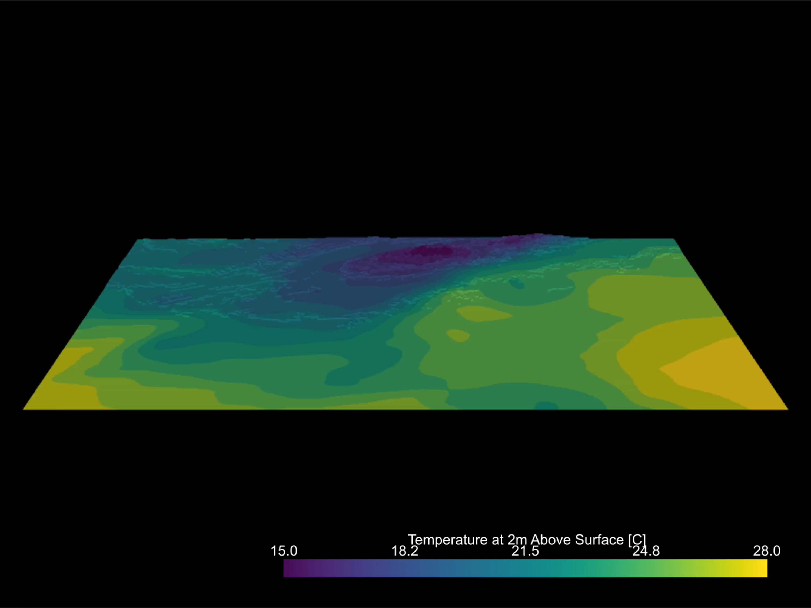
WRF-ELEC Simulation of Hurricane Helene

Slide 8
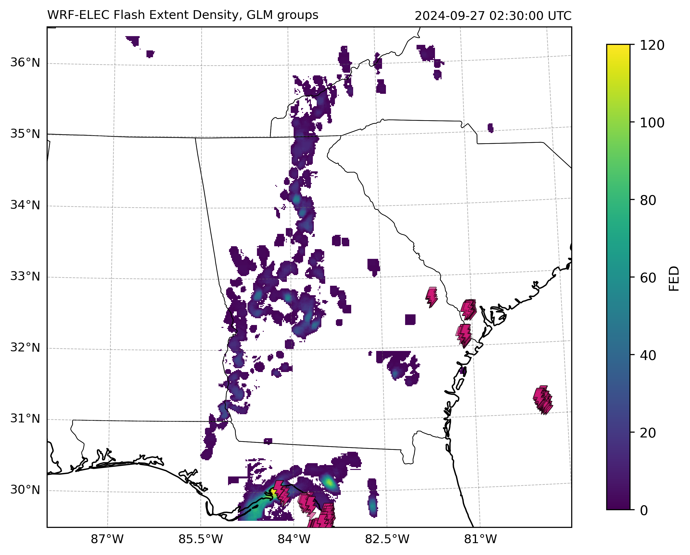
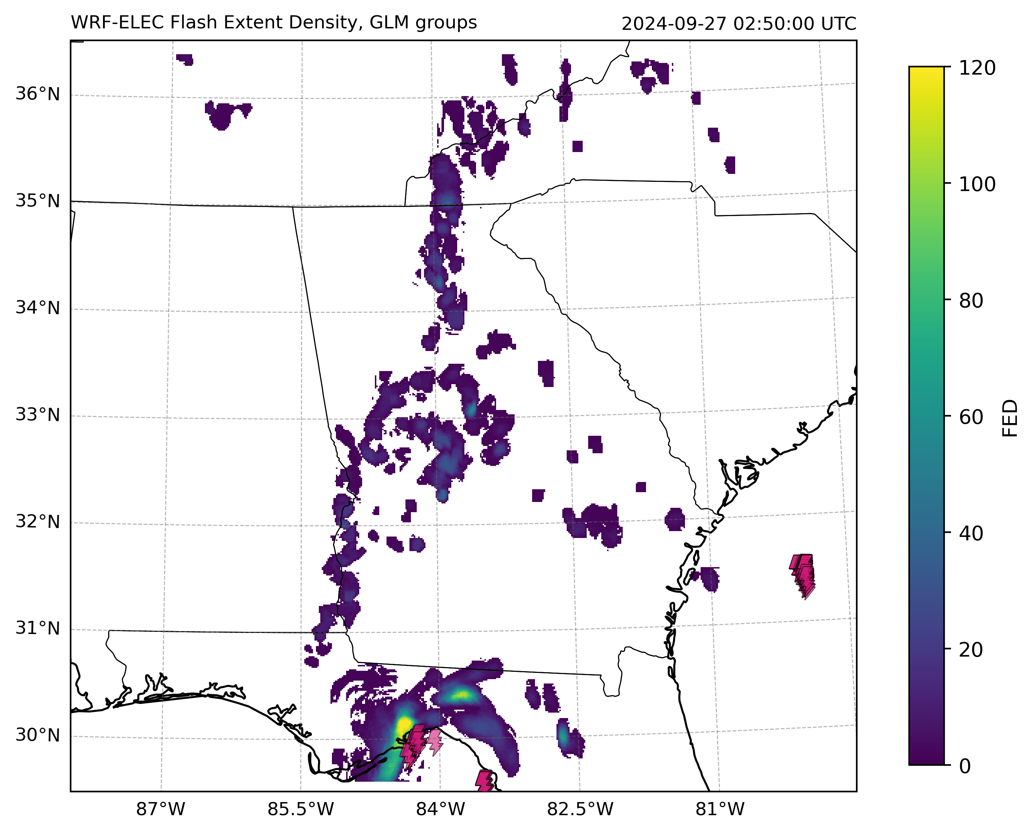
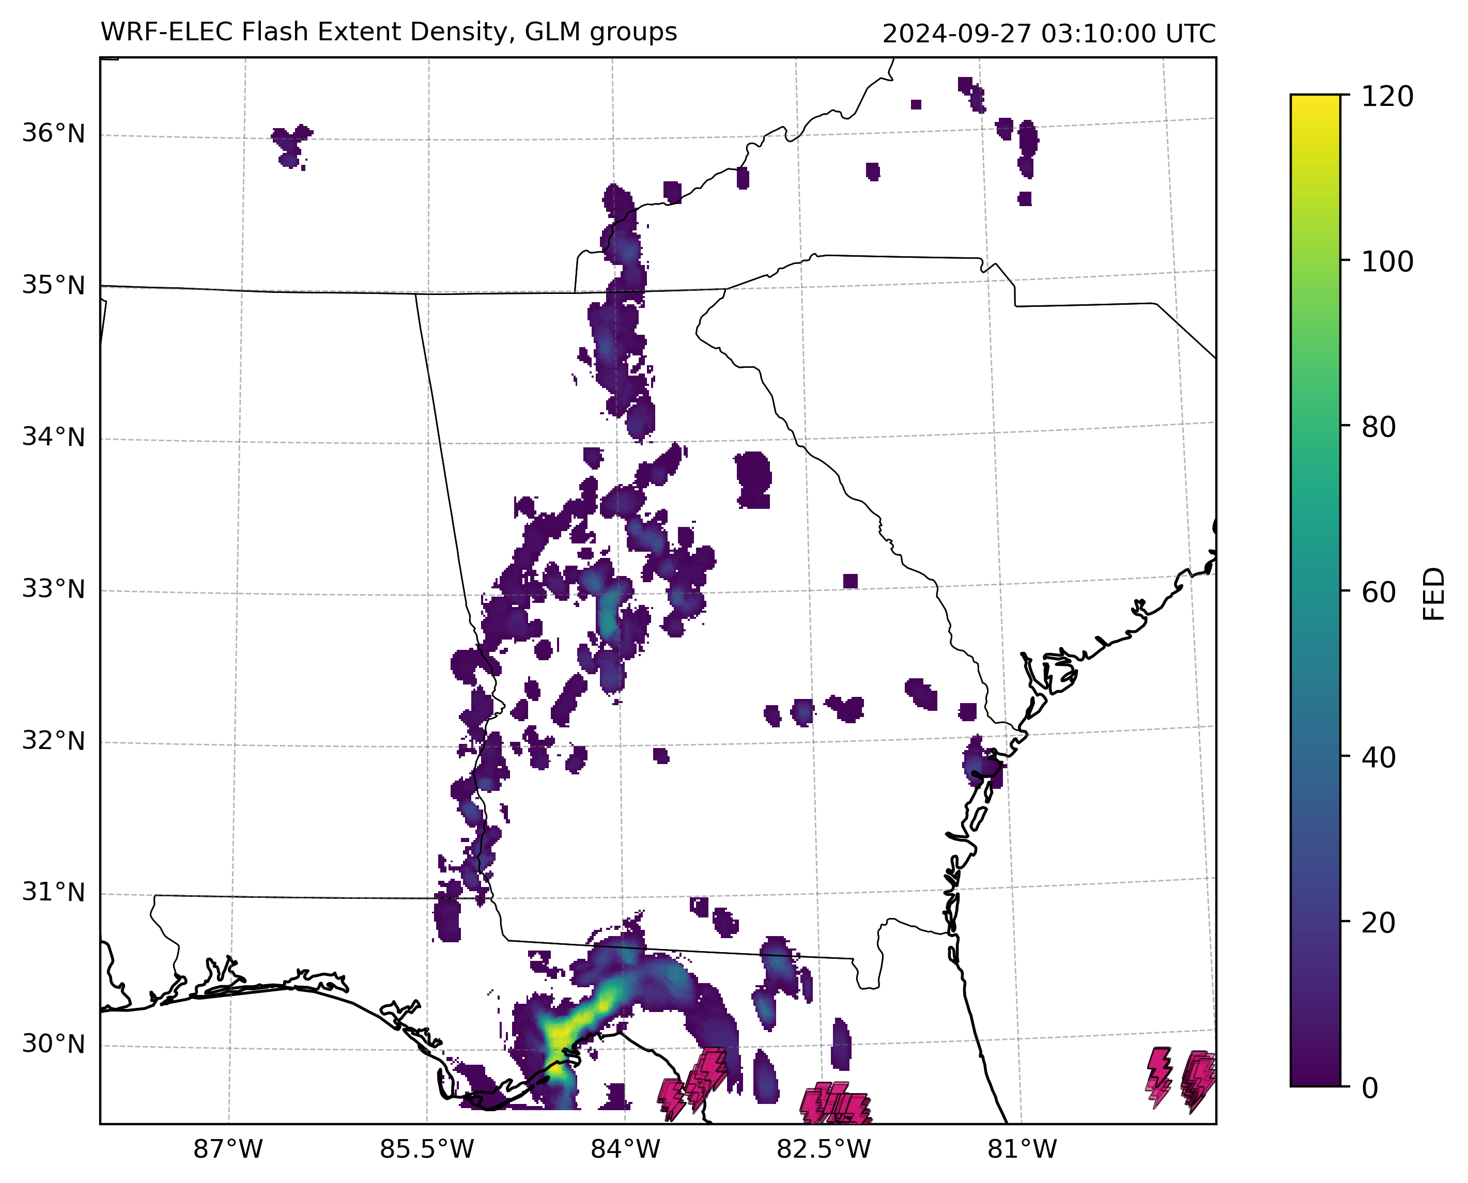
WRF-ELEC Simulation of Hurricane Helene (cont.)
Undergraduate research through the 2025 Georgia Tech EAS Summer REU Program
Initial qualitative assessment of WRF-ELEC outputs for the TC Helene case
Compared WRF-ELEC simulated radar reflectivity and FED with MRMS and GLM observations, focusing on spatiotemporal correspondence
Found that intensity and flash production generally agreed with observed data prior to landfall, but were overestimated post-landfall

Slide 9
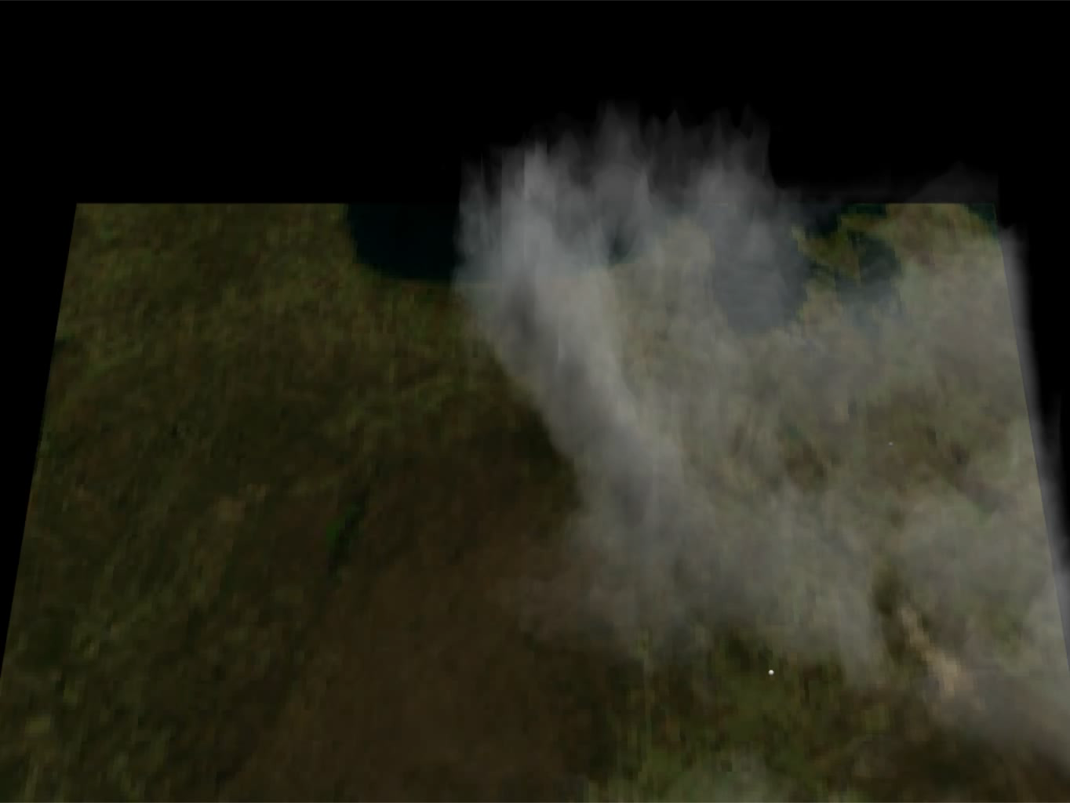
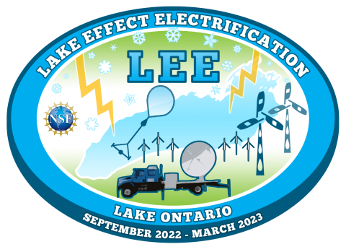
LMA: Lake Effect Long-Horizontal Winter Lightning

Slide 10
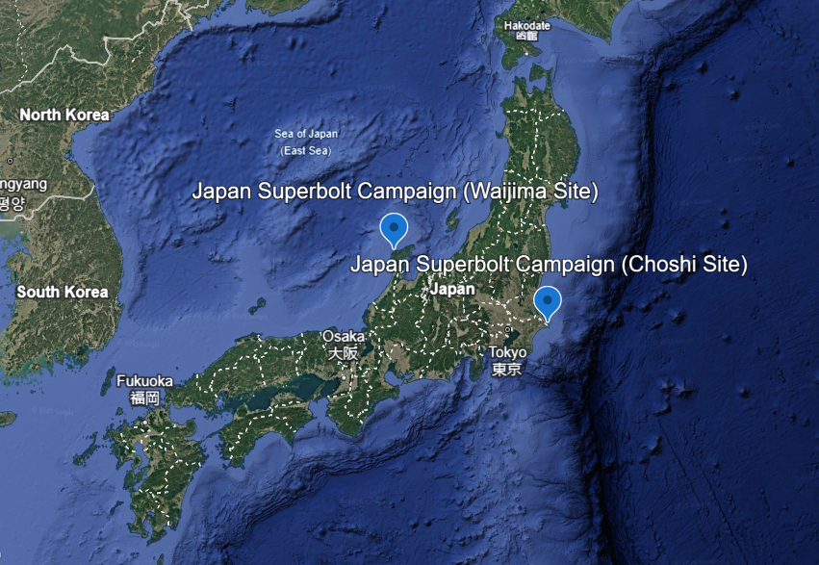
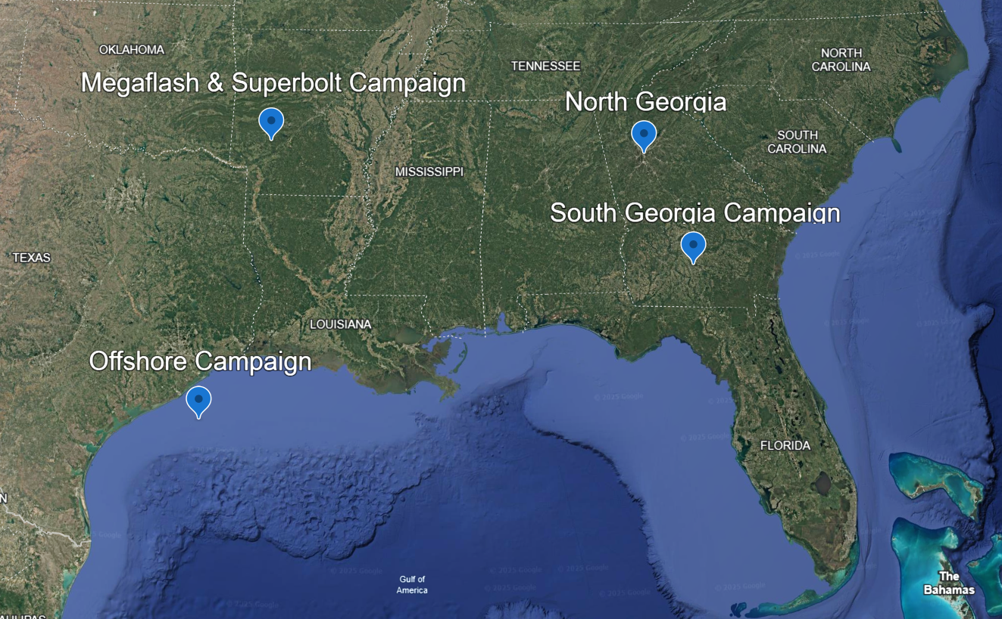
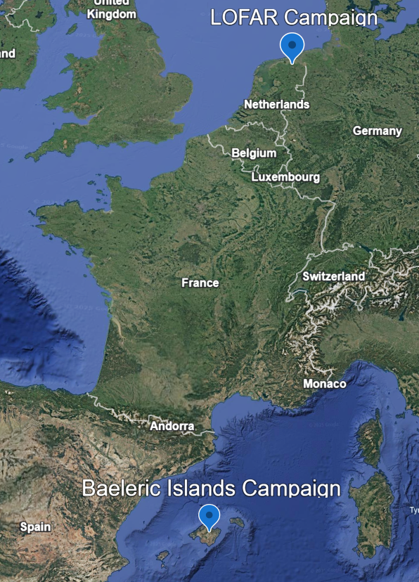
Future LMA Collaboration Ideas
Targets:
Large megaflashes (500+ km)
Multiple LMAs fully map flashes
Targets:
Fine-scale breakdown processes
Numerical modeling
Optical scattering effects
Targets:
Sea of Japan versus Pacific differences in superbolts, flashes, and storms
Targets:
Intense maritime thunderstorms
Changes in electrification in storms moving onshore / offshore
Hurricanes transitioning to land
Severe weather situational awareness for agriculture
Targets:
Intense oceanic thunderstorms
High-altitude Narrow Bipolar Events (NBEs)
Seawater attachment CG strokes
Targets:
Mediterranean megaflashes and superbolts
Environmental forcings on Mediterranean lightning phenomena
Intense oceanic thunderstorms
Suggestions, feedback, and
collaboration welcome!

Slide 11
Conclusion
The SSRC maintains core research capabilities with the LMA, multiple weather radars, and space-based sensors including GLM
North Georgia LMA operations in the Atlanta area
Participation in field deployments such as LEE
The SSRC plans to improve upon and expand our core research capabilities
LMA field site augmentation
Radar measurements of lightning channels
GLM reprocessing, ground network integration, and new lightning product generation
Through new efforts and collaborations, the SSRC aims to stand up new capabilities to support the severe weather research community and other stakeholders
Specialized WRF-ELEC simulations (e.g., high-resolution, coupling with hydrologic or ionosphere models, or unique applications like Electro-Magnetic signal propagation)
Micro-scale weather sensing for disaster resilience
“FulminoSat” formation for ionospheric sensing

Slide 12
Questions?
[1] LA-UR-21-31100

