Slide 1
Identifying Lightning Ignited Wildfires Earlier
Scott Rudlosky, NOAA/NESDIS/GEO
Joseph Patton, UMD/ESSIC/CISESS
Tanya Noiplab, KSU/CS
Ruoming Jin, KSU/CS
Daile Zhang, UND/AS
GLM Science Meeting – 2 September 2025

Slide 2
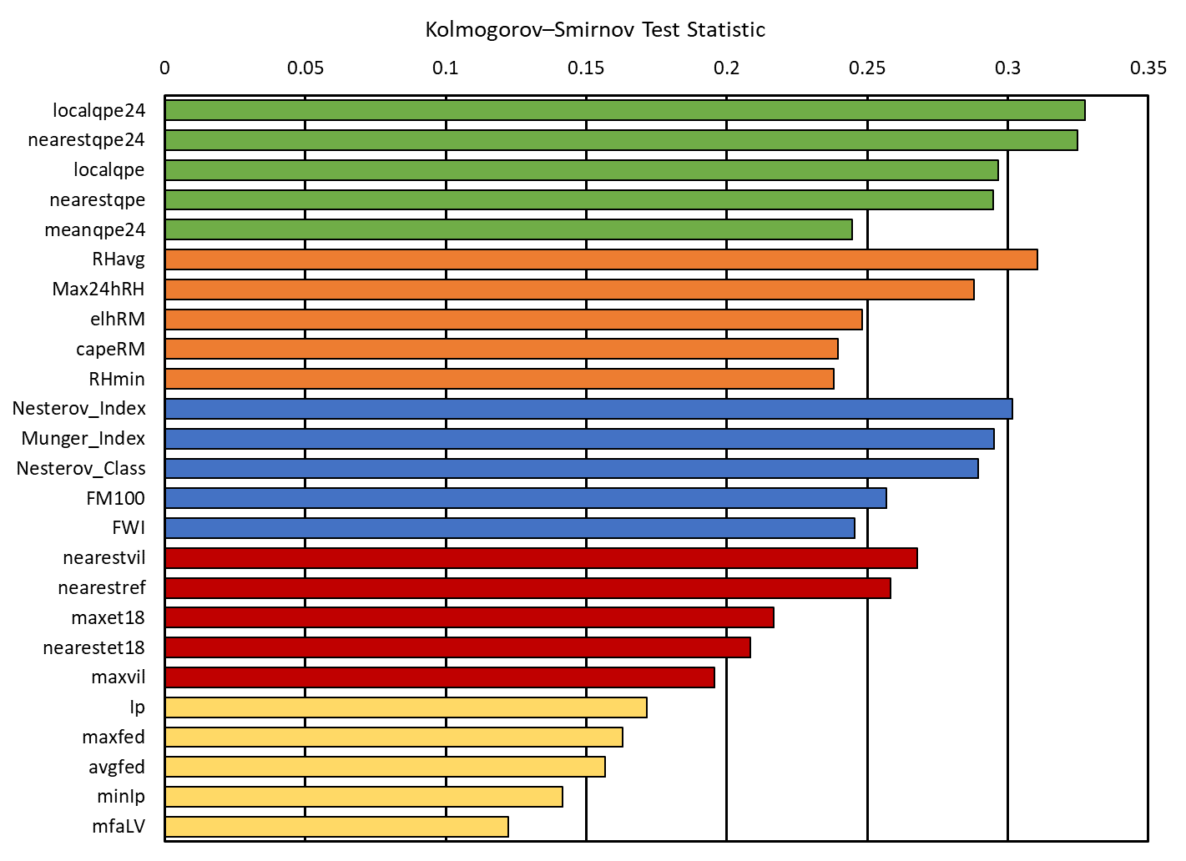
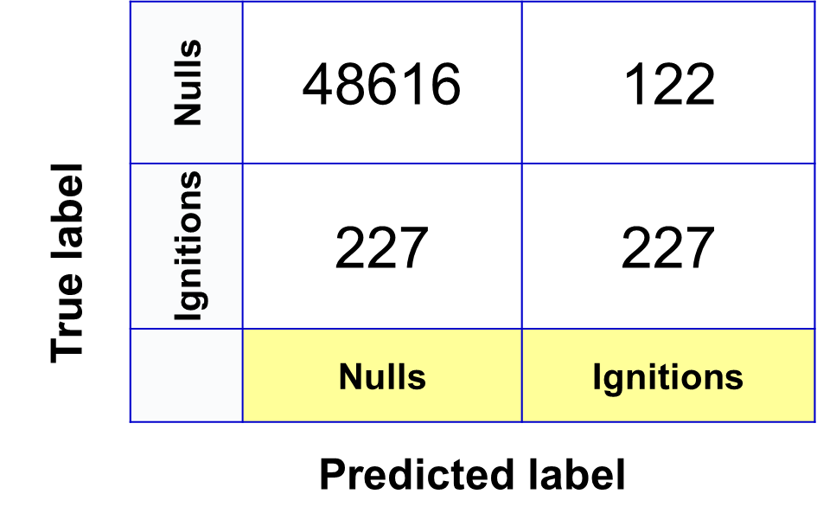
Identifying Lightning Ignited Wildfires Earlier
Compiled a fire-centric lightning climatology that provides great insights into the types of lightning that ignites fires.
Findings indicate clear differences between both the ignition and null environments, and the fires detected the day of the lightning versus those that holdover.
Distributions of lightning, land surface, and meteorological conditions can be used to help identify locations most vulnerable to lightning ignitions.
Developed ML tools to predict the likelihood of wildfire ignition
*
*

Slide 3
Identifying Lightning Ignited Wildfires Earlier
Automated identification of lightning that ignites wildfires leaves more uncertainty than desired (i.e., requires too many assumptions), so tools are developed to bring human observers into the loop when determining which lightning ignited each wildfire.
Updated analysis uses new fire start reports rather than wildfire perimeters.
Developed two models to alert to the potential for lightning-ignited wildfires
Lightning Ignition Likelihood Index (LILI) indicates the likelihood that lightning has ignited a fire in a given grid cell by characterizing the environment near new wildfire reports and/or new fire hot spot observations
Lightning Ignition Region of Interest (LIROI) indicates the potential that lightning ignited a wildfire the previous day based on lightning, meteorological, and land surface conditions

Slide 4
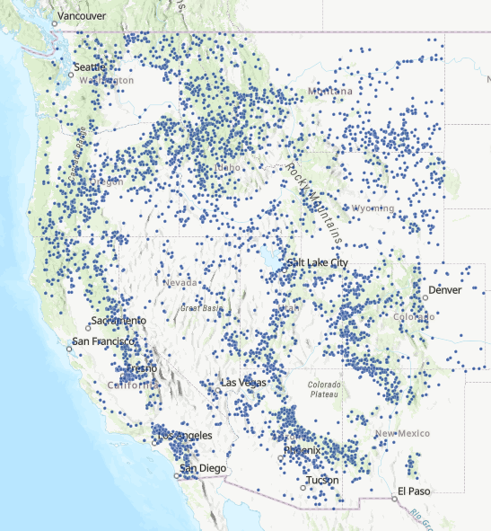
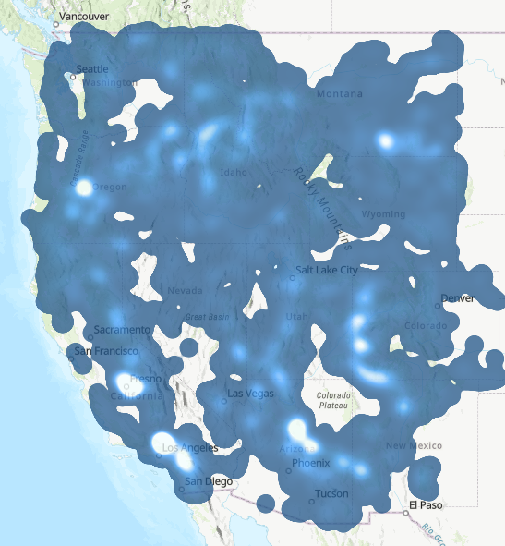
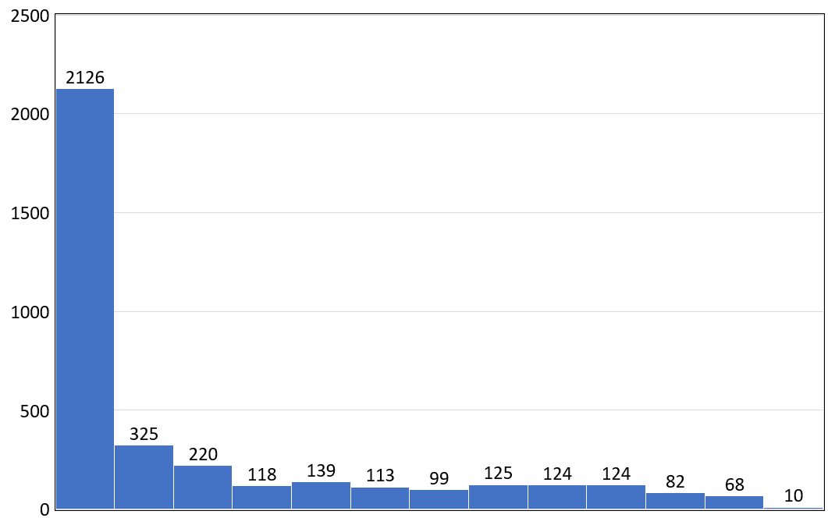
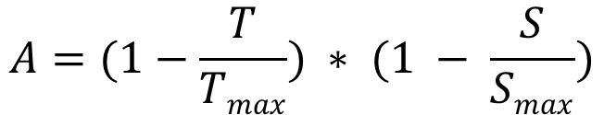
Updated 2024 Sample
Of 4630 fires labeled as natural or unknown, 3747 were confirmed to have ignited fires, with 1980 (52.8%) detected within the first 24 h
 | Distance Offset (°) | Time Offset (h) | Avalue
Mean | 0.0073 | 64.0 | 0.69
Median | 0.0046 | 21.2 | 0.78
Locations of all new wildfire reports labeled as natural or unknown in the western U.S. during Summer 2024.
Holdover duration (days)
$$A=(1−\frac{T}{Tmax}) ∗ (1 − \frac{S}{Smax})$$
Tmax defines the longest considered holdover time and Smax the maximum buffer radius around the ignition point.

Slide 5
LIROI and LILI Models
Developed two models to alert to the potential for lightning-ignited wildfires
Both models predict likelihood categories…
6 – Certain, 5 – Very Likely, 4 – Likely, 3 – Even Chance, 2 – Unlikely, 1 – Very Unlikely
A dashboard was developed to display these products alongside other relevant fire, weather, and land surface information
Lightning Ignition Region of Interest (LIROI)
Daily lightning grids created and blended with many auxiliary datasets
Search for new fire starts within each active grid cell for the following 14 days
Lightning Ignition Likelihood Index (LILI)
Search for lightning near new wildfire reports and new fire hot spot observations
Develop ML models to predict likelihood of fire ignition
Develop ML model to predict likelihood of fire ignition
Apply ML model to daily lightning grids
Confirm natural ignition and blend new fire starts with many auxiliary datasets
Apply ML models to daily potential new fire starts

Slide 6
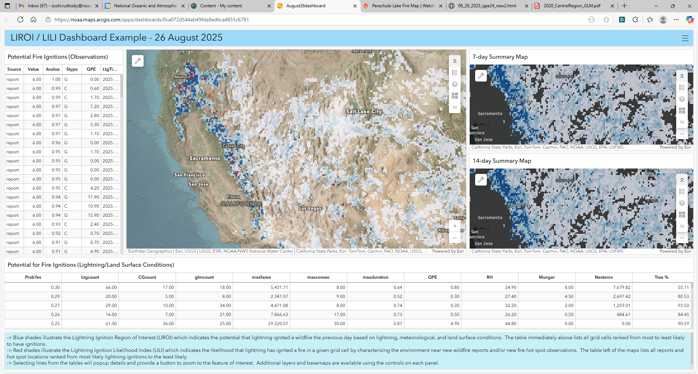
Lightning Fire Dashboard

Slide 7
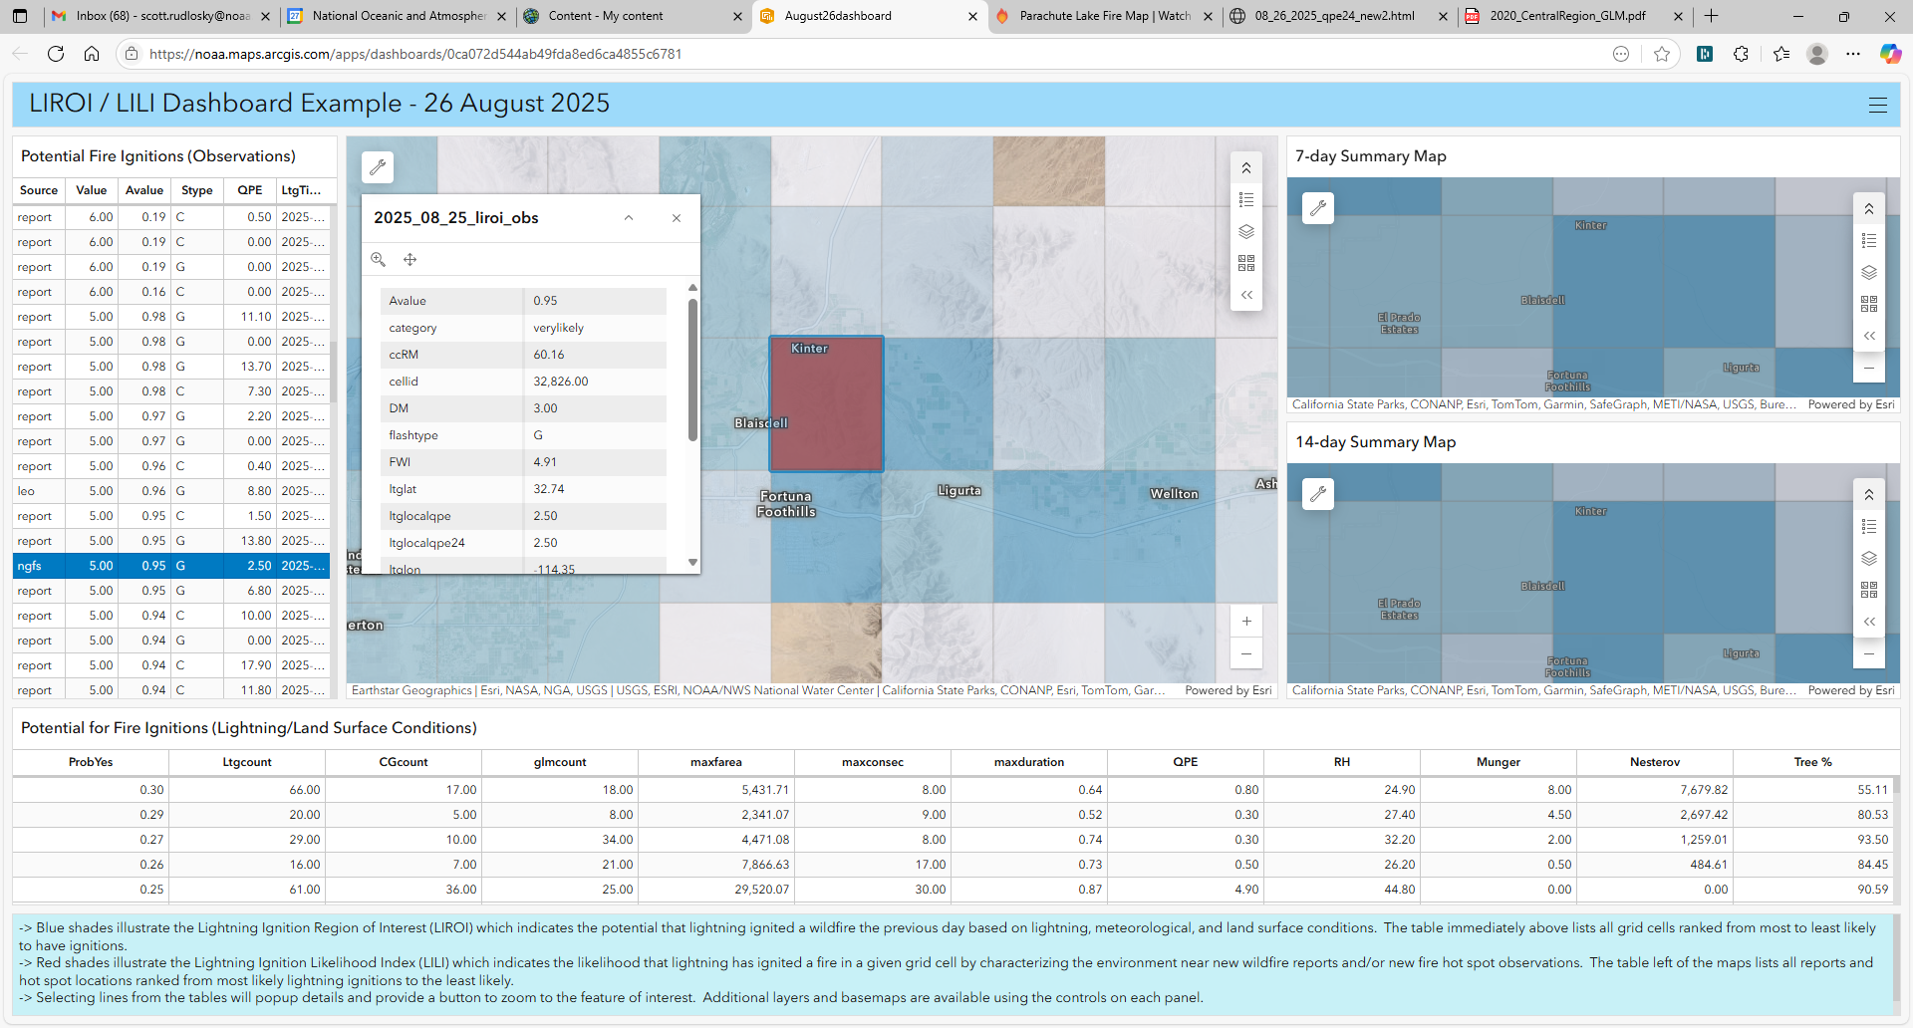
Lightning Fire Dashboard
Hold
Hold

Slide 8
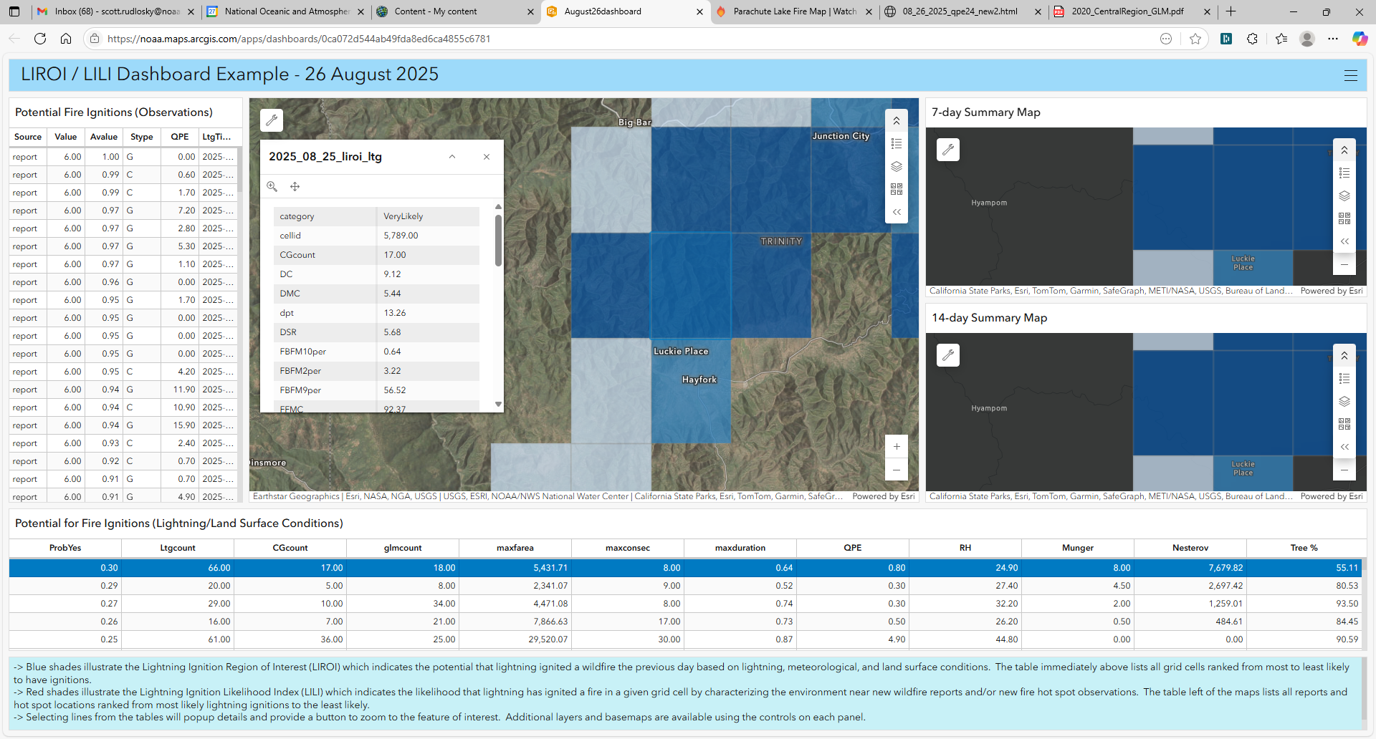
Lightning Fire Dashboard
Hold
Hold

Slide 9
Summary
Developed two models to alert to the potential for lightning-ignited wildfires
Created a lightning fire dashboard to display these products
Work continues to refine both the ML models and dashboard display
Planning for a demonstration during summer 2026
The following slides present some earlier results which have also been reported by Rudlosky et al. (2025)…
Rudlosky, S. D., J. Patton, D. Zhang, T. Noiplabd, R. Jind, L. Heuscher-Stewart, and J. A. Otkin, 2025: Characterizing the relation between lightning and wildfires in the western United States, J. App. Meteor. Climatology, Conditionally Accepted.

Slide 10
Backup Slides

Slide 11
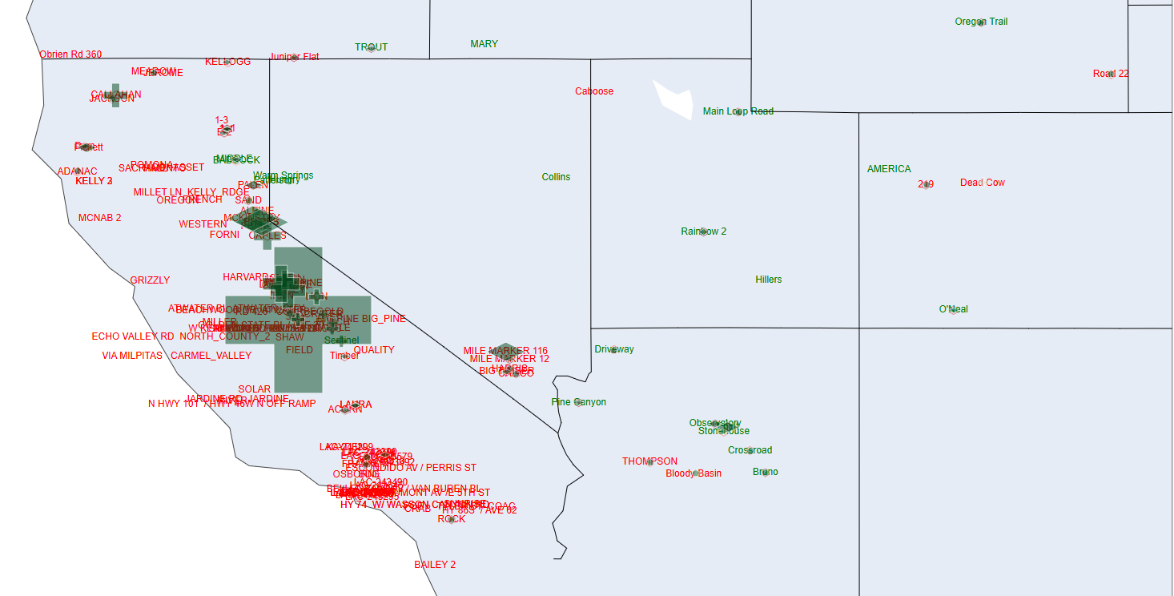
Daily Lightning/Fire Maps
HTML maps display
New fire reports
Green = Natural
Red = Unknown
Nearest NLDN strokes
Diamond = -CG
Plus = +CG
Hexagon = IC
Size scaled by estimated peak current
Maps include zoom, pan, and hover/query functionality
Example of daily html map from 14 July 2024

Slide 12
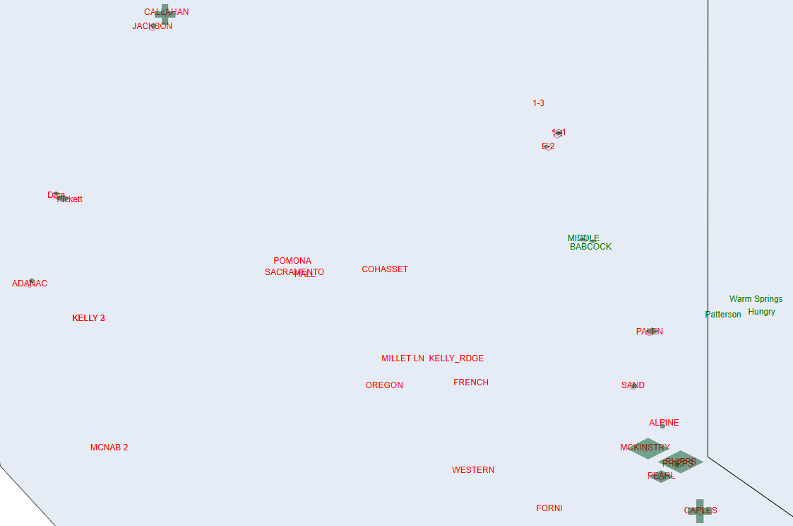
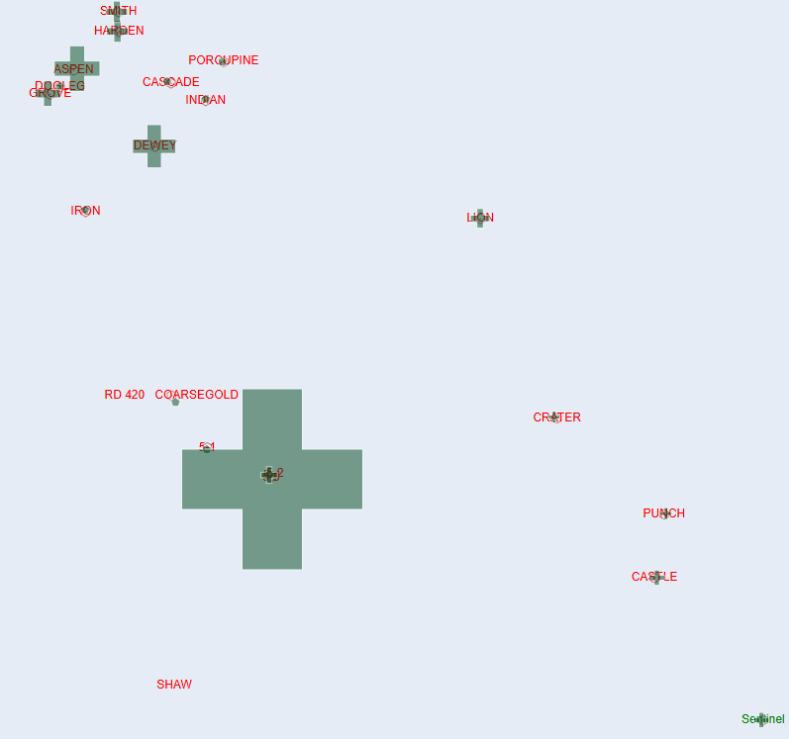
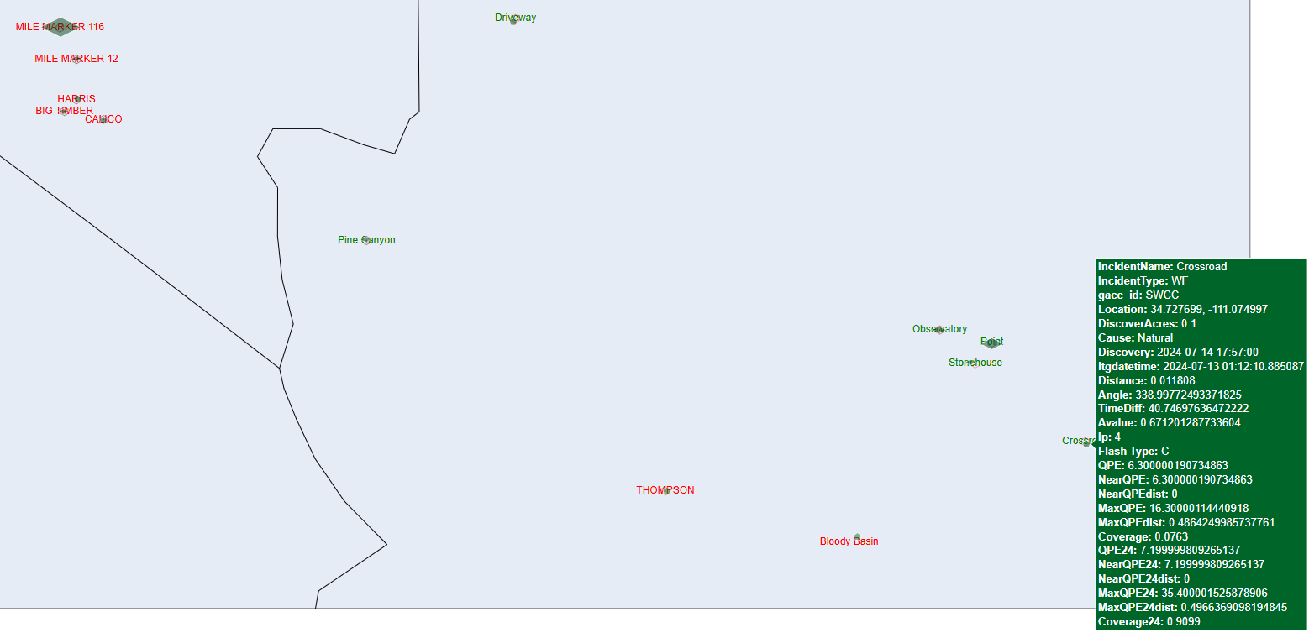
14 July 2024

Slide 13
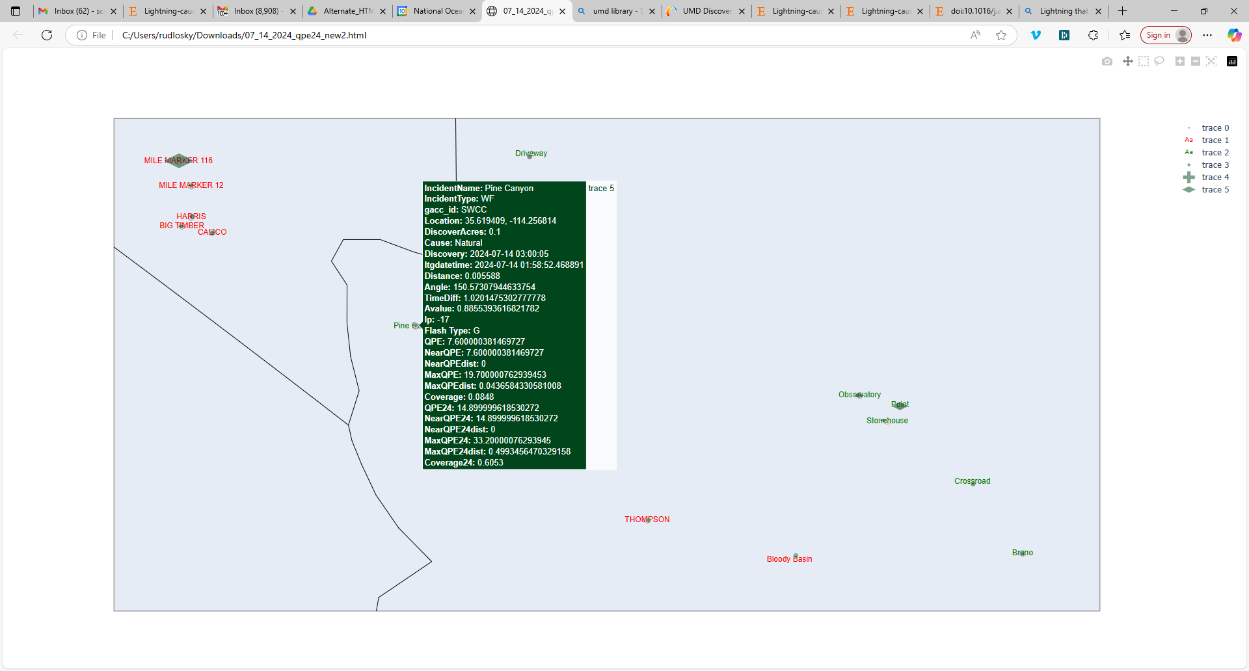
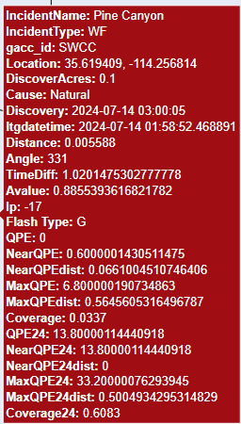
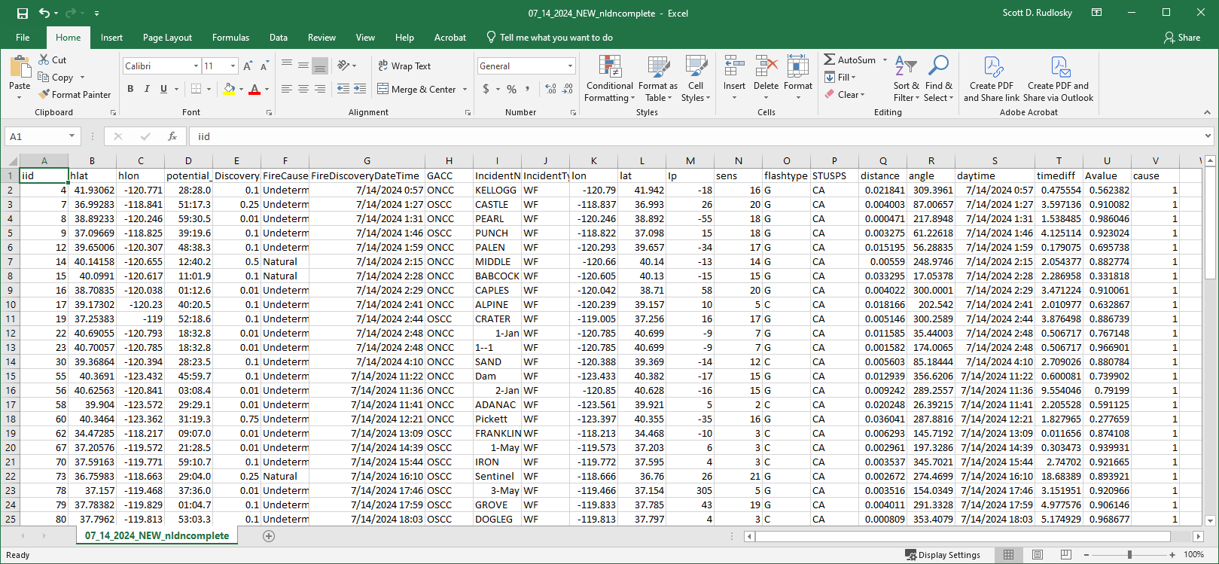
Identifying Ignition Strokes
14 July 2024
Hover Text (Lightning)
Hover Text (Reports)
Added Manually

Slide 14
Ignitions and Nulls
 | Sample | ltgcount | cgfrac | minIp | maxIp | Tree | Munger | Nesterov
Mean | Ignit | 17.2 | 0.4 | -19.2 | 8.2 | 50.6 | 66.9 | 5284.7
Median | Ignit | 7 | 0.33 | -16 | 7 | 55.0 | 2.0 | 1789.3
Mean | Null | 10.9 | 0.2 | -8.9 | 5.6 | 28.0 | 62.4 | 4414.9
Median | Null | 4 | 0 | -5 | 5 | 11.3 | 0.5 | 664.2
Many variables differ between the ignition and null samples
ML models can leverage these difference to predict the likelihood of fire ignition
 | localqpe24 | maxqpe24 | meanvalue24 | median24 | coverage24
Ignit Mean | 4.5 | 28.5 | 3.5 | 2.2 | 0.51
Ignit Median | 2.0 | 21.6 | 2.8 | 1.5 | 0.50
Null Mean | 6.1 | 37.7 | 4.9 | 3.1 | 0.60
Null Median | 2.8 | 31.5 | 4.0 | 2.2 | 0.63
Mean Diff | 1.6 | 9.1 | 1.4 | 0.9 | 0.1
Median Diff | 0.8 | 9.9 | 1.2 | 0.7 | 0.1
Mean Diff % | 26.6% | 24.3% | 27.9% | 29.6% | 16.4%
Median Diff % | 28.6% | 31.4% | 30.7% | 31.8% | 21.3%
 | rhLV | wgLV | wsLV | pwLV | capeLV | pblRM | elhRM | umotLV | vmotLV | glmcount | avgfed | avgmfa
Mean | 42.6 | 6.9 | 4.5 | 23.0 | 514.4 | 1442.7 | 8150.4 | 6.3 | -0.3 | 2630.4 | 1.4 | 466.8
Median | 37.8 | 6.2 | 4.0 | 21.9 | 410.0 | 1373.7 | 8567.4 | 7.2 | -1.1 | 2201.5 | 1.3 | 402.2
Mean | 45.5 | 7.6 | 5.3 | 25.5 | 714.4 | 1711.0 | 9585.5 | 5.1 | -1.4 | 3063.2 | 1.5 | 427.1
Median | 41.3 | 6.8 | 4.8 | 24.6 | 580.0 | 1724.0 | 9905.4 | 5.9 | -2.2 | 2657.0 | 1.3 | 371.5
Mean Diff | 2.9 | 0.7 | 0.7 | 2.5 | 200.0 | 268.3 | 1435.1 | -1.2 | -1.1 | 432.8 | 0.1 | -39.6
Median Diff | 3.5 | 0.6 | 0.8 | 2.7 | 170.0 | 350.3 | 1338.0 | -1.3 | -1.2 | 455.5 | 0.0 | -30.8
Mean Diff % | 6.3% | 9.0% | 14.1% | 9.9% | 28.0% | 15.7% | 15.0% | -24.6% | 77.9% | 14.1% | 4.7% | -9.3%
Median Diff % | 8.5% | 9.5% | 16.8% | 10.9% | 29.3% | 20.3% | 13.5% | -22.1% | 52.3% | 17.1% | 3.6% | -8.3%

