Slide 1
Update on the MTG-LI Programme
Bartolomeo Viticchié
Remote Sensing Scientist – Lightning Imagery
EUMETSAT
2025 GLM Science Meeting
2-3 September 2025

Slide 2
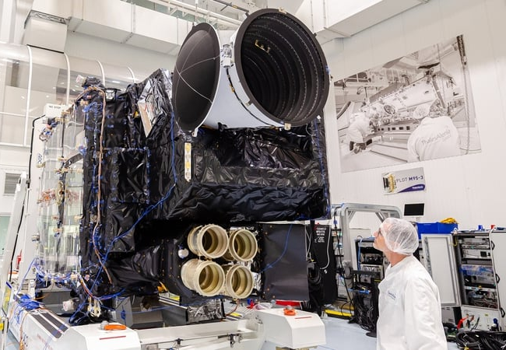
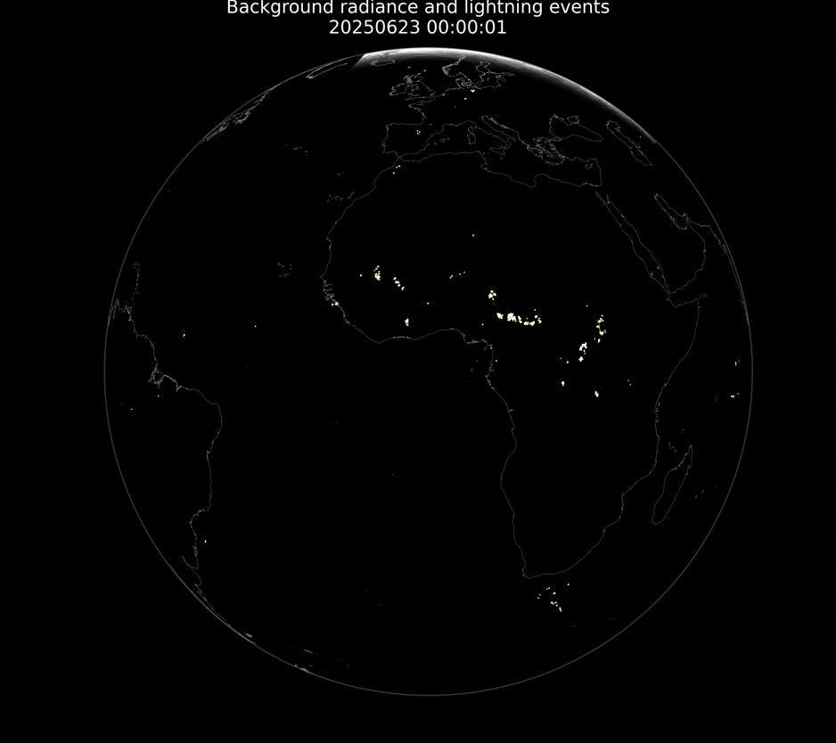
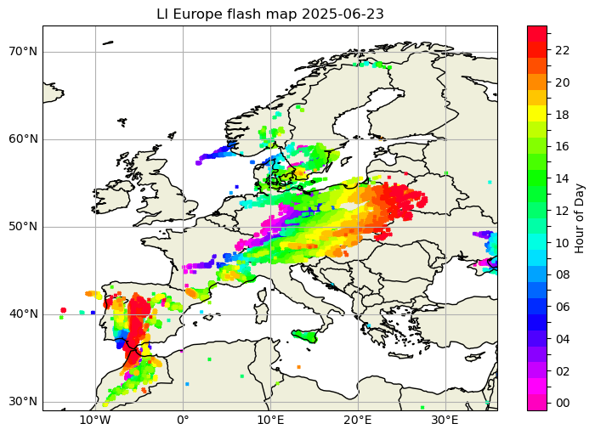
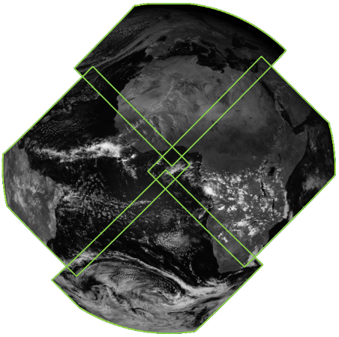
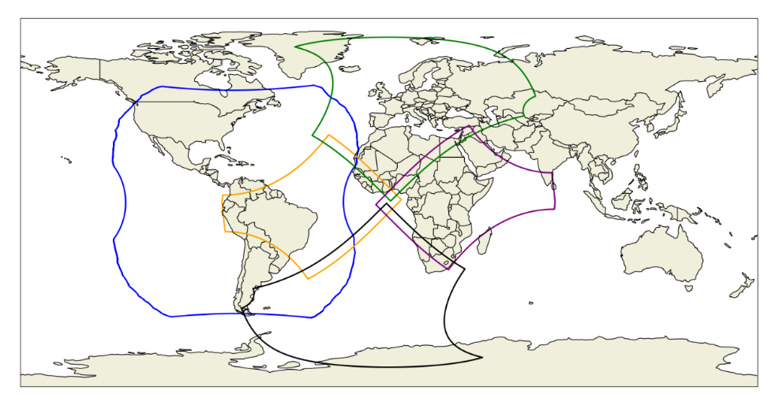
LI System
Key design features
Detector(s) | 1000x1170(x4) pixels CMOS
Spatial resolution | 4.5 km at Nadir (about 8 km over Europe)
Coverage | Up to 80 degrees North
Spectral band | 777.4 nm with 1.9 nm bandwidth
Integration time | 1 millisecond
On-board processing | Lightning detection + data filtering
On-ground processing | Level 1b (Radiometry + INR + event filtering) Level 2 (event filtering + product definition)
Level 2 products to users | Lightning groups (RC 10 sec), flashes (RC 10 sec) and accumulated products (RC 30 sec)
The Lightning Imager is manufactured by Leonardo (Italy) under the industrial prime contractor Thales Alenia Space (France) as part of the ESA lead MTG space segment development.
MTG-LI was declared pre-operational on July 4, 2024 and operational on October 31, 2024.
Its performances have been fairly stable during the first year of operation.
Main challenges:
Processing stability → data availability
INR stability → end-to-end performances
Management of instrument operation and processing during eclipse season → data availability and end-to-end performances
EUMETSAT is working on overcoming such challenges and tuning the LI System
Field-of-view of GLM on GOES East (blue) and FOV of the four cameras of LI (west in yellow, north in green, east in purple, and south in brown, respectively).
LI Level 2 flashes disseminated to users over 24 hours on June 23, 2025 (zoom over Europe).
24 hours (June 23, 2025) of LI Level 1b lightning events overlayed on Level 1b background images

Slide 3
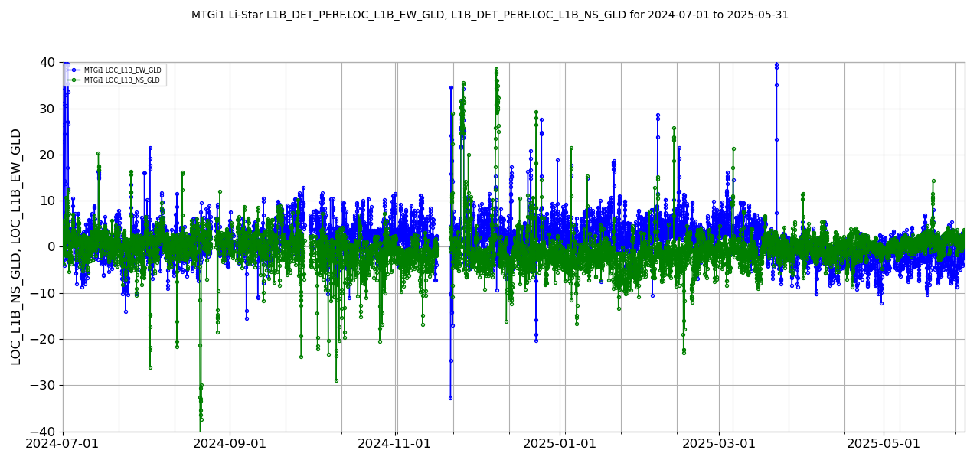
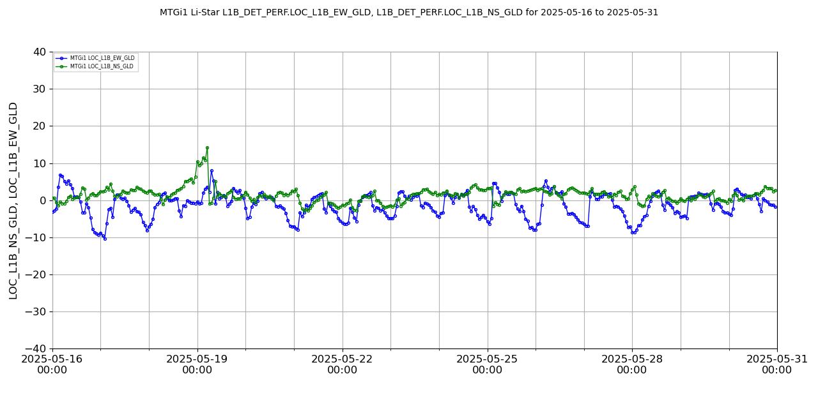
LI product quality – Level 1b LA
Considerable improvement achieved by INR experts of RSP over 12 months
Due to favorable illumination conditions and landmark location, during northern hemisphere spring/summertime LI LA shows a clear improvement
LI Level 1b LA relative to GLD360 strokes over the period May 16 – 31, 2025.
LI Level 1b LA relative to GLD360 strokes over the period July 2024 – May 2025.
24h cycle with progressive degradation of LA from about 17:00UTC until 04:00UTC+1, followed by a sudden recovery due to the availability of illuminated landmarks
July – October 2024 with good overall LA and several episodes of INR instability
October 2024 – April 2025 with worse LA compared to summertime and several episodes of INR instability
From April 2025 improved LA compared to the previous summertime and considerable improvement of INR stability

Slide 4
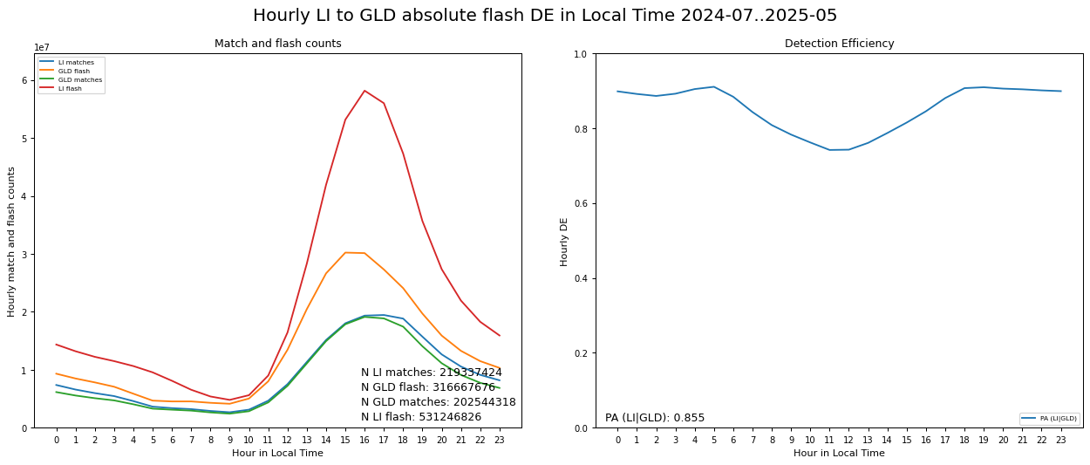
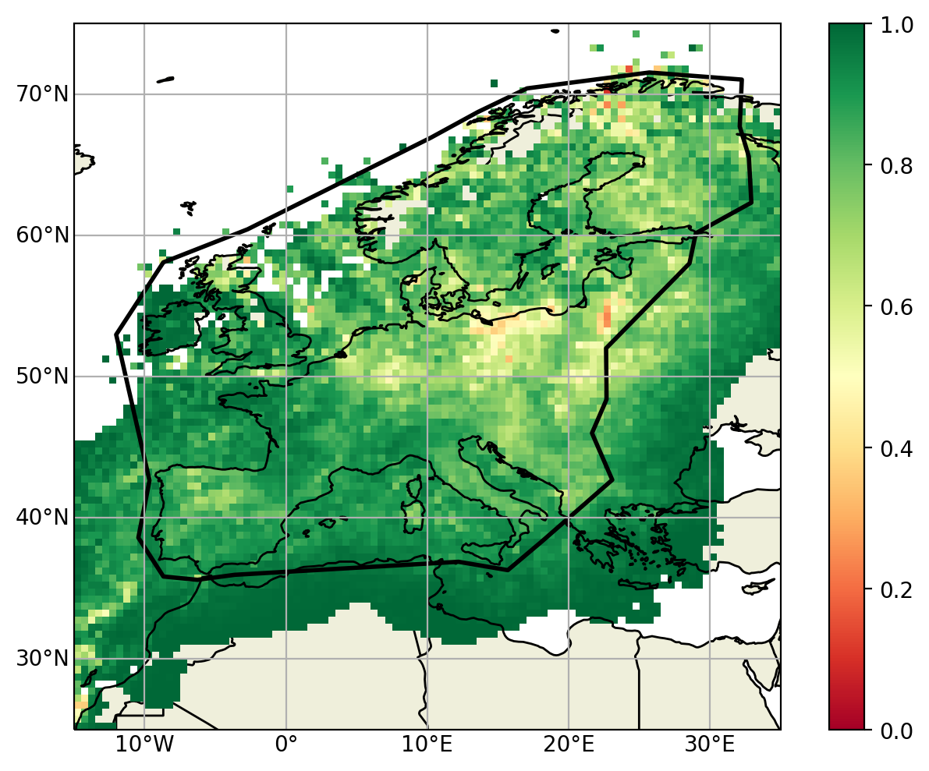
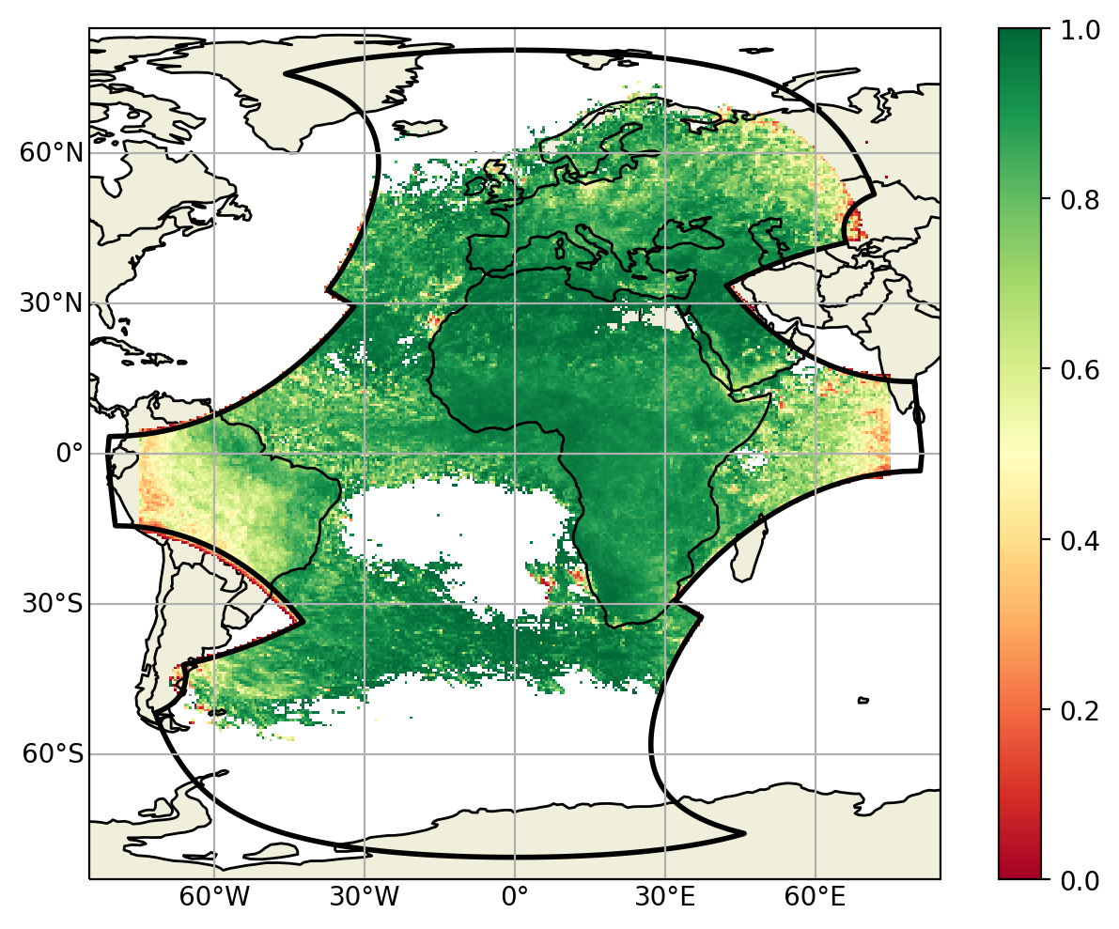
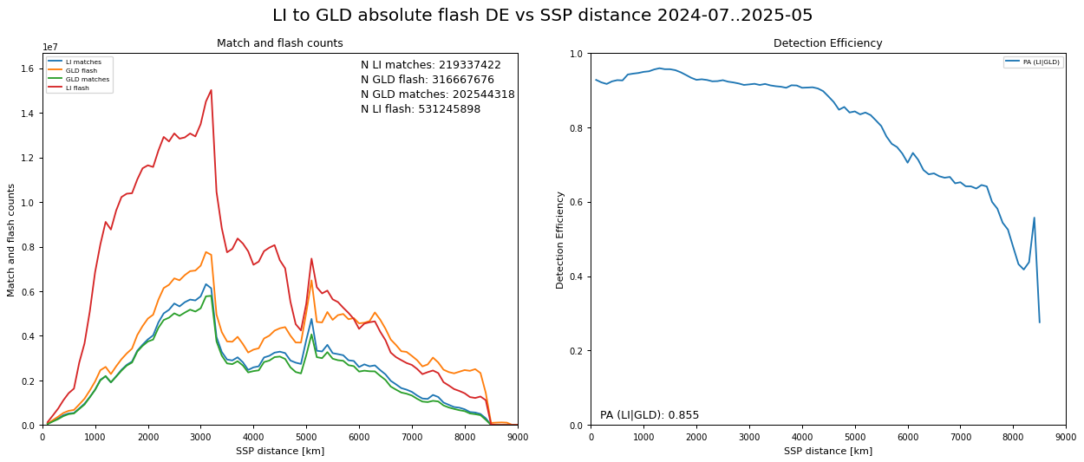
LI product quality – Level 2 DE
LI Level 2 absolute DE (right panel) and data sample (left panel) as a function of the local time (July 2024 – May 2025)
LI Level 2 absolute DE as a function of the location within the LI field-of-view over the period July 2024 – May 2025 (EUCLID-based).
LI Level 2 absolute DE (right panel) and data sample (left panel) as a function of the distance (in km) from SSP (July 2024 – May 2025)
LI Level 2 absolute DE as a function of the location within the LI field-of-view over the period July 2024 – May 2025

Slide 5
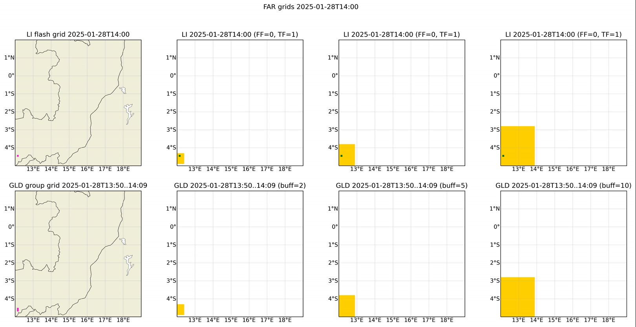
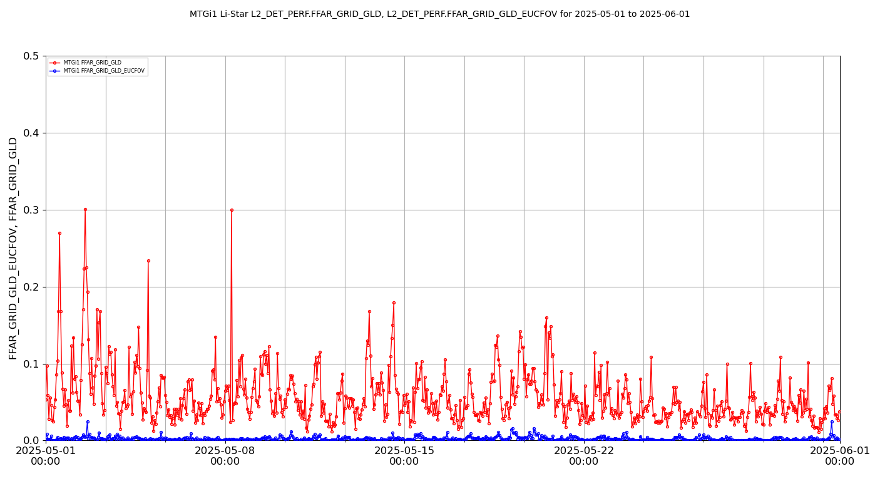
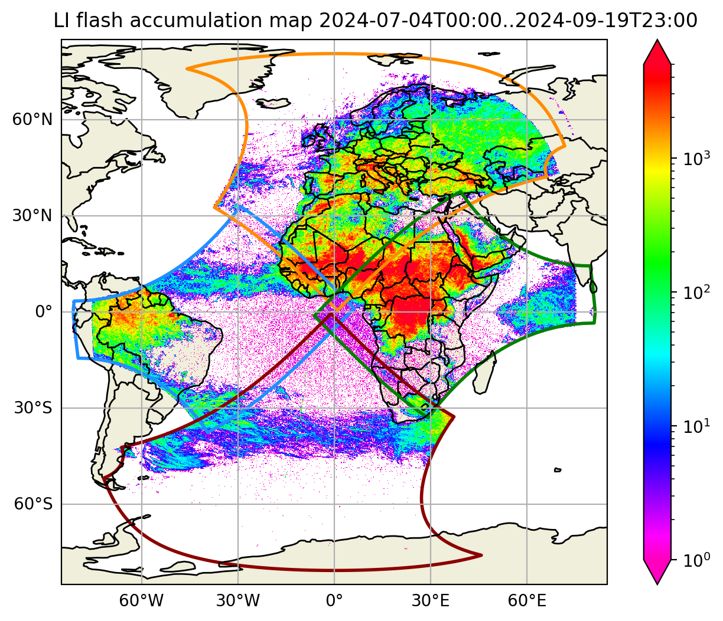
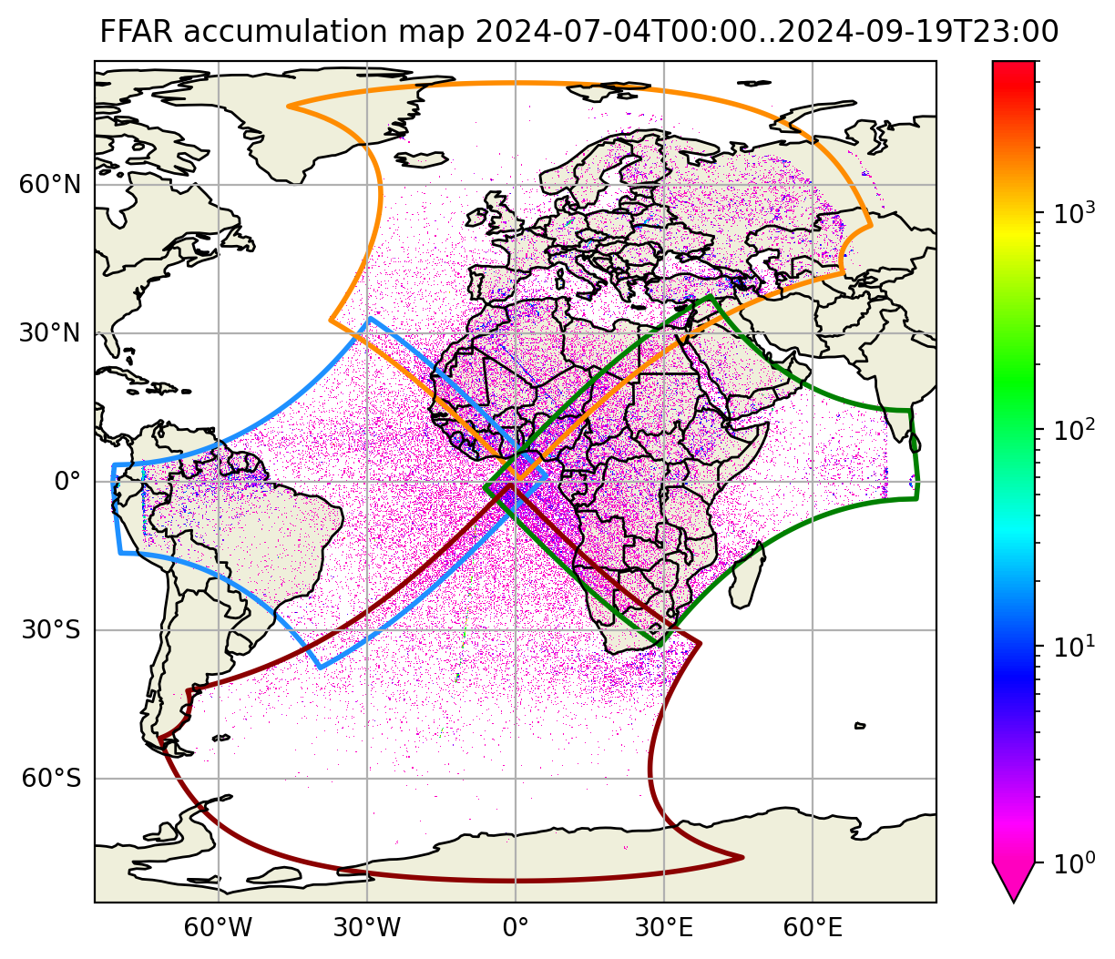
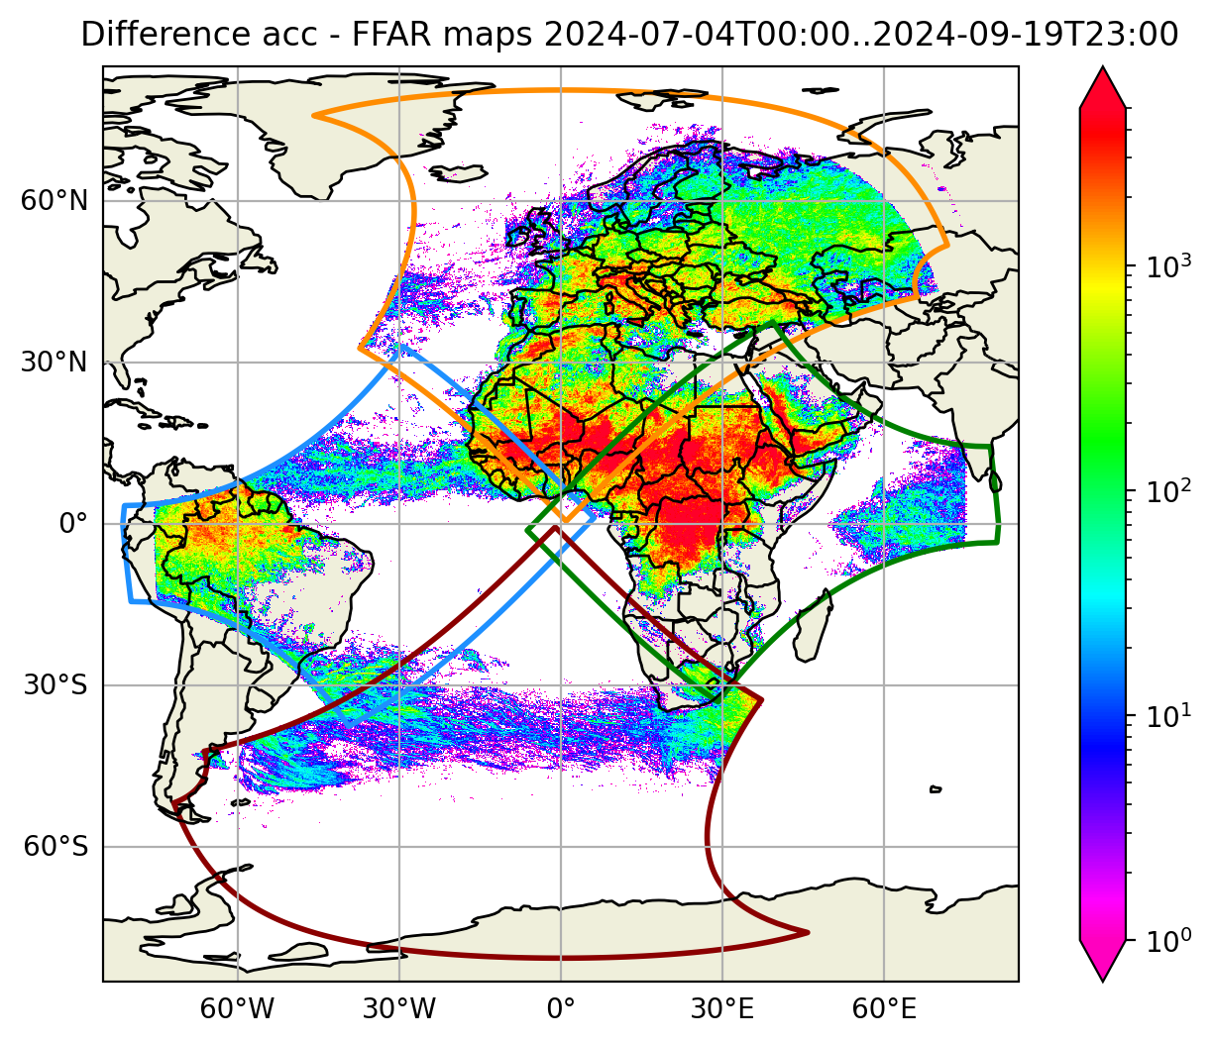
LI product quality – Level 2 FAR
Classification of LI flashes measurements by means of GLD360 reference and different configurations: red = false, while green = true. False Flashes are defined using the rightmost configuration.
Normally the Flash False Alarm Rate is <0.2 flashes per second over the whole field-of-view and about 0.001 flashes per second over Europe;
Large peaks of Flash False Alarm Rate are due to objects crossing the LI field-of-view;
Small peaks can be an effect of multiple small storms being missed by GLD360.
Flash False Alarm Rate in May 2025. In red over the whole field-of-view, in blue over Europe.
-
=
LI Level 2 flash accumulation July 4 – September 19, 2024 (MTG yaw-flip)
LI Level 2 false flashes
July 4 – September 19, 2024 (MTG yaw-flip)
LI Level 2 “clean” flash accumulation
July 4 – September 19, 2024 (MTG yaw-flip)

Slide 6
Conclusions A
The MTG-LI System is operational since October 31, 2024. High-quality science data are being produced since July 4, 2024 (start of pre-operational dissemination)
MTG-LI is the state-of-the-art System for lightning detection from GEO orbit:
It is by far the best performing System to monitor lightning activity over Europe, Africa, and part of the Atlantic Ocean
Its Level 2 average absolute flash detection efficiency varies between 70% (day) and 95% (night). Its average Flash False Alarm Rate is below 0.2 flashes/sec (below 0.001 flashes/sec over Europe)
It enables the monitoring of lightning activity from global scales (e.g., for climate applications) down to single storms with spatial and temporal sampling of 4.5 km at nadir and 1 millisecond (e.g., for now-casting applications)
Its Location Accuracy has been progressively improving since the beginning of pre-operational dissemination through the work of INR experts of RSP. In addition, LA varies over 24h with a well-known behavior

Slide 7
Conclusions B
EUMETSAT experts are actively working on further improving MTG-LI performances, processing stability and data availability
Currently, different event filtering solutions are being tested. These include a “relaxed” configuration which gives one higher DE for a small increase of FAR
Filtering during eclipse season is currently being tested to handle Sun-induced large peaks of FAR happening every day around midnight
End-to-end processing timeliness remains an open issue, especially to handle larger data rates (tightly related to tuning attempts) → monitoring of continuing currents and large flashes
LI on MTG-I2
ESA and industry communicated that the new LI is expected to deliver performances in line with the first one (HW improvements concern instrument stability and instrument operability)
The preparation of the MTG-I2 Commissioning has been kicked-off. Two main phases:
Phase 1: repeat the Commissioning done for LI on MTG-I2
Phase 2: Commissioning while FCI is being operated in Rapid Scan Service (RSS). LI INR strongly relies on FCI and in RSS only part of the FOV will be acquired by FCI
According to the MTG Programme baseline, LI on MTG-I2 will be switched off after the completion of the Commissioning

Slide 8
Thank you!
Questions are welcome.

