Slide 1


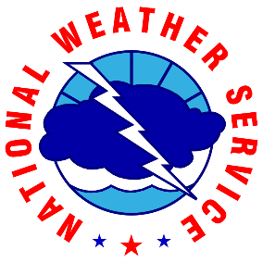
Lightning Safety Guide for
Sports and Special Events
Charlie Woodrum
Preparedness Lead
National Weather Service Headquarters
September 2nd, 2025

Slide 2
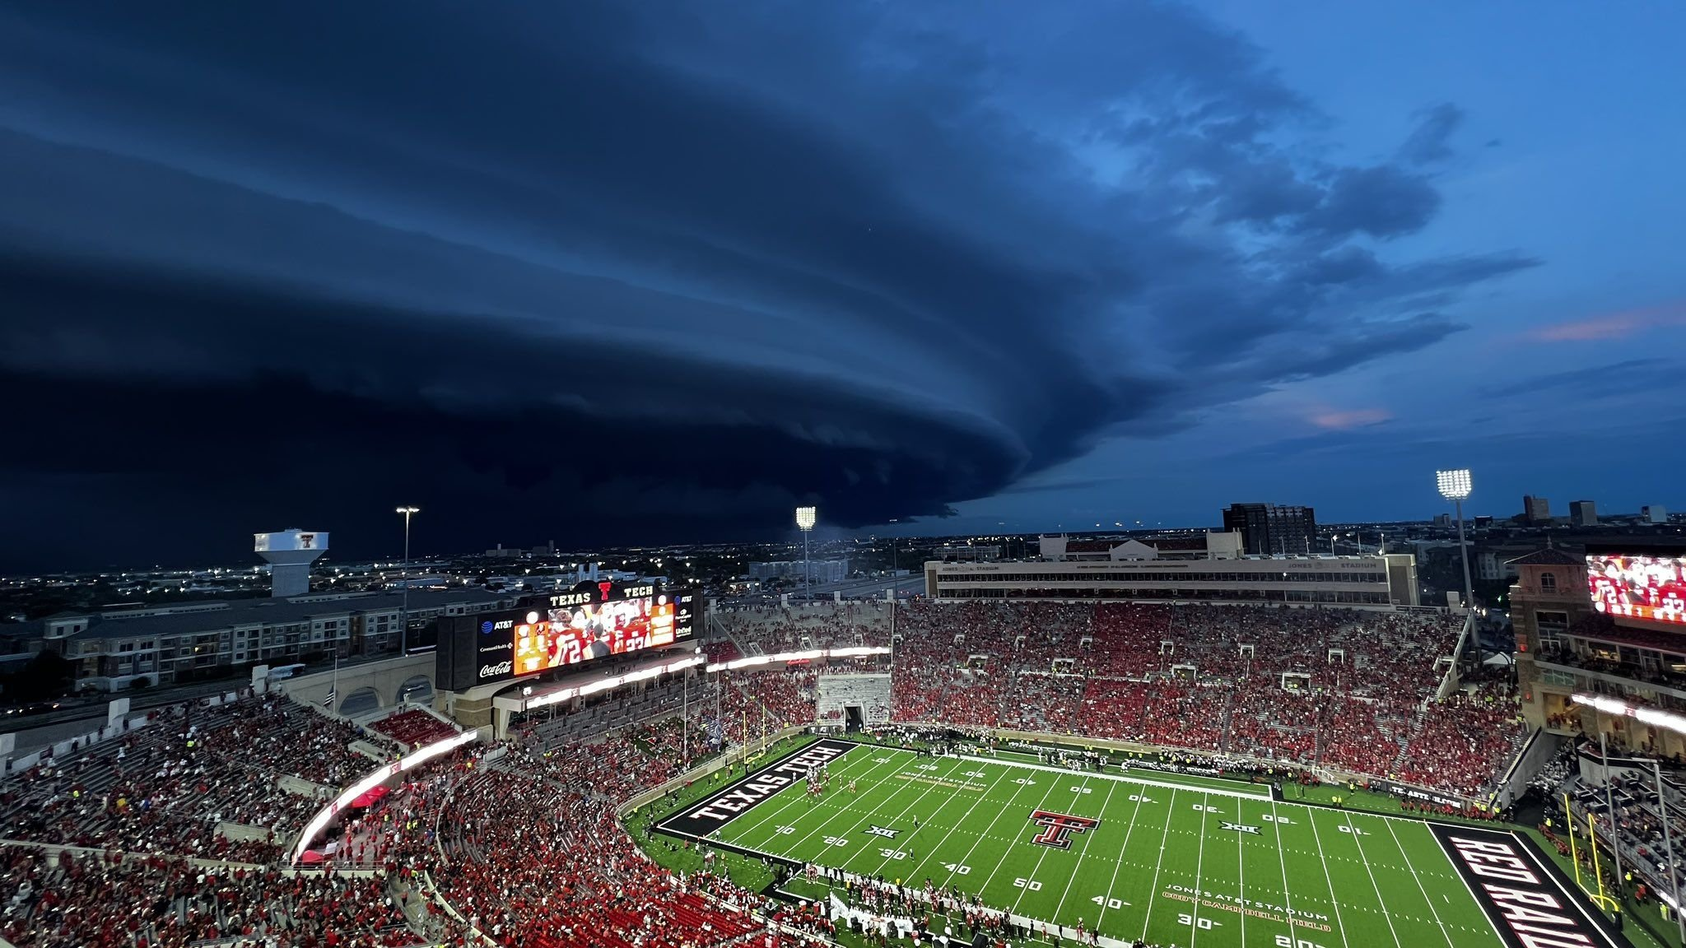
Outline
Background - Lightning Safety Toolkit
Partnerships
Guidelines
Radii - Actions
Image: A thunderstorm approaches Jones AT&T Stadium on August 30, 2025. (Credit: KCBD, Andrew Wood )

Slide 3
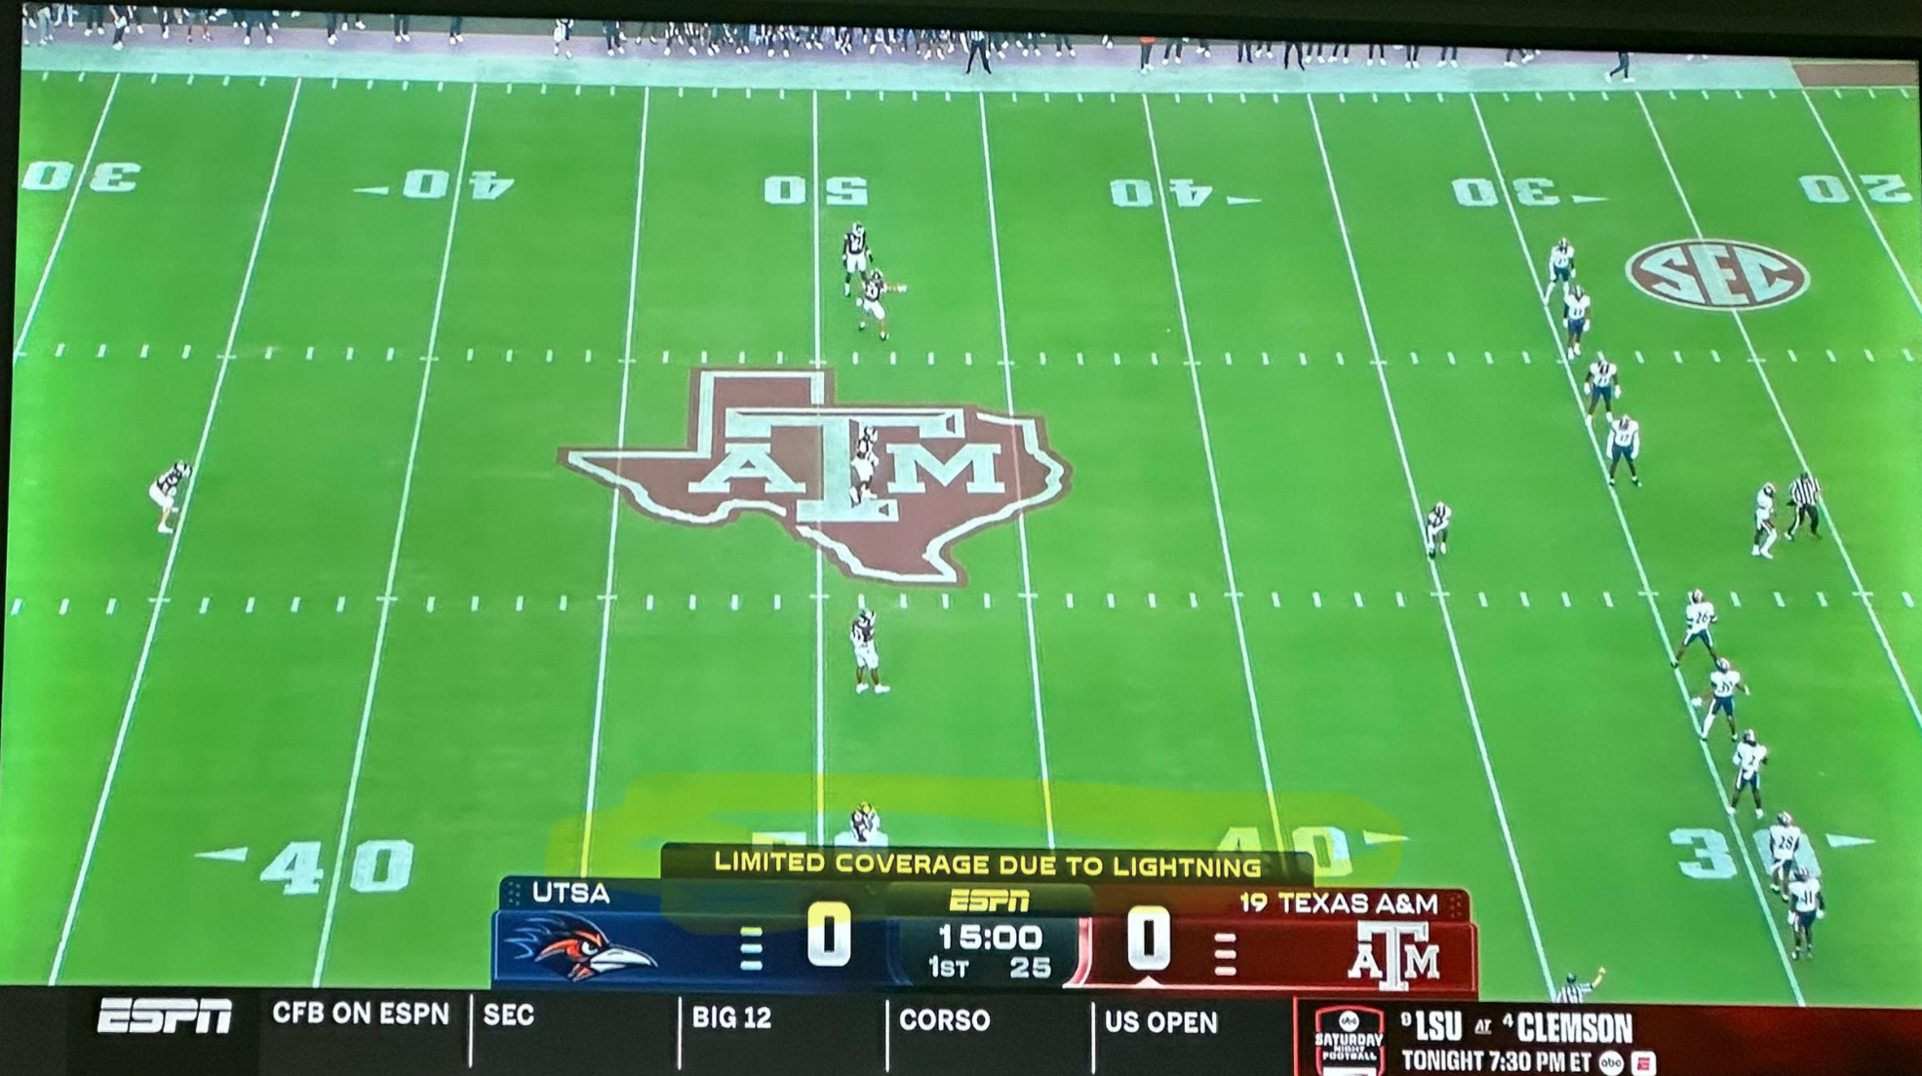
Why is this important?
Image: Television coverage of the UTSA-Texas A&M game on August 30, 2025 (Credit: ESPN)

Slide 4
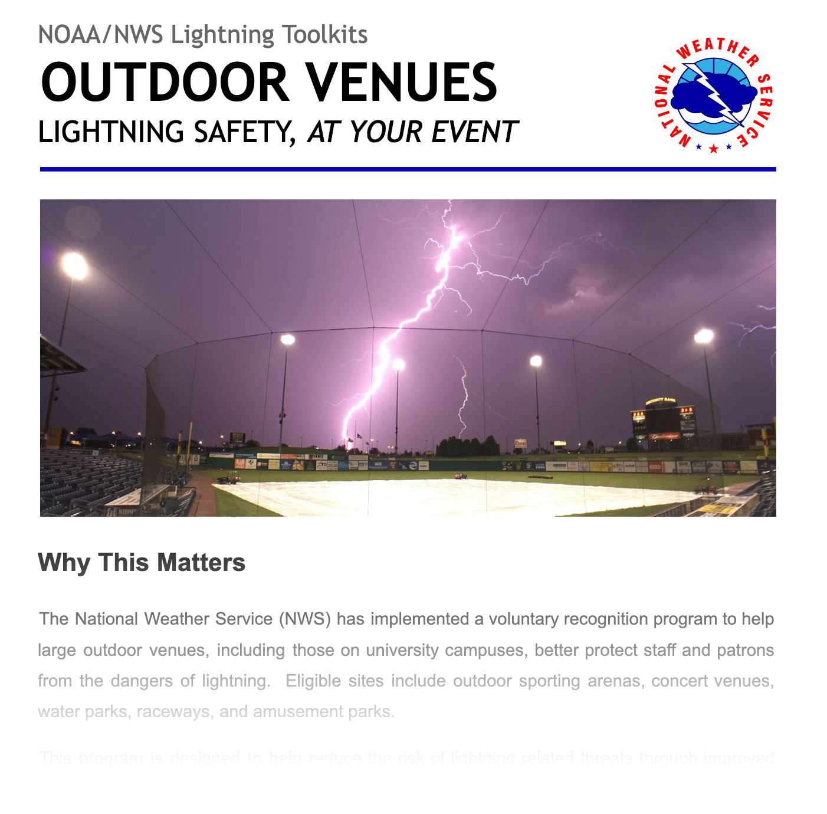
Lightning Safety Toolkit for Outdoor Venues
Toolkit refreshed in 2023 in coordination with venue managers and organizations:
Stadium Managers Association
Philadelphia Eagles
Houston Astros
Las Vegas Aviators
West Virginia University
Toolkit still divided up into key sections:
Information Reception
Establish Weather Watcher
Decision Support Standards
Lightning Radii (8/12/15 miles)
Public Notification Plan
Includes pre-canned statements
Protection Program
Identify fully-enclosed structures
Safety/Education/Preparedness
Checklists

Slide 5





Key Partnerships

Slide 6
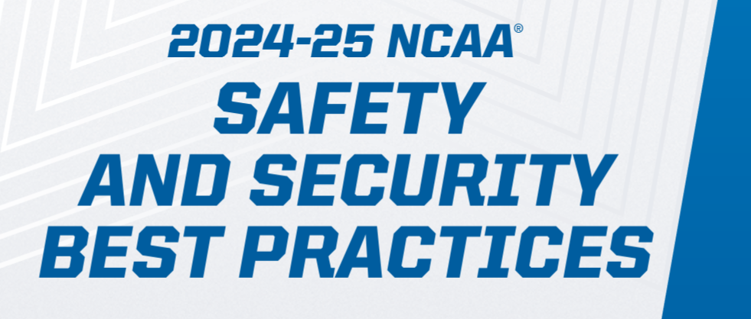
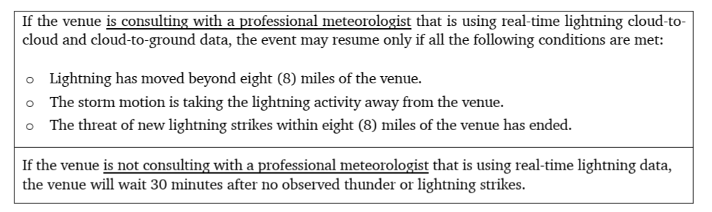

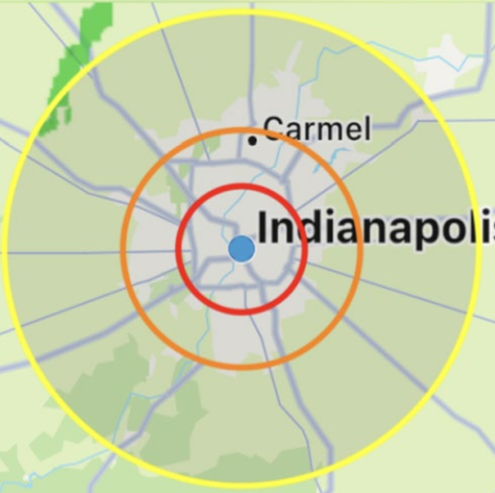
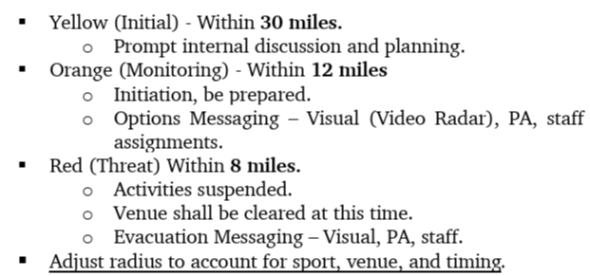
Key NCAA Guidance

Slide 7
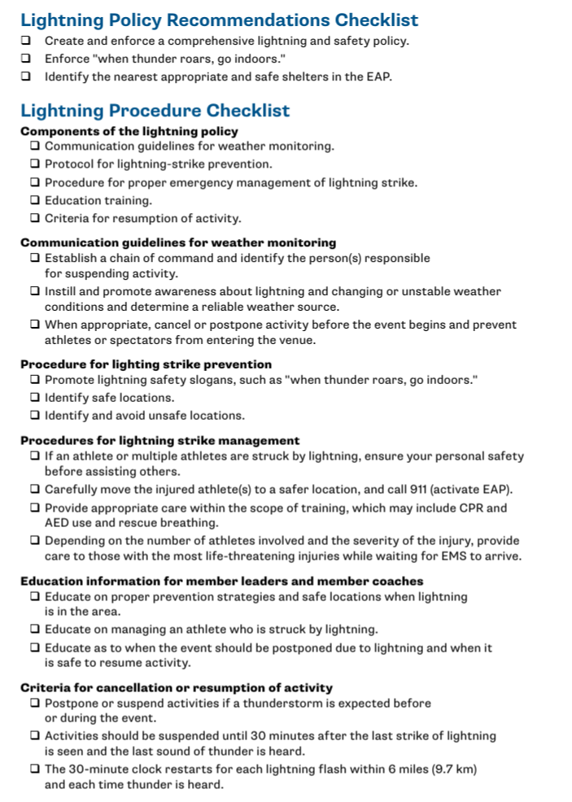

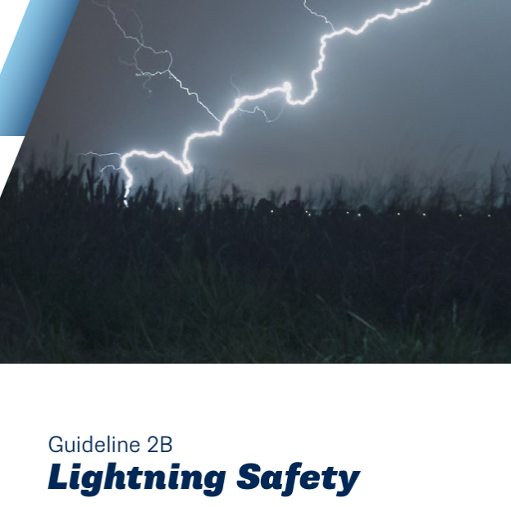
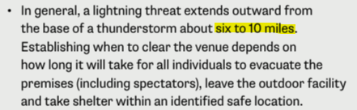
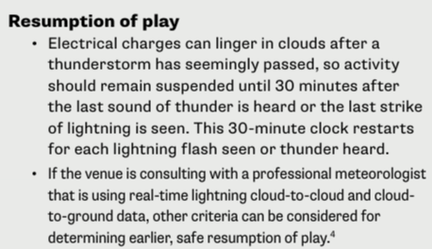
Key NCAA Guidance

Slide 8

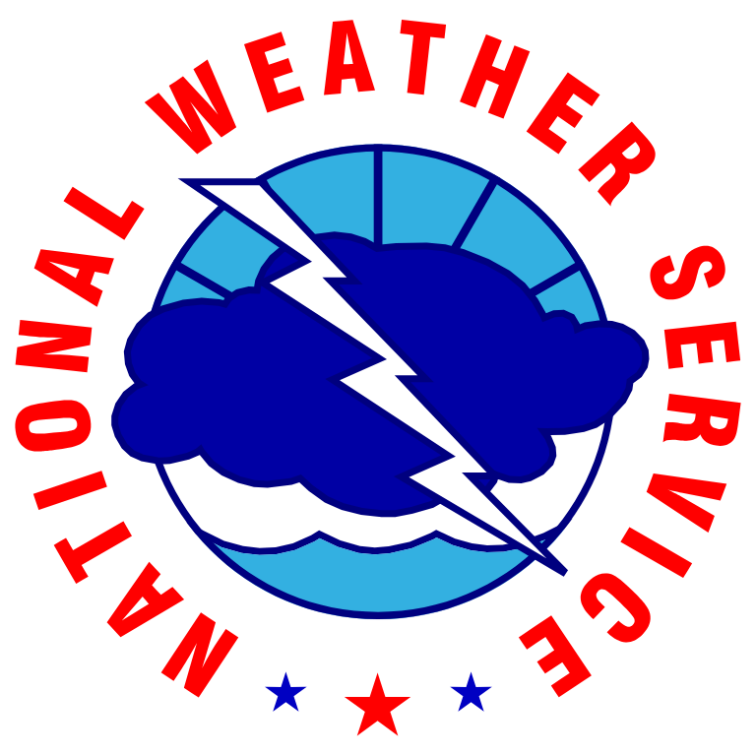








Venue and Weather Experts Come Together
Preview

Slide 9
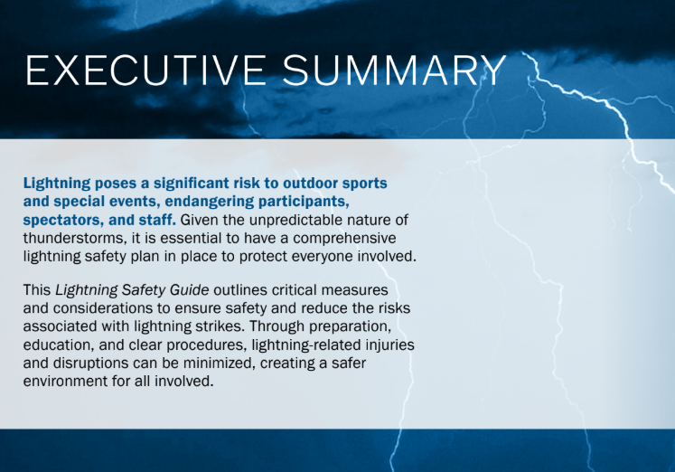
Guide Outline
Executive Summary
Knowledge Base
Detection and Prediction
Preparedness
Government Support
Preview

Slide 10
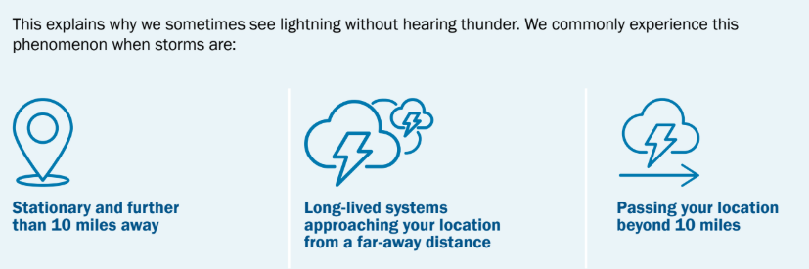
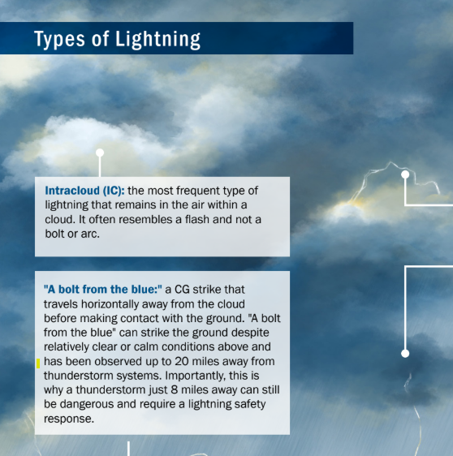
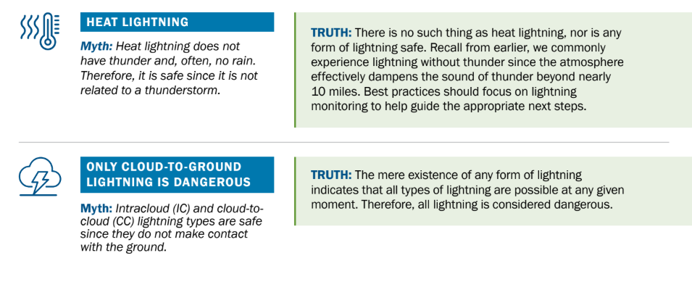
Knowledge Base
Preview
Preview
Preview

Slide 11
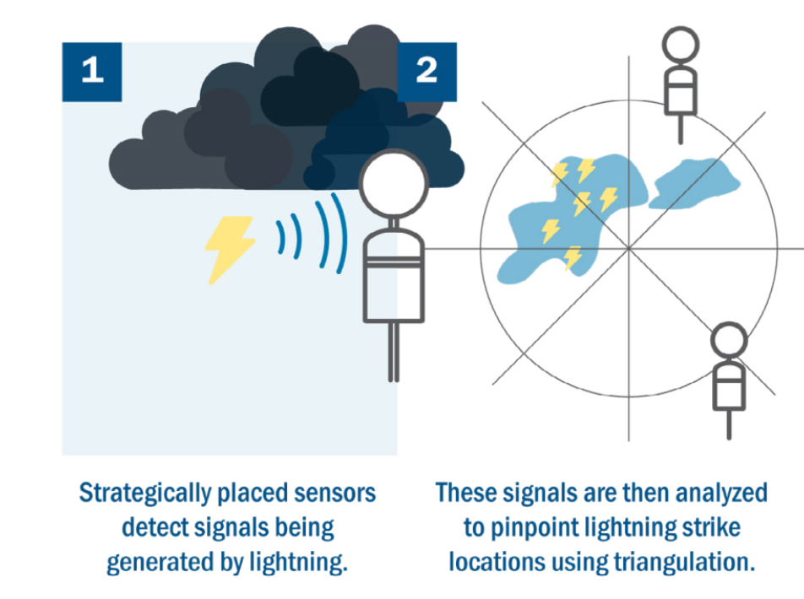
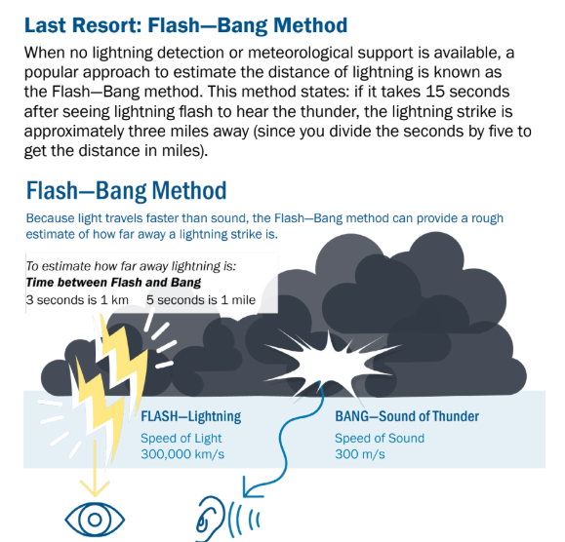
Detection and Prediction
Preview
Preview

Slide 12
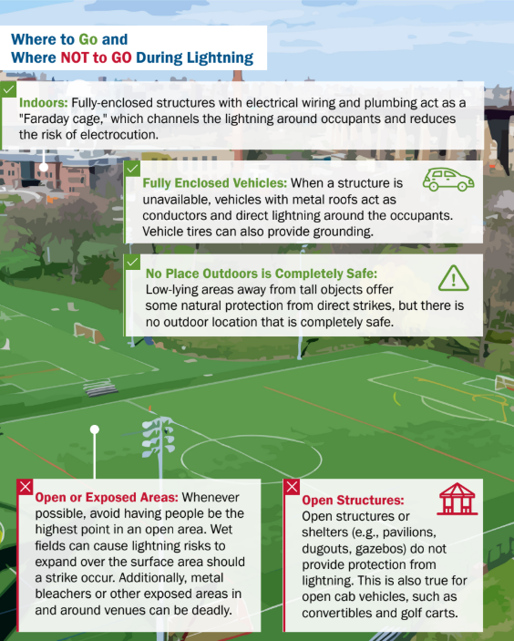
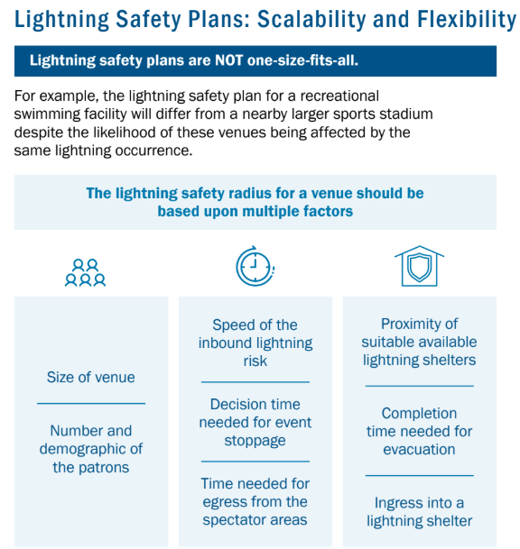
Preparedness
Preview
Preview

Slide 13
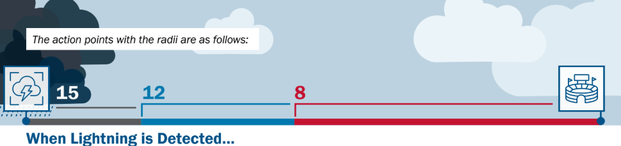
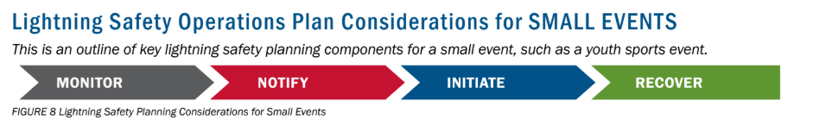
Actions - Radii
Lightning Radii - Actions
Preview
Preview
Notes:
We MUST Do This -- Stats Tell Part of the Story
People are the other part -- NWSers going “above and beyond”
Sleeping in their office
Evacuating their families while staying in the office -- Eating PB&J for a week
IMET involved in car accident on what to a site -- still got to the fire
Juneau hydrologist going door-to-door -- glacial flooding risk

Slide 14
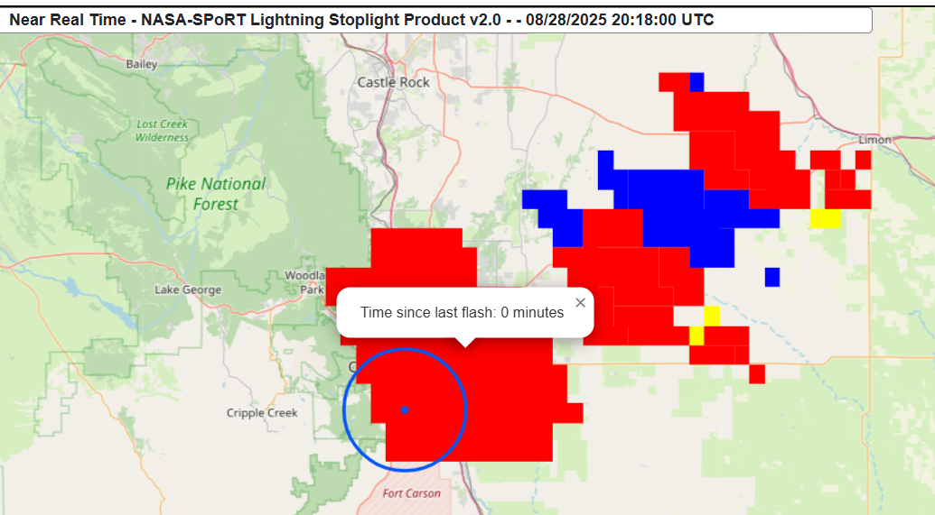



Actions - Radii
Alignment with Experimental Lightning Viewer Tool
https://weather.ndc.nasa.gov/sport/lightning-viewer/
Notes:
We MUST Do This -- Stats Tell Part of the Story
People are the other part -- NWSers going “above and beyond”
Sleeping in their office
Evacuating their families while staying in the office -- Eating PB&J for a week
IMET involved in car accident on what to a site -- still got to the fire
Juneau hydrologist going door-to-door -- glacial flooding risk

Slide 15
Summary
Safety Guide release this Fall - coming soon!
Look for more potential NCAA guidance updates in the next year.
After the release, next step is to work directly with the college conferences to make sure they are aware of the guidance updates.
Help us educate and inform, from little league baseball to MLB!

Slide 16

Thank You!
Contact - Charlie Woodrum, charles.woodrum@noaa.gov
www.weather.gov/wrn/
www.weather.gov/stormready
www.weather.gov/skywarn
www.weather.gov/safety/lightning-toolkits

