Slide 1
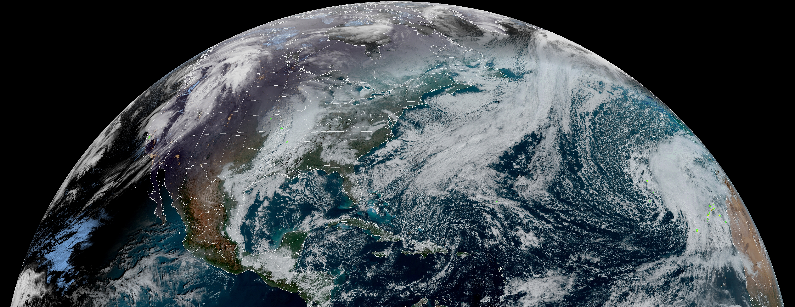
LMX Instrument Status
2025 GLM Science Team Meeting
September 2nd, 2025
Tewa Zepp

Slide 2
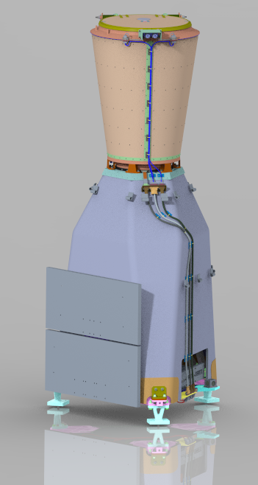
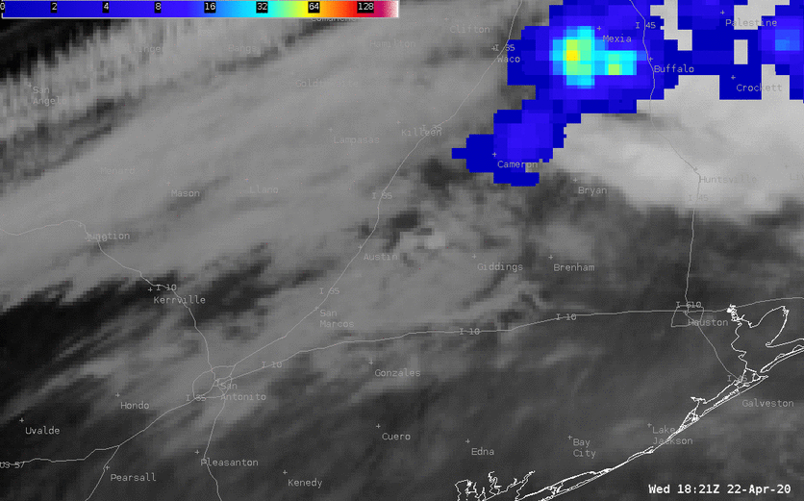
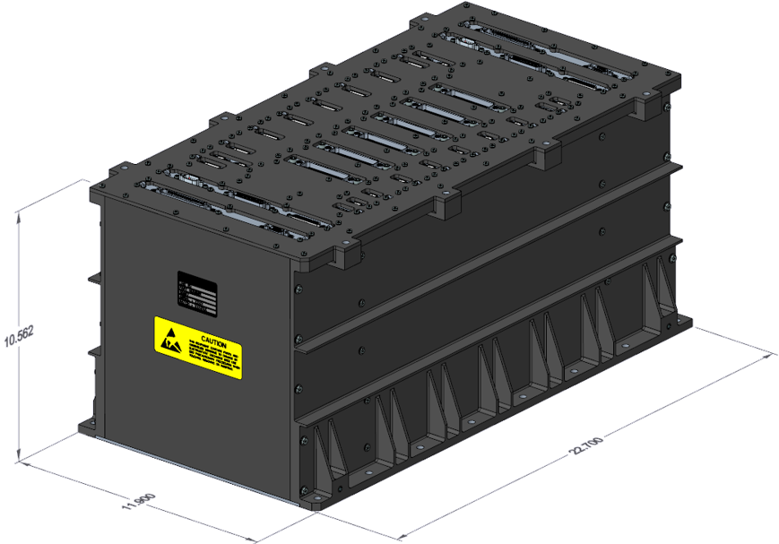
Introducing: LMX
Externally, LMX shows its proven GLM heritage
Internally, LMX introduces three major technology advances
Next generation large format all-digital CMOS focal plane
Real time event processor with adaptive thresholding
Refined L1b filter algorithms pull more lightning from Level 0 data
LMX keeps the best parts of GLM and adds these advances to achieve improved performance
credit: Bill Line
LMX Sensor Unit
LMX Electronics Unit
LMX seamlessly continues lightning observations from GEO

Slide 3
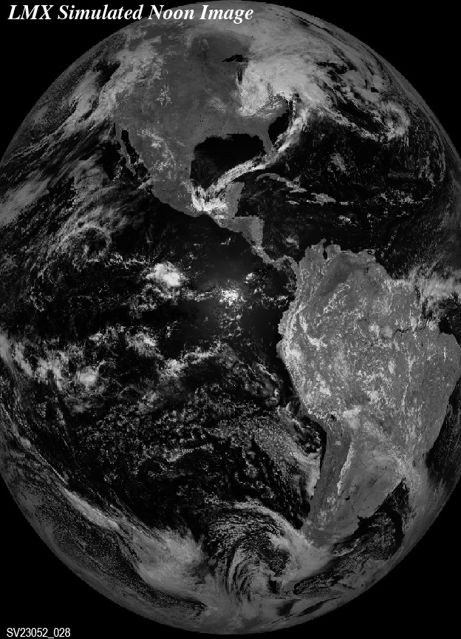
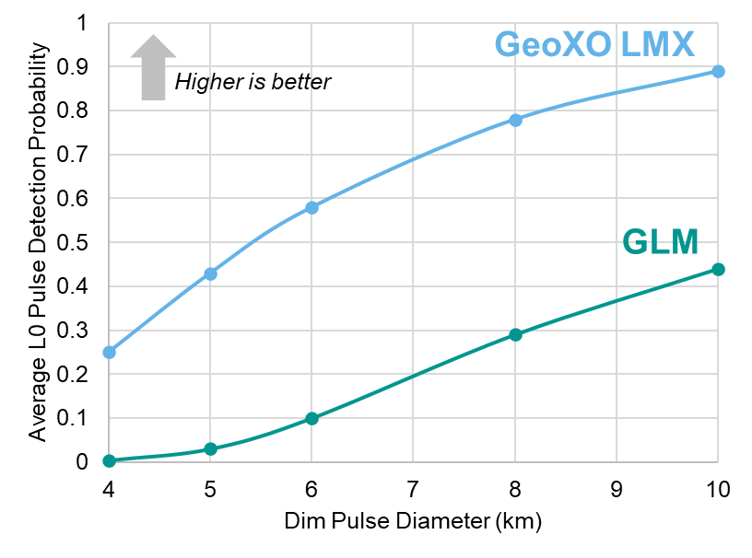
LMX Performance
Greater Coverage
Improved Sensitivity
Improved Resolution
86%
requirement
East
East
expanded
coverage
86%
requirement
West
LMX provides 100% coverage overlap over CONUS from East and West, with expanded coverage of Alaska and polar regions.
Smaller, dimmer optical pulses are prevalent in supercells. They are challenging to detect against high cloud albedo. LMX reaches deeper into the noise than GLM.
Full-frame simulated image illustrates full disk coverage of LMX, with 1.7x more pixels than GLM sampled 1.6x faster
LMX will detect nearly 2x more lightning pulses than GLM

Slide 4
LMX by the Numbers
Parameter | Unit | GeoXO LMX | GOES-R GLM (ref)
Lens prescription | mm EFL, f number | 134 f/1.2 | 134 f/1.2
Lens field of view | deg radius | 8.8 | 8
% of GEO disk covered | % | up to 95% (86% required) | 86%
Focal plane format | pixels (N-S x E-W) | 2044 x 1480 (windowed) | 1372 x 1300
Frame rate | fps | 774 | 503
Pixel size | µm (N-S x E-W) | 20 x 24 | 30 x 30 (variable pitch)
Ground sample distance @ nadir | km | 6.4 | 8.0
ADC bit depth | bits | 12 | 14
Downlink data rate | Mbps | 75 | 7.7
Event data structure size | bits | 96 | 64
Probability of detecting a dim pulse (6.4 – 8.8 µJ/m²/sr) of 6 km Ø | % | 58 | 10
(Current predicts, subject to change)
LMX has unprecedented sensitivity to sub-pixel lightning

Slide 5
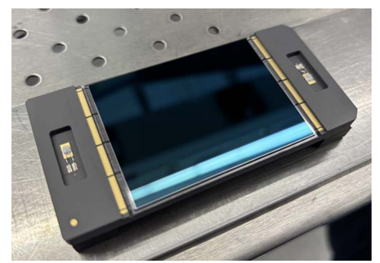
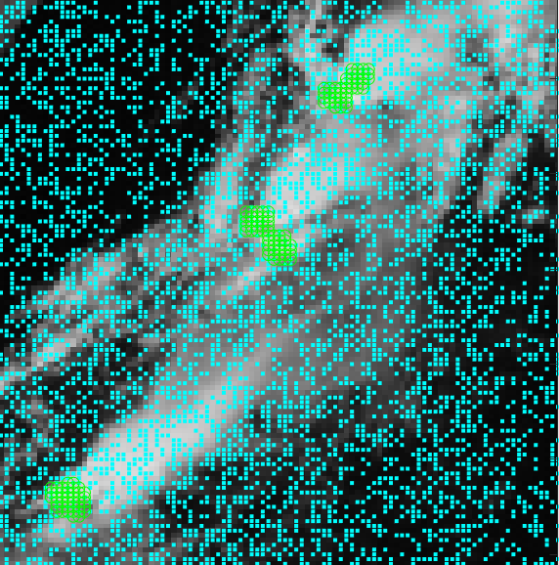
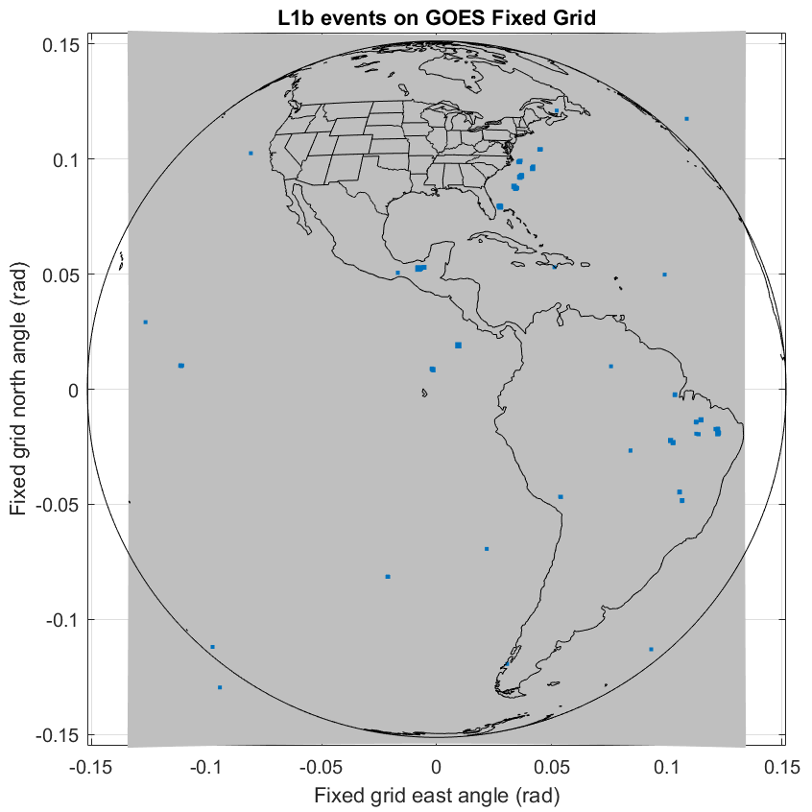
Three Innovations for LMX
Next Gen CIS326 from Teledyne e2v
Next Gen Event Detection Algorithm
Next Gen Ground Processing Algorithms
Back-side illuminated CIS326
Photo: Teledyne e2v
L1b product is lightning events. Additional internal meta-data:
1-minute calibrated full disk background,
Threshold image
Data Quality map
Uniform false events
(in cyan)
The CIS326 is a bespoke high speed, large format monolithic CMOS imager with low read noise and on-chip ADC. It generates 30 Gbps of raw video data, ~3x GLM (First Light achieved June ‘24)
Initial characterization test completed
The new RTEP algorithm employs each pixel as a jitter sensor to measure its noise and adapt its individual threshold to a target TNR (Threshold to Noise Ratio)
Cluster-before-filter architecture provides spatial and temporal context for coherency calculations to pluck more lightning out of noise, including the first event in a flash

Slide 6
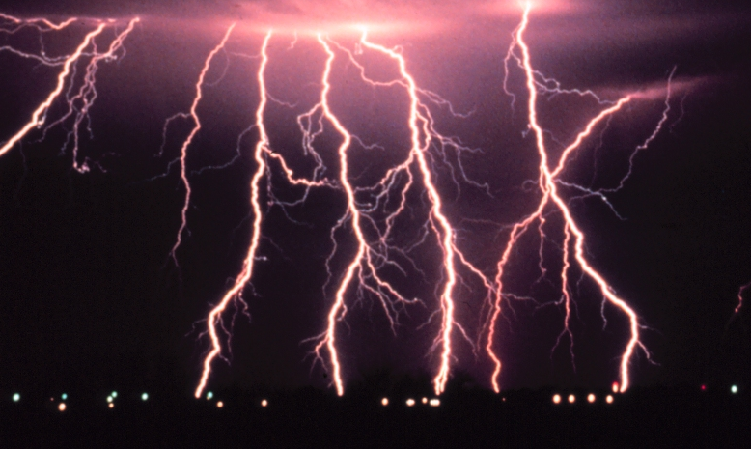
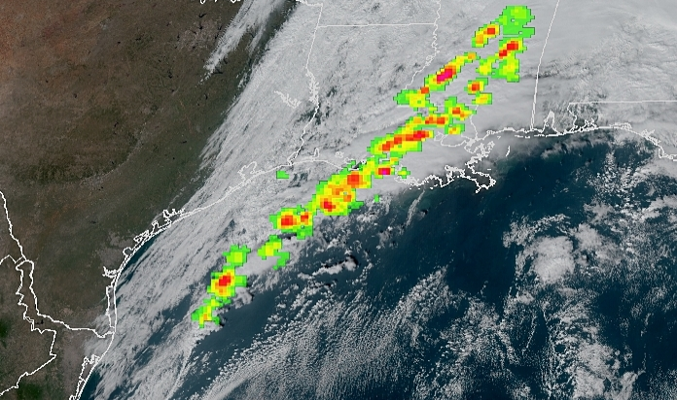

Status & Conclusions
Lockheed Martin has innovated and invested in hardware and algorithms for LMX, shaped by the lessons learned from over 8 years of GLM operational experience
LMX will provide consistent and reliable data products to end users of lightning mapper data
No data overflows
Richer data quality indications
Fewer data artifacts
More detected lightning
Program Status
SRR in March 2025, PDR planned for May 2026
Technical Status:
Technology maturation for TRL6
CMOS FPA development with Teledyne e2v
Instrument SU & EU designs
GPA Updates
Credit: C. Clark / NOAA / Public Domain
Credit: NOAA NESDIS
LMX will serve end users into the 2050s
Credit: Giorgio Montersino / Flickr / CC BY-SA 2.0

Slide 7
Thank you
© 2025 Lockheed Martin Corporation. All Rights Reserved. This presentation was made possible by work performed under NASA contract 80GSFC25CA013

